Slide 1
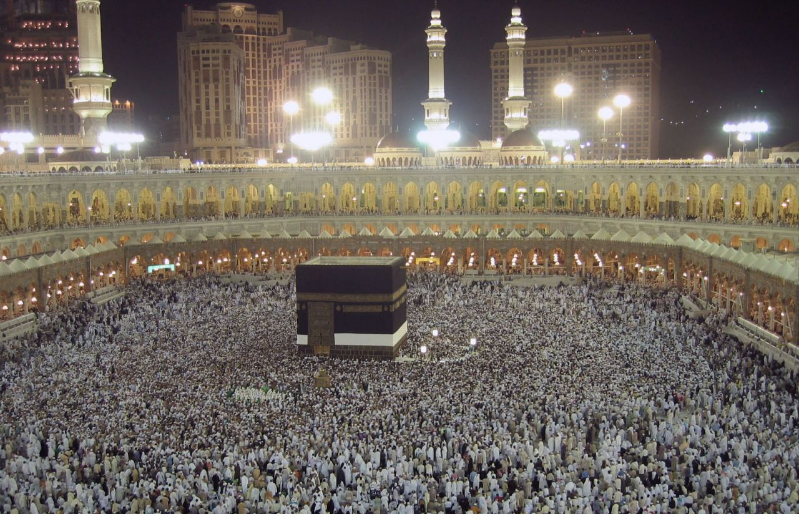
Modern World History Islam

Slide 2
World Muslims
1.2 billion, Muslims represent between 19.2% and 22% of the world's population.
One of every five humans in the world is a Muslim
Second largest religion in the world
Fastest growing including Europe and America

Slide 3
World Distribution of Muslims
Africa
308,660,000
27.4%
Asia
778,362,000
69.1%
Europe
32,032,000
2.8%
Latin America
1,356,000
0.1%
North America
5,530,000
0.5%
World
1,126,325,000
100%

Slide 5
American Muslims
6 million (The New York Times, Feb. 21, 1989)
About 40% African-American
Not all Muslims are Arabs, Not all Arabs are Muslims

Slide 6
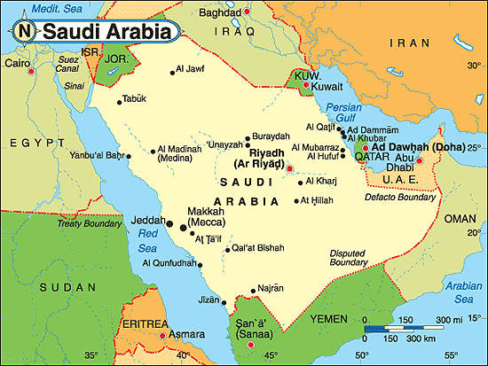
Bedouins in Arabia
Bedouins – nomads of the Arabian peninsula and desert
Organized into tribes and groups called clans
Adapted to the desert conditions
Defended against other groups seeking water, land, and food
Many settled near oases and coastal which could support farming

Slide 7
Muhammad – Prophet of Islam
At age 40, Muhammad, a successful businessman, received his first revelation from the angel Gabriel, a messenger from God, in 610
622 → Hijrah → Muhammed flees Mecca for Medina.
The beginning of the Muslim calendar (1 A.H.)
Muslims returned to defeat Mecca and unify the Arabian peninsula under Islam
Brown – where Islam spread
in Muhammad’s life

Slide 8
Definitions
Allah – name of the God of the Muslims in the Arabic language (same God as the one of the Jews and Christians)
Islam – means “submission to the will of Allah” and is the name of the religion founded by Muhammad
Muslims – means “one who has submitted” and refers to believers of the religion of Islam
Qur’an (Koran) – holy book of the Muslims which contains the teachings of Muhammad

Slide 9
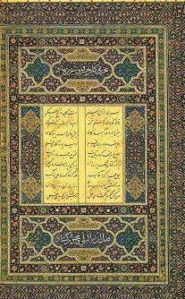
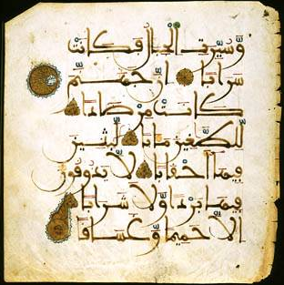
The Qur’an (Koran)
Muhammad’s revelations were compiled into the Qur’an after his death.
Muslims believe it contains the word of God.
114 suras (chapters).
In the name of Allah, the compassionate, the merciful.
Written in Arabic.

Slide 10
The
Five Pillars
of
Islam

Slide 11
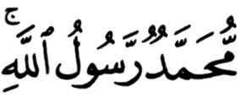
1. The Shahada
The testimony.
The declaration of faith:
There is no god worthy of worship except God, and Muhammad is His Messenger [or Prophet].
1

Slide 12
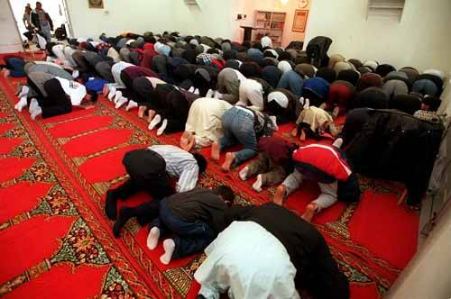
2. The Salat
The mandatory prayers performed 5 times a day: * dawn * noon * late afternoon * sunset * before going to bed
Wash before praying.
Face Mecca and use a prayer rug.
Pray in the mosque on Friday.
2

Slide 13
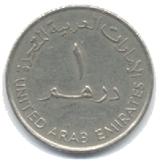
3. The Zakat
Almsgiving (charitable donations).
Muslims believe that all things belong to God.
Zakat means both “purification” and “growth.”
About 2.5% of your income.
3

Slide 14
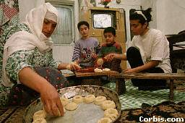
4. The Sawm
Fasting during the holy month of Ramadan.
Considered a method of self- purification.
No eating or drinking from sunrise to sunset during Ramadan.
4

Slide 15
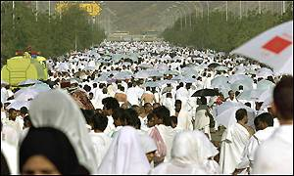
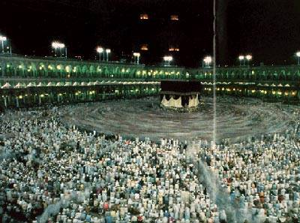
5. The Hajj
The pilgrimage to Mecca.
Must be done at least once in a Muslim’s lifetime.
2-3 million Muslims make the pilgrimage every year.
5

Slide 16
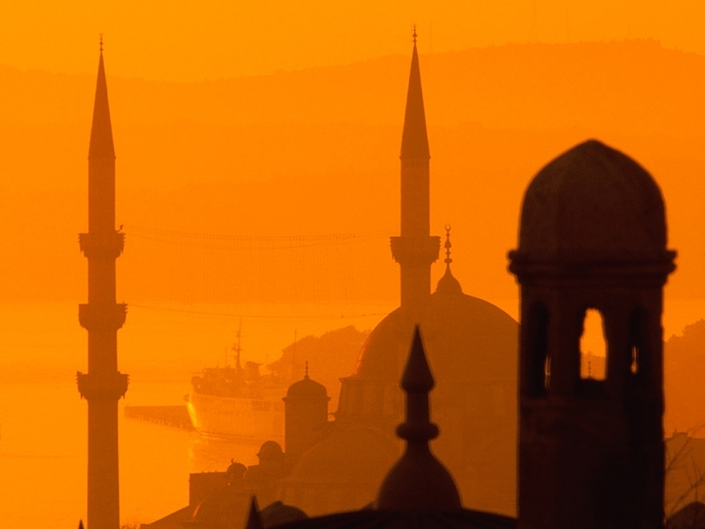
Islam – A Way of Life
No priests, Muslims pray directly to Allah
Muslims do not separate their personal life from their religious life
Following the 5 Pillars of Islam ensures they live their religion
Other Islamic laws
affect daily life
Can’t eat pork
Can’t drink alcohol

Slide 17
Islam → An Abrahamic Religion
Muslims are strict monotheists.
They believe in the Judeo-Christian God, which they call Allah.
Muslims believe that the Torah and the Bible, like the Qur’an, is the word of God (they consider Jews and Christians to be “Peoples of the Book”)
They believe in heaven and hell and a day of judgment

Slide 18
Abraham’s Genealogy
HAGAR
ABRAHAM
SARAH
Ishmael
Isaac
12 Arabian Tribes
Jacob
Esau
12 Tribes of Israel

Slide 19
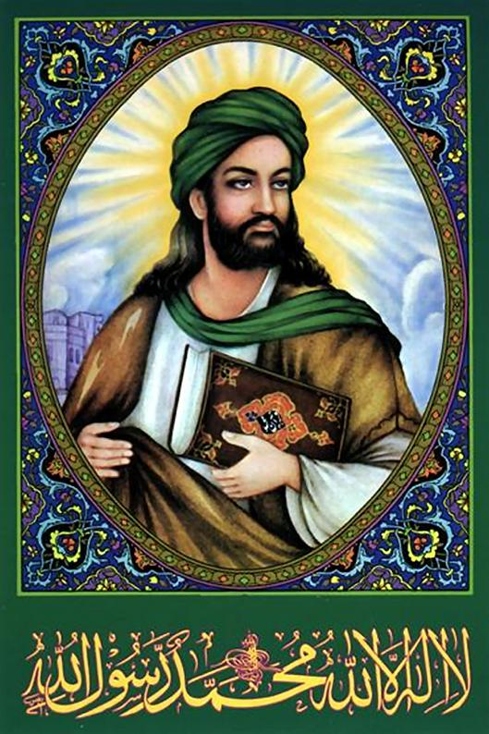
The Prophetic Tradition
Adam
Noah
Abraham
Moses
Jesus
Muhammad
Video on Relationship between 3 Religions

Slide 20
Caliphs of Islam
Caliphs – successors to Muhammad as leaders of Islam
Fought military campaigns to spread influence and force tribes to pay taxes
Built an empire from the Atlantic Ocean to the Indus River

Slide 21
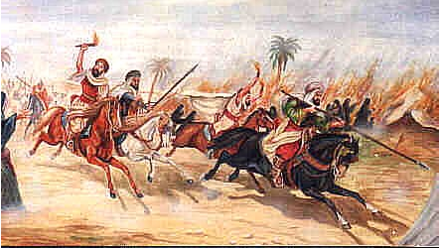
Muslim Armies
Soldiers drew energy and inspiration from their faith
Armies were well-trained and had good tactics
Byzantine and Persian Empires had been in conflict for a long time and were thus weakened

Slide 22
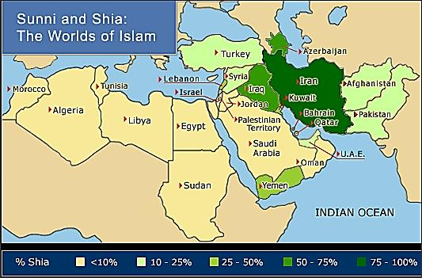
Split of Islam
Umayyads – family who took over the leadership of Islam and moved the capitol from Mecca to Damascus in Syria, and began to show off their tremendous wealth
Shiá (Shiite) – those who were opposed to the Umayyads
Sunni – those who supported the Umayyads

Slide 24
Muslim Empire and Trade
World trade centered around the Mediterranean Sea and the Indian Ocean, where the Muslim Empire was located
Single language (Arabic) and currency could be used throughout
Muslims became bankers, financing trade ventures

Slide 25
Social Classes in the Muslim Empire
Upper class – Muslims at birth
Converts to Islam (who had to pay higher taxes)
Protected people -- monotheistic “people of the book” (Jews, Christians, and Zoroasters)
Slaves – prisoners of war (non-Muslim)

Slide 26
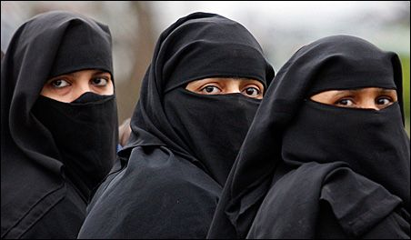
Role of Women
Women are to be obedient to men who control them
Poorer women were to work in the fields
Wealthy women supervised the household and servants
Women raised the children
Originally women had more rights than today

Slide 27
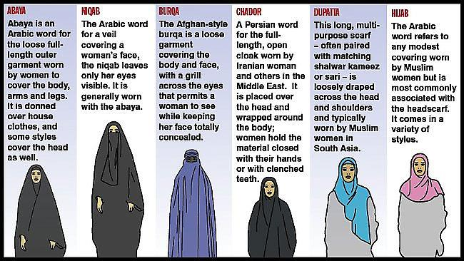
Muslim Women Garments

Slide 28
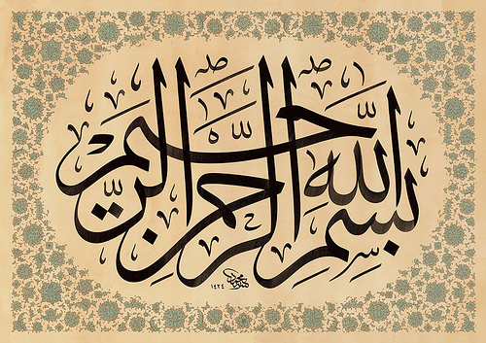
Muslim Advancements
Medical encyclopedia
Algebra in math
Astronomy – charted stars, comets, and planets
Writing – many great works of literature (calligraphy)

