Slide 1
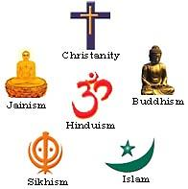
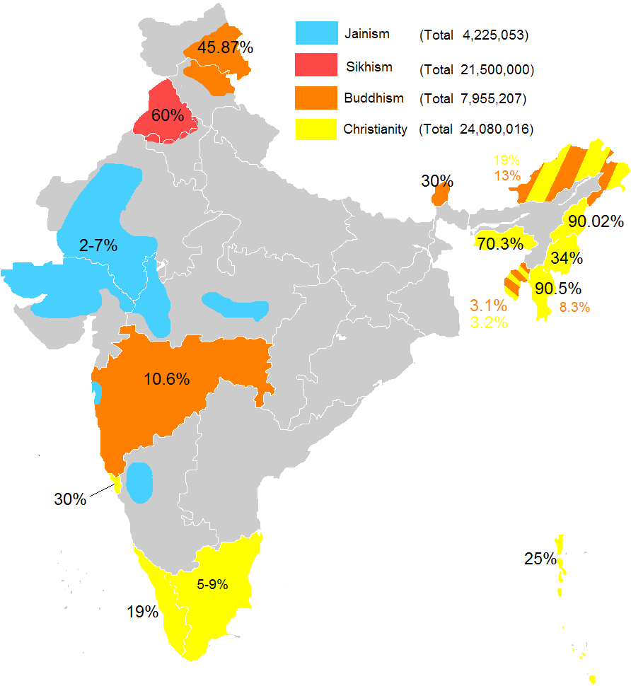
Modern World History Religions of Classical India

Slide 2
Indo-Europeans Invasions
Indo-European people who were semi-nomadic people from the grassland steppes of Central Asia
Herded cattle, sheep and goats
Potential reasons for their invasions:
Lands where animals grazed dried up
Their human and animal populations grew too large to feed
Tried to escape other invaders
Outbreak of disease drove them away

Slide 3
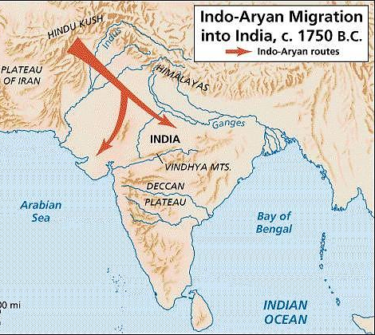
Vedic Age 1500-500 BCE
Ancient Indian society declined beginning in 1900 BCE (reasons unknown)
Aryans (an Indo-European people) arrived by 1500 BCE from Central Asia by way of the Khyber Pass through the Hindu Kush Mountains
The Aryans practiced a limited amount of agriculture, but they depended much more heavily on a pastoral economy (herding cattle, sheep and goats)
Used horse-drawn chariots in conflicts with the native Indians known as Dravidians (who they called dasas or “enemies”)

Slide 4
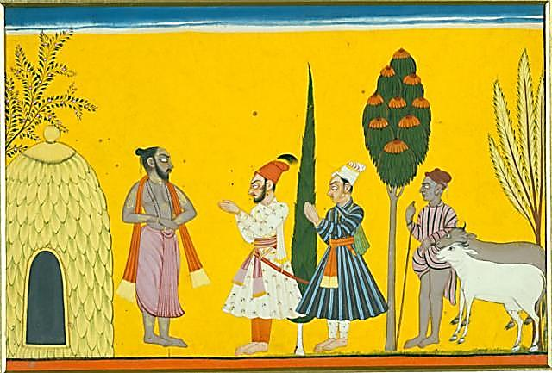
Caste and Varna
Castes are hereditary, nearly unchangeable social classes
The Aryans used the term Varna (Color) to refer to the major social classes – “wheat colored v. darker skinned”
After about 1000 B.C.E., the Aryans increasingly recognized four main Varnas:
Brahmins (priests)
kshatriyas (warriors and aristocrats)
vaishyas (cultivators, merchants, artisans)
shudras (landless peasants and serfs)
Untouchables (those who
did dirty jobs) came later

Slide 5
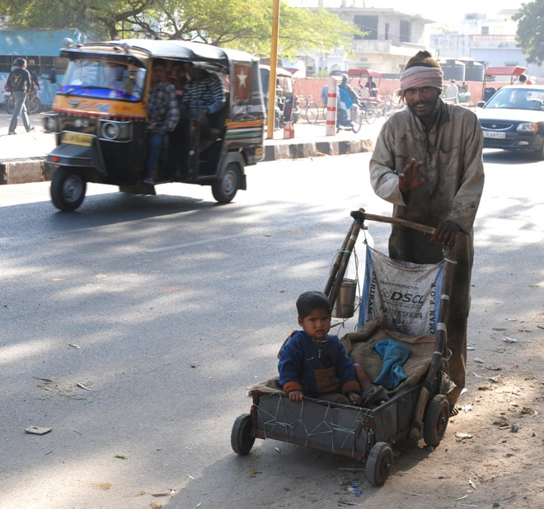
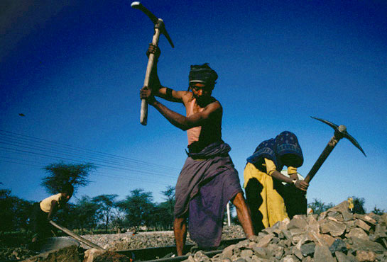
Modern Untouchables
Modern India has 160 million untouchables or approximately 15% of India’s population.

Slide 6
Varna (Social Hierarchy)
Brahmins
Kshatriyas
Vaishyas
Shudras
Pariahs [Harijan] → Untouchables

Slide 7
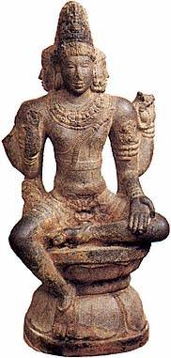
Caste and Social Mobility
Caste distinctions became central institutions in Aryan India
In other empires, states maintained public order, but in India the caste system served as a principal foundation of social stability
Individuals are often more closely identified with their jati (sub-castes based on occupation) than their cities or states, and have played a large role in maintaining social discipline
Patriarchal society developed; women influenced affairs within their families but enjoyed no public authority
Brahmins
Kshatriyas
Vaishyas
Shudras

Slide 8
Bhagavad Gita “Song of the Lord”
a 700-verse scripture that is part of the Hindu epic Mahabharata
This scripture contains a conversation between Pandava prince Arjuna and his guide Lord Krishna
A kshatriya warrior Arjuna doesn’t want to fight in a destructive war and turns to his charioteer Krishna for counsel
Krishna imparts to Arjuna wisdom, the path to devotion, and the doctrine of selfless action
The Gita upholds the theological tradition of the Upanishads

Slide 9
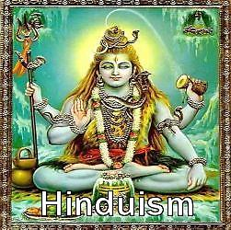
Birth of Hinduism
Hinduism is a collection of beliefs that developed slowly over time (through the blending of Dravidian and Aryan beliefs)
Unlike Christianity, Judaism, and Buddhism, it did not have a founder with a single set of ideas

Slide 10
Teachings about Reincarnation
Brahman – universal soul
Samsara – upon death souls go to the World of the Fathers and are then returned to Earth in a new incarnation (process of reincarnation)
Karma – determined the incarnations of the soul (if an individual led a virtuous life and fulfilled all their duties they could expect rebirth into a purer caste)
Moksha – state of perfection where the soul liberates from the rebirth cycle and joins with Brahman in eternal peaceful ecstasy

Slide 11
Hinduism and the Caste System
Hinduism reinforced the caste system in India by having people accept their caste position
people believed the bad life they have is from bad karma from their last life, or the good life they have is from good karma in their last life
to improve their situation they must accept their current status so they can move up in their next life
If everyone accepts their current caste status then there is little social unrest or rebellion

Slide 12
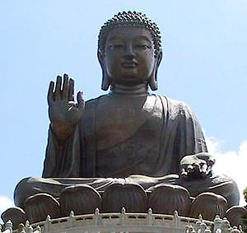
Buddhism
Founded in India by Siddhartha Gautama – who left his comfortable upper-class life in 534 BCE to find spiritual enlightenment and an explanation for suffering
After achieving “enlightenment” with intense meditation – he understood suffering and became the “Buddha” (the enlightened one”)

Slide 13
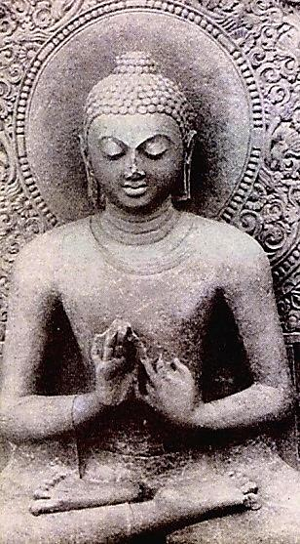
Buddha’s Teachings
The Four Noble Truths
1. All life includes suffering
2. The cause of all suffering is desire
3. Eliminating desire will end suffering
4. Following the Eightfold Path will end desire
*The Four Noble Truths and the Eightfold Path constitute Buddhist Doctrine (belief system) known as the Buddhist Dharma

Slide 14
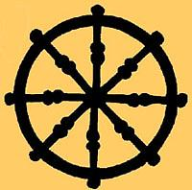
The Eightfold Path
Lead a balanced, moderate life (don’t follow extremes) leading a life that where you possess:
1 – right belief
2 – right resolve
3 – right speech
4 – right behavior
5 – right occupation
6 – right effort
7 – right contemplation
8 – right meditation
Following this would bring people to personal salvation – escaping cycle of reincarnation – and the attainment of Nirvana (state of perfect spiritual independence)

Slide 15
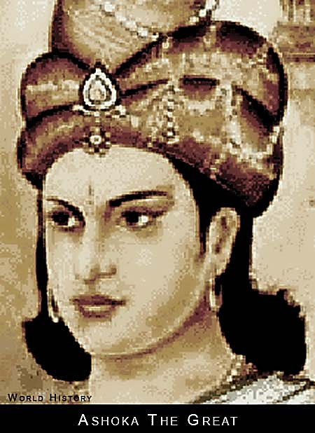
Popularity of Buddhism
Appeal of the Message – it resonated with people of lower castes, who didn’t have to depend on services of Brahmins (priests) to perform complex rituals
Language – Buddhist monks taught in vernacular (local) languages instead of formal Sanskrit that the Brahmins used
Devotion of Followers – Enthusiastic followers formed monasteries and devoted their lives to spreading the message of “dharma” (the Four Noble Truths + the Eightfold Path) – Basic Buddhist Doctrine
Support of Ashoka Maurya: spread message through edicts; Felt Buddhism could help his culturally diverse empire; temporarily replaced Hinduism as dominant religion in India

Slide 16
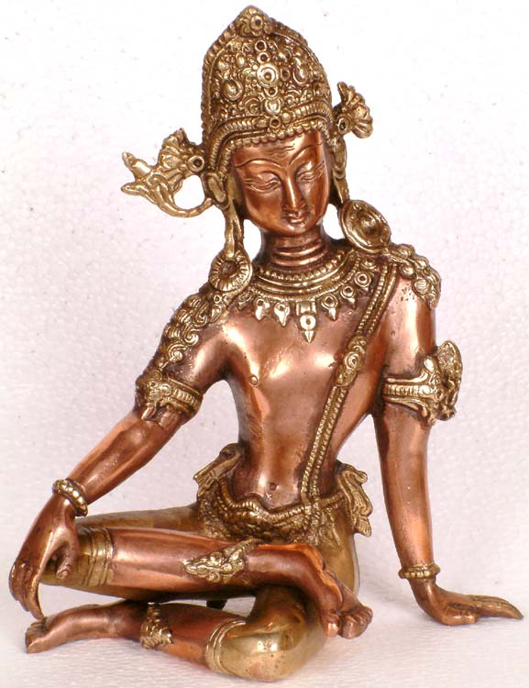
Buddhism vs. Hinduism
Similarities
Differences
Both religions believed in reincarnation
Both believed in the effort to achieve a state of perfection
Buddhism – try to attain nirvana
Hinduism – try to attain moksha
Buddhism rejected the many gods of Hinduism
Buddhism rejected the privileges of the Brahmin priests and all the complex rituals they performed
Buddhism rejected the caste system

Slide 17
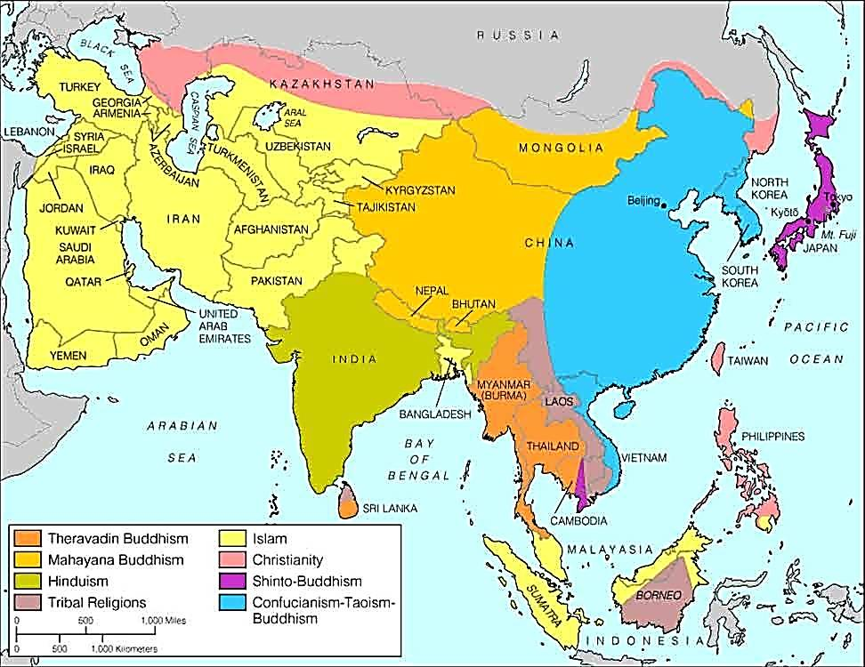
Spread of Buddhism
2 main ways Buddhism spread:
Missionaries traveled and spread Buddhist teachings
Merchants or traders carried Buddhist ideas with them as they traveled around Asia and influenced others

Slide 18
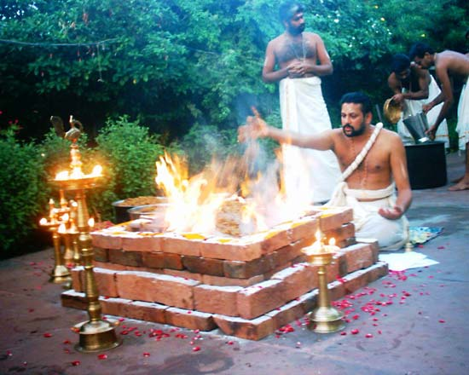
Buddhism and Hinduism Became Removed from the People
Buddhism:
Ideal of self-denial was too difficult to follow for most people
Hinduism:
Was dominated by priests and their complex rituals
Lower-class people were turned off by it

Slide 19
Buddhism Adapts
Therevada – those who followed the original stricter teachings of Buddha
Mahayana – those who accepted the new Buddhist teachings that attracted more followers
Worshipping Buddha as a god
People could become Buddhas and give up nirvana and work to save others through good works and self-sacrifice
Less strict for the other followers
Spread to China, Japan, Korea, and southeast Asia

Slide 20
Hinduism Adapts
Began to believe their was one divine force and the various Hindu gods were just different representations of that one divine force (more like monotheism)
One god (Brahma – Supreme Spirit) takes many different forms
Vishnu – preserver of the world
Shiva – the destroyer
Krishna – youthful god, often in human form
Became a more personal religion, which could appeal to the masses (relied less on rituals of priests, and more based on ethical behavior)
Taught people should meet their caste obligations

Slide 21
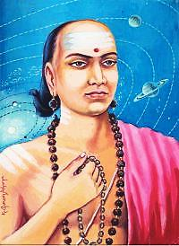
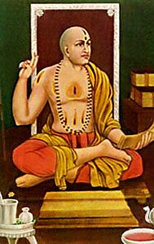
Indian Culture and Learning
Advances in science, math, medicine, and other areas shared with other civilizations, such as:
Determined that the Earth was round
Created math terms for zero and infinity
Calculated value of pi
Calculated length of the solar year
Created guidebooks with classifications of diseases and medicines in them

Slide 22
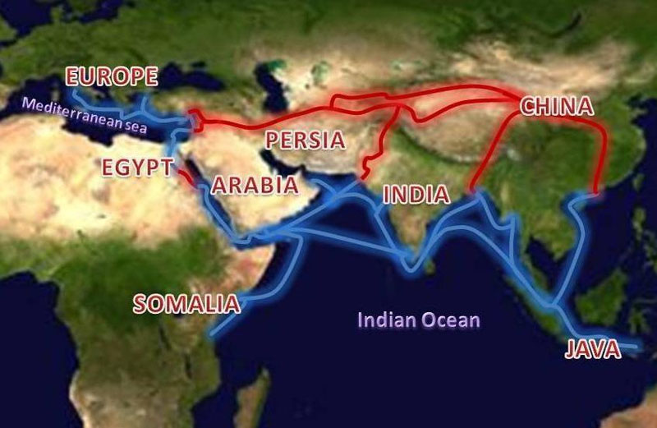
Indian Trade
Overland trade on silk roads
Indians became the middlemen profiting off of trade in each direction
Sea trade east and west on Indian Ocean
Spices from SE Asia
Traded with merchants from as far away as Rome
Effects
Rise in banking in India
Indian art, architecture, science, etc. spread

