Slide 1
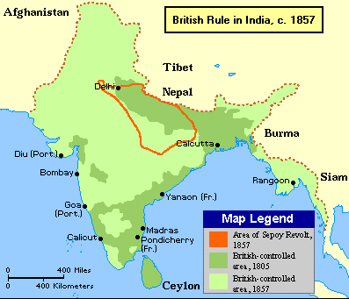
Modern World History Chapter 11, Section 4 British Imperialism in India

Slide 2
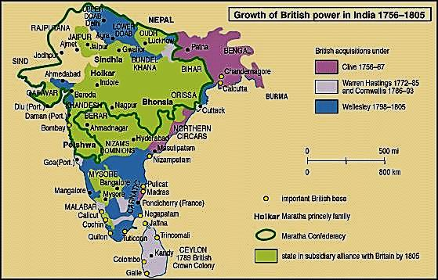
British Expand Control over India
The British East India Company set up trading posts in India, but the company was kept from taking over by the powerful Mughal Empire until a battle in 1757 in which the company won control (Setting the Stage)
The British East India Company gradually took control of more land until it controlled all of northern and southern India and modern-day Bangladesh (#1)

Slide 3
East India Company Dominates
The British government regulated the East India Company which controlled India (#1)
Sepoys – These Indians were most of the soldiers for the British East India Company which had its own army led by British officers

Slide 4
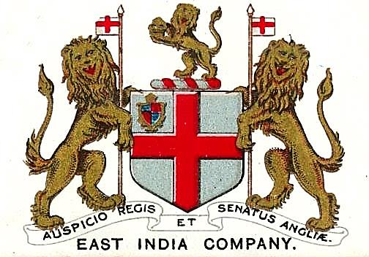
Britain’s “Jewel in the Crown”
India was valuable to the British during the Industrial Revolution as a source of raw materials and potentially as a market to sell its manufactured goods (#1)
“jewel in the crown” – nickname the British gave to India because it was the most valuable of all of Britain’s colonies
The British controlled the Indian economy by requiring that they buy British goods and prevented Indian competition with their products(#2)

Slide 5
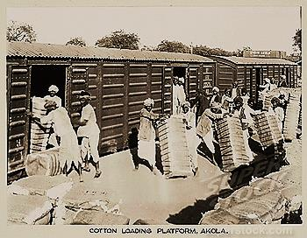
British Transport Trade Goods
British used modern transportation to make its empire more profitable (railroads shipped agricultural goods to ports in India and steamships shipped it and tea from China back to Britain) (#1)
International events made products from the British empire more profitable (Crimean War led to demand for jute from Bengal instead of Russia, and Civil War led to demand for cotton from India instead of the US) (#2)

Slide 6
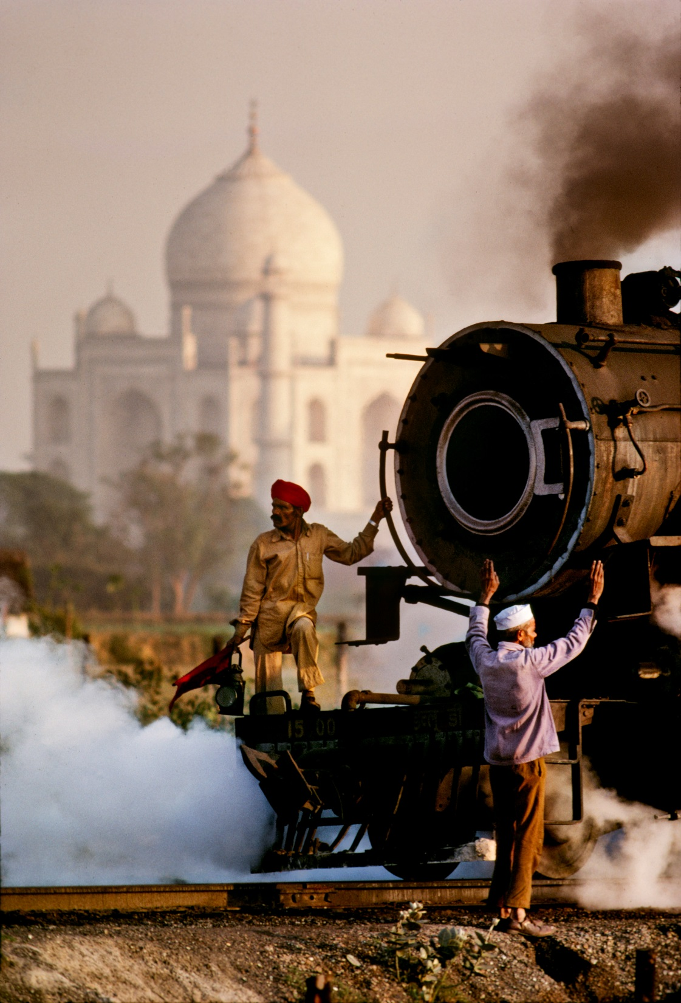
Impact of Colonialism
Negative impact – British held political and economic power, cash crops led to a loss of self-sufficiency for villages and famine, and influence of British threatened traditional Indian life (#1)
Positive impact – British built railroads, dams, bridges, better roads, telephone and telegraph lines, and irrigation systems and ended local warfare, built schools and colleges, and improved public health(#2)

Slide 7
The Sepoy Mutiny – Sources of Conflict
Though the British controlled India their were pockets of discontent and many Indians resented their attempts to convert the to Christianity and their racist attitudes toward Indians (#1)
As economic problems increased for Indians so did feelings of resentment toward the British and Indian nationalism (Indians Rebel #1)
Rumors spread among the sepoy soldiers that the British greased the cartridges of their new rifles with beef and pork (Indians believe the cow is sacred and they don’t eat pork) (More #1)

Slide 8
The Sepoy Mutiny – Indians Rebel
Sepoy Mutiny – When Indian soldiers were jailed by the British for not accepting the new rifle cartridges, sepoy soldiers marched on Delhi and the rebellion spread throughout India and lasted a year before the British sent government troops to assist the East Indian Company who defeated the sepoys
The Indians had weak leadership and couldn’t unite against the British as the Hindus didn’t want a return to Muslim rule like in the Mughal Empire, some Indian leaders did not have their people take part in the rebellion, and a third group the Sikhs had remained loyal to the British (#4)

Slide 9
The Sepoy Mutiny - Turning Point
After the Sepoy Mutiny the British government took direct control of India with a British governor-general called a viceroy in charge (#1)
Raj – term for British rule of India
The British said they would respect previous treaties for Hindu leaders who stayed out of the rebellion, but in reality the British took greater control (#2)
The rebellion caused British people in India to have even more racist beliefs against both Muslims and Hindus there (#3)

Slide 10
Nationalism Surfaces in India
Some Indian thinkers began to believe that India needed to modernize and change traditional ideas like child marriage and the caste system in order to some day not be controlled by outsiders (#1)
Nationalist feelings began to emerge in India that resented being treated and paid like second-class citizens in their own country (#2)
Ram Mohun Roy – Indian scholar
and supporter of modernization

Slide 11
Nationalist Groups Form
Two nationalist groups (the Indian National Congress and the Muslim League) were formed that at first fought for specific concerns for Indians, but were calling for self-government by the early 1900s (#1)
The nationalists were further upset by the partition of the province of Bengal (largest part of India) into an eastern and Muslim province and a western Hindu province in 1905 (#2)
Keeping the religions apart made it difficult for them to unite against the British, but the British gave in and reunified the two provinces in 1911

