Slide 1
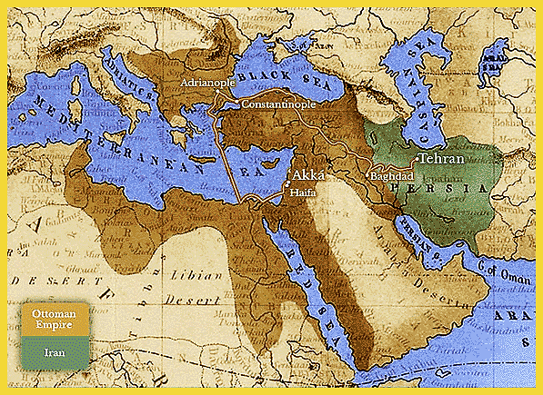
Modern World History Chapter 11, Section 3 Europeans Claim Muslim Lands

Slide 2
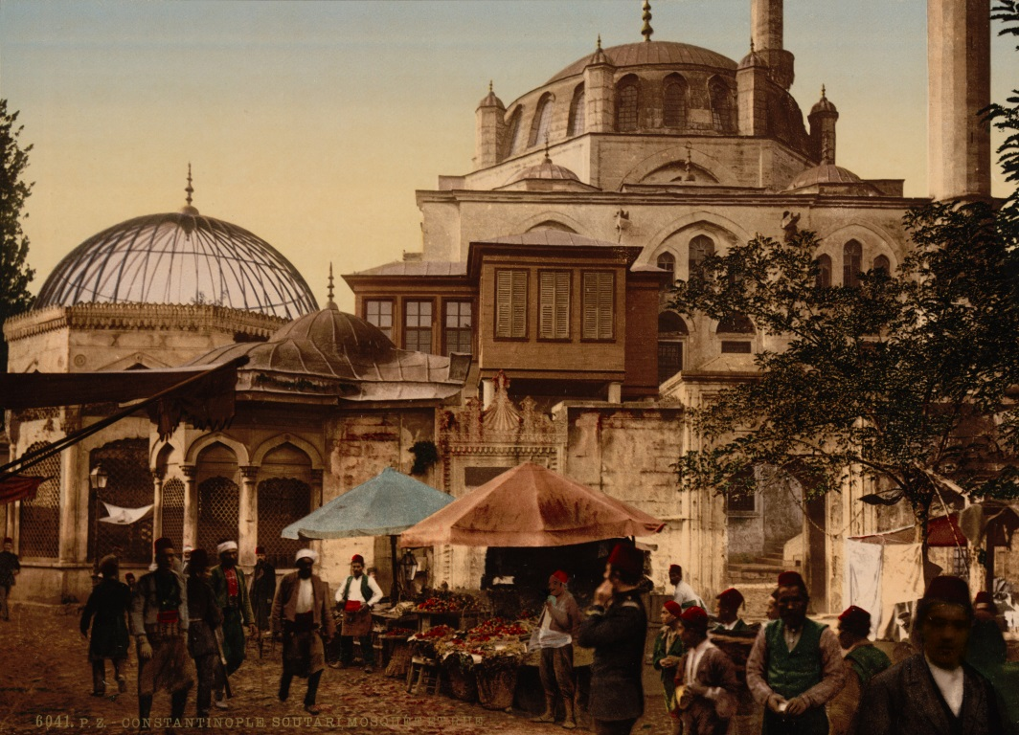
Ottoman Empire
Controlled North Africa, parts of Middle East, Turkey, and Balkan Peninsula
As it weakened European powers competed to take its lands
Reasons it weakened:
It was slower to modernize than the rest of Europe
Series of weak emperors following the death of Suleyman the Great
Govt. became corrupt
Heavy inflation
Nationalist feelings in peoples ruled by the empire

Slide 3
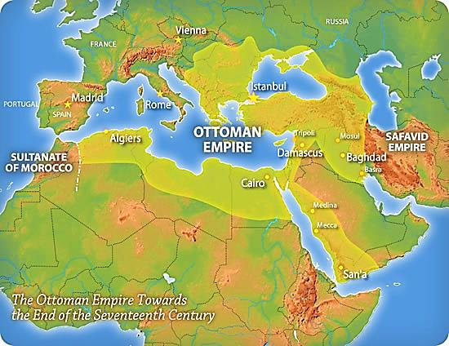
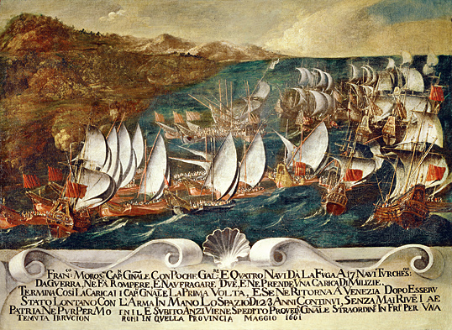
Europeans Grab Territory
Geopolitics – interest in or taking of land for its strategic location or products
Ottoman Empire was attractive to European powers due to its location in the Mediterranean Sea and control of sea trade

Slide 4
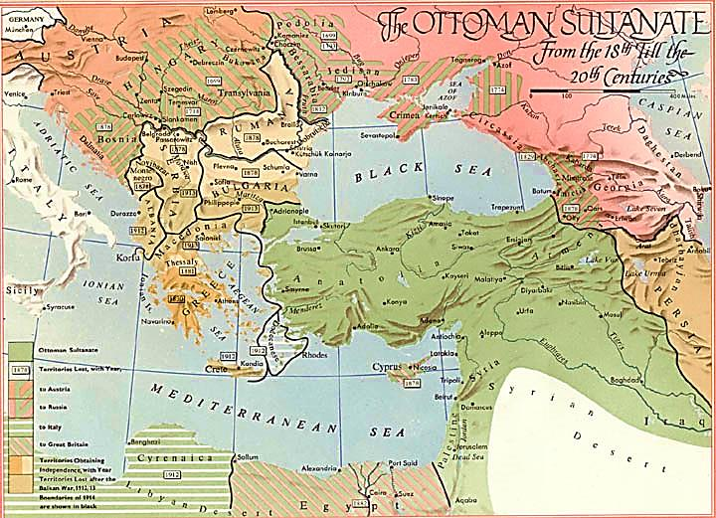
Crimean War
Russian czars had fought several wars to gain land on the Black Sea to give them access to water for trade
Crimean War – war in 1853 between the Russians and the Ottomans over the peninsula in the Black Sea where most of the fighting took place
France and Britain entered the war on the side of the Ottoman Empire to prevent Russia from gaining more land and defeated the Russians
Russia later helped the Slavic people of the Balkans win their independence when they rebelled against the Ottomans
Ottomans lost control of Romania, Montenegro, Cyprus, Bosnia, Herzegovina, and Bulgaria
↖
Crimea
↗
Balkans

Slide 5
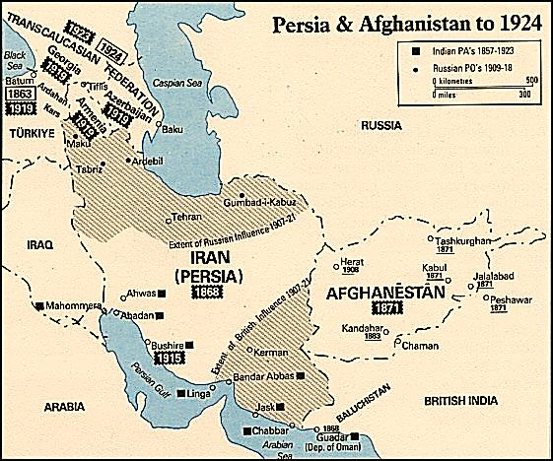
“The Great Game”
Another geopolitics struggle during the late 1800s that took place in Afghanistan between Britain and Russia
Russia wanted to extend to India, Britain wanted to extend north, Afghanistan in the middle
Afghanistan was an independent Muslim kingdom
After decades of fighting both Britain and Russia eventually withdrew

Slide 6
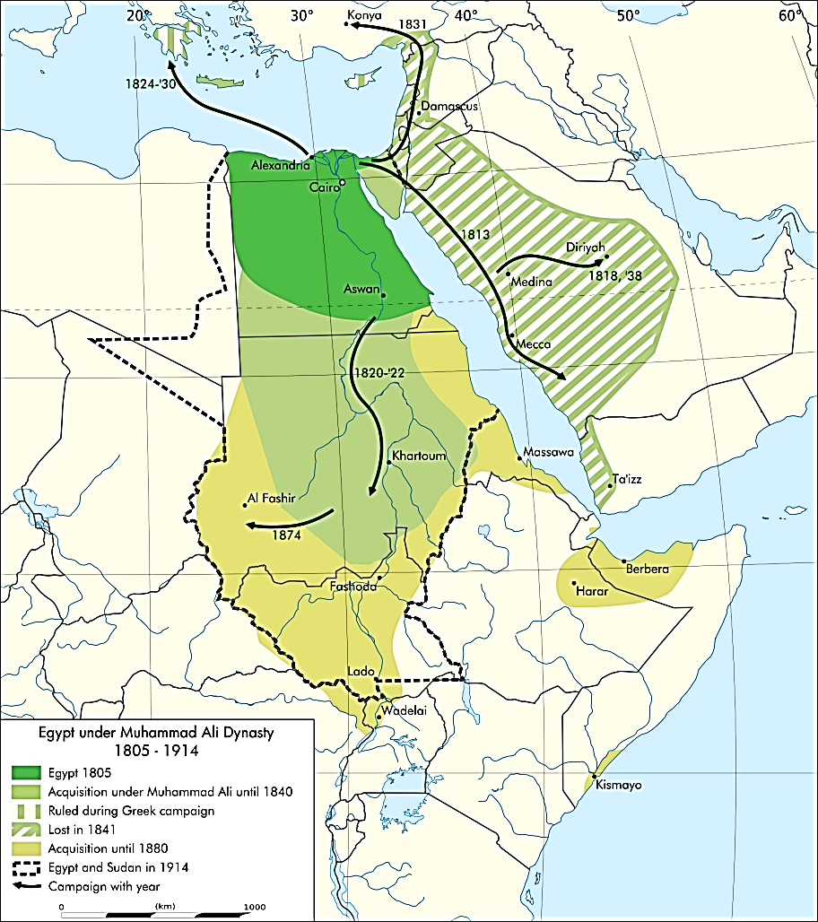
Modernization in Egypt
To avoid being controlled by European powers, some Muslim leaders decided to modernize
Egypt’s location at the head of the Red Sea was desired by the British and French
New leader Muhammad Ali broke away from the Ottoman Empire began reforms in the military and economy
Cash crop farming of cotton
Later built the Suez Canal

Slide 7
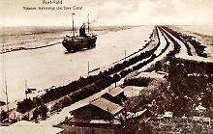
Suez Canal
Suez Canal – man-made canal that cut through the Isthmus of Suez that connected the Red Sea to the Mediterranean Sea and opened 1869 which was built mainly with private French investments and Egyptian labor
The allowed shipping to go from Europe to the Far East without having to steam around the southern tip of Africa
Egypt fell into debt as it was unable to pay back the European banks it borrowed from
The British insisted on taking financial control of the canal and sent troops to occupy the region in 1882

Slide 8
Persia Pressured to Change
Russia and Britain competed over Persia
Russians hoped to gain access to the Persian Gulf ports
British wanted to take advantage of oil found there
Persian rulers gave western businessmen concessions to develop its resources (set up spheres of influence)
Religious leaders fought these concessions as they feared western influences on their people
Tobacco boycott against a foreign business led to riots that spun out of control
Persian ruler was forced to establish a constitution to settle things down

