Slide 1
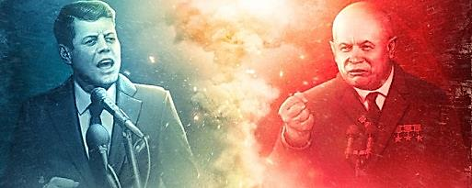
Modern World History Cold War Divides the World Assign. #4-4

Slide 2
Three “Worlds” During the Cold War (#1)
Political scientists grouped nations during the Cold War into three “worlds”
“First World”
industrialized capitalist nations led by the U.S.
“Second World”
communist nations led by the Soviet Union
“Third World”
developing nations, often newly independent from European imperialism
The Cold War saw the superpowers competing for influence in the Third World

Slide 3
Major Strategies of the Cold War (#2) (see page 549 in textbook)
Foreign aid
the two superpowers tried to win allies by giving financial aid to other nations
Espionage
the two superpowers spied on each other as they feared the other might be gaining an advantage
Multi-national alliances
used alliances to gain support (NATO for US and Warsaw Pact for USSR)
Propaganda
both powers used it to try to win support in other nations (Radio Free Europe broadcast into Eastern Europe)
Brinkmanship
both willing to go to the brink of war to achieve goals (Cuban Missile Crisis)
Surrogate wars
as US and USSR couldn’t fight directly they backed opposing sides in smaller conflicts (Korea and Vietnam)

Slide 4
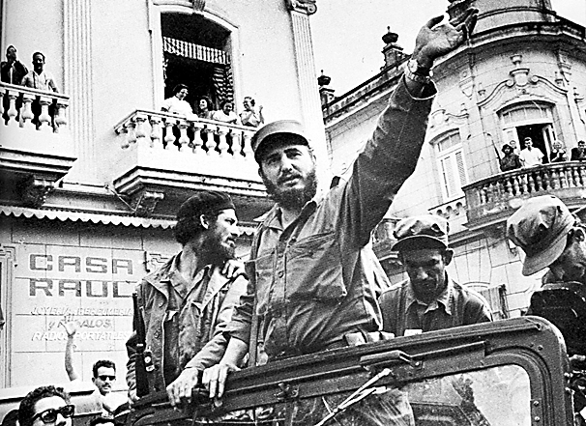
Fidel Castro Comes to Power in Cuba (#3)
In the 1950s Cuba was ruled by an unpopular dictator, Fulgencio Bautista
A popular revolution overthrew Bautista in 1959 and Fidel Castro became the nation’s new leader
Castro’s government:
Suspended elections, jailed or executed opponents, tightly controlled the press
Castro’s reforms:
Nationalized the Cuban economy (including U.S.-owned sugar mills and refineries)
U.S. responded by ordering an embargo on trade with Cuba
USSR responded by giving Cuba economic and military aid

Slide 5
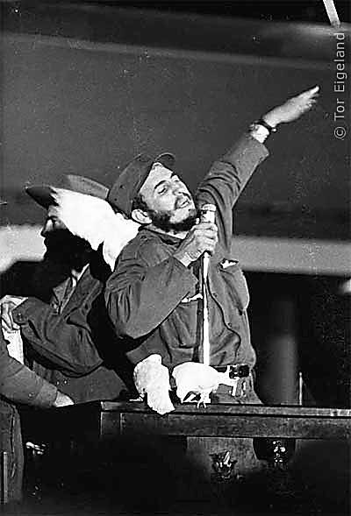
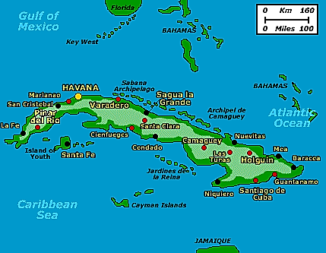
Bay of Pigs Invasion
Cuba’s new Communist leader Fidel Castro
- 1959 - Cuban revolution that places Communist Fidel Castro in power
Jan. 3, 1961 (17 days before JFK took office) - Eisenhower broke off diplomatic relations with Cuba
US feared Cuba could be used by Soviet Union for an attack on the US
US makes plan to overthrow Communist govt. in Cuba without the appearance of US involvement
Cuba, only 100 miles from tip of Florida

Slide 6
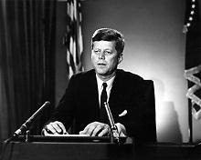
- US began to train an army of Cuban exiles to overthrow the govt.
- invasion began April 16
- Soviet Union accuses US of planning the invasion
- Cuban exile forces defeated by the Cuban military
- 1189 men were captured by Cuban govt.
- JFK continued to deny involvement, but faced severe criticism
Cuban exile invaders captured by Cuban Troops at Bay of Pigs

Slide 7
Cuban Missile Crisis (#4)
- Oct. 14, 1962 - a US U-2 spy plane detects nuclear missile sites being built in Cuba
- JFK weighs 2 options:
1. military response
(from air strikes on the missile bases to invasion of Cuba)
2. naval blockade of Cuba
(called a quarantine to keep missiles out)
- What option did JFK choose? Why that one?
Detail of U2 Photos of Missile Site in Cuba

Slide 8
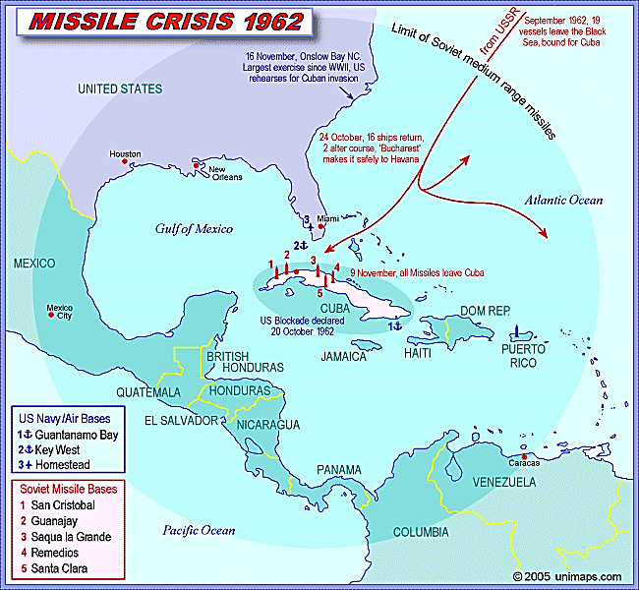

Slide 9
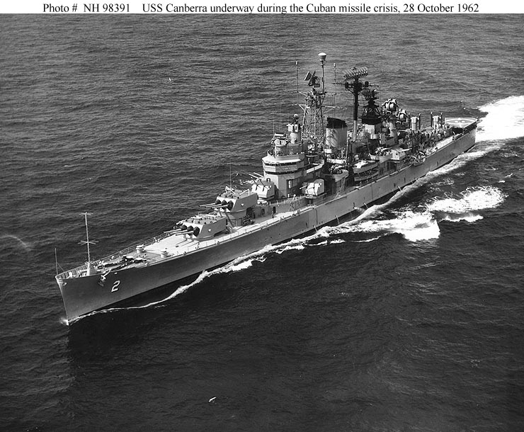
- crisis kept secret until Oct. 22 when JFK informed the US in a televised address
- Soviets responded by sending ships to break the blockade (quarantine)
- US warns that they will fire upon any ship attempting to cross the quarantine line
- Oct. 24 - Soviet ships turned back, and the nation breathes a sigh of relief
President Kennedy speaks to nation about the Cuban crisis
US ship that was part
of quarantine of Cuba

Slide 10
- Oct. 26 - JFK receives a letter from Soviet leader Nikita Khrushchev saying the USSR would remove missiles if US lifted the blockade and pledged not to invade Cuba
- Oct. 27 - JFK received 2nd letter adding that the USSR wanted US missiles in Turkey removed
- Oct. 27 - JFK ignores the 2nd letter and agrees to the terms of the first letter
- Oct. 28 - Khrushchev agrees to remove missiles from Cuba and crisis ends
US Ambassador Stevenson reports on Soviet missiles in Cuba to Security Council of the United Nations on Oct. 26, 1962

Slide 11
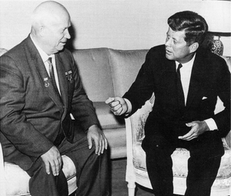
- both Kennedy and Khrushchev were relieved that nuclear war was avoided and took steps to avoid another crisis that could lead to nuclear war:
- “hotline” installed connecting the White House and Kremlin directly
- Limited Nuclear Test Ban Treaty signed banning the testing of new nuclear weapons above ground, which signaled to the world that the two superpowers were trying now to get along
Soviet leader Nikita Khrushchev
US President John F. Kennedy

Slide 12
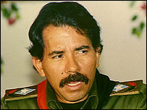
Civil War in Nicaragua (#5)
Just as the U.S. supported the dictator Bautista in Cuba, it supported the dictator Anastazio Somoza in Nicaragua and his family since 1933
The leftist Sandinistas led by Daniel Ortega overthrew Somoza’s son and received aid from the USSR
The US then supported rebels against the Sandinistas called the Contras
A civil war was waged for more than a decade, which seriously weakened the Nicaraguan economy
Ortega agreed to the first elections in the nation’s history in 1990, and a reform candidate won removing the Sandinistas from power
Ortega
Contra rebels

Slide 13
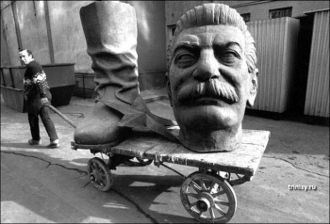
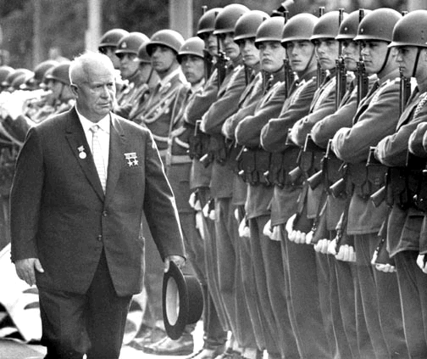
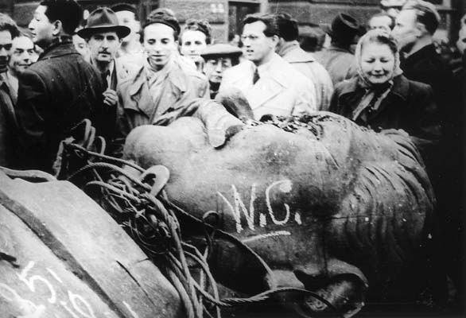
Destalinization (#6)
After the death of Joseph Stalin in 1953, Nikita Khrushchev took over the USSR
He began a policy of de-stalinization, or the removal of the glorification of Stalin

Slide 14
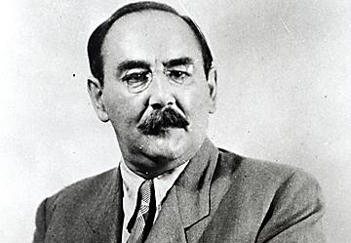
Hungary Defies the Soviet Union (#7)
When the communist regime in Hungary supported destalinization, large numbers of their citizens demanded democracy and the breaking of ties with the Soviet Union
With massive street demonstrations going on, communist Imry Nagy took power and asserted Hungarian nationalism and withdrew Hungary from the Warsaw Pact
In late 1956, Soviet tanks entered Budapest and crushed the uprising, and installed a new hard-line communist regime (Nagy was executed)
Nagy

Slide 15
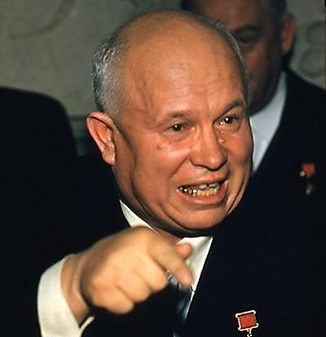
Brezhnev replaces Khrushchev
Despite Khrushchev’s show of force in Hungary he had lost prestige in his country due to the Cuban missile crisis
In 1964 party leaders voted Khrushchev out of power
He was replaced by Leonid Brezhnev, who quickly adopted repressive domestic policies
Strict enforcement of limits to free speech and worship
Many arrests to those who opposed the communist government

Slide 16
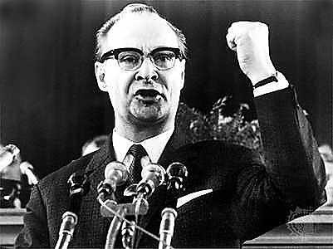
Prague Spring (#8)
Communist Party leader Alexander Dubček launched a “democratic socialist revolution” in Czechoslovakia in 1968
A liberal movement known as the “Prague Spring” began as he promised “socialism with a human face”
Like in Hungary in 1956, the Soviet Union sent tanks in to crush the movement
This reasserted Soviet control over the Eastern bloc nations

Slide 17
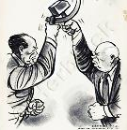
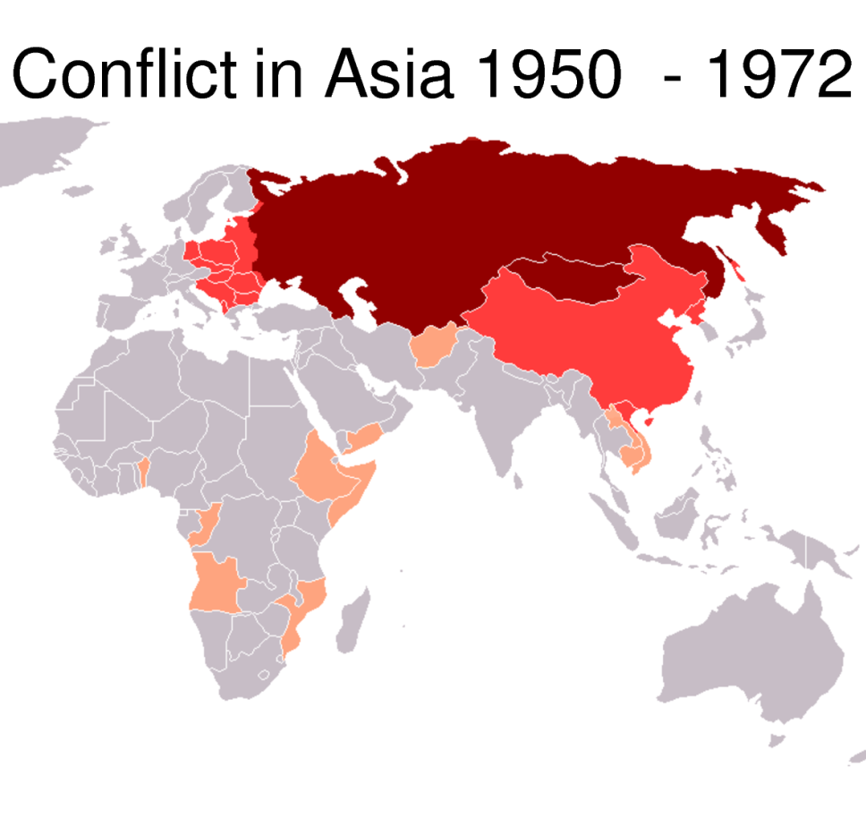
Soviet-Chinese Split (#9)
Soviet Union believed that China would follow their leadership in world affairs
As China grew more confident it gradually became unhappy with its relationship with the USSR, and didn’t want to be in the USSR’s shadow
Both nations began competing for influence in nations in Africa and Asia that had recently gained their independence from European powers

Slide 18
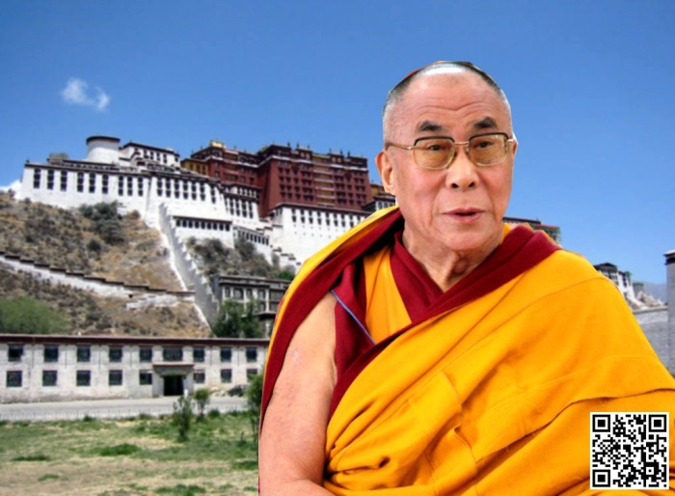
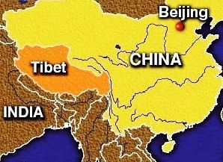
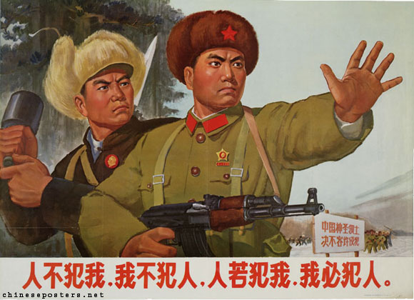
Soviet-Chinese Split
Other sources of conflict:
China received military aid during the Korean War, but had to pay it back on a strict deadline
China received less aid than non-communist nations like Egypt and India
China took Tibet in 1950 and the USSR declared neutrality between China and India in the dispute over this
Border clashes began to take place between the Soviet Union and China
China upset with USSR for accepting idea of peaceful coexistence with the US

Slide 19
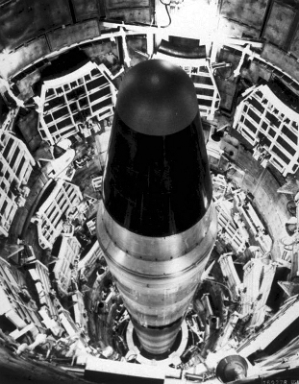
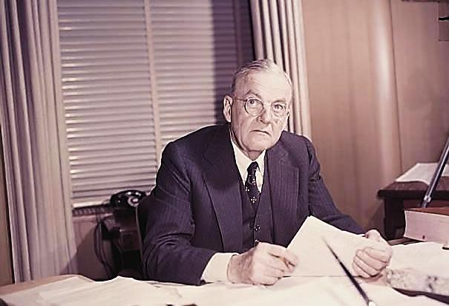
Brinkmanship (#10)
US foreign policy supported by Secretary of State John Foster Dulles under President Eisenhower in the 1950s
The policy stated the US’s willingness to go to the brink (or edge) of war to oppose communism
It included the threat of using nuclear weapons
M.A.D. – Mutually Assured Destruction

Slide 20
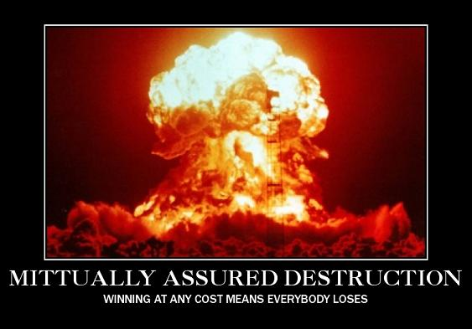
Brinkmanship Breaks Down Under Kennedy and Johnson in the 1960s
Brinkmanship led to one crisis after another between the U.S. and the Soviet Union
The world was at risk of experiencing nuclear war during these crises
Suez Crisis of 1956
Intervention by the USSR in Hungary in 1956
U-2 Incident in 1960
Cuban missile crisis in 1962
Vietnam War

Slide 21
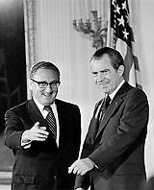
Nixon’s Foreign Policy
Realpolitik –
comes from the German for “actual politics,” and means that foreign policy decisions would be based on practical US interests and not moral or political ideas (like containment)
Détente –
Tensions during the Cold War begins to ease during Nixon’s presidency, and the easing of tensions between rivals is called détente (#10)
Ending of Vietnam War and improved U.S. relations with China and the Soviet Union were key elements of détente
Secretary of State Henry Kissinger with President Nixon

Slide 22
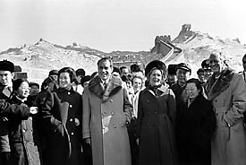
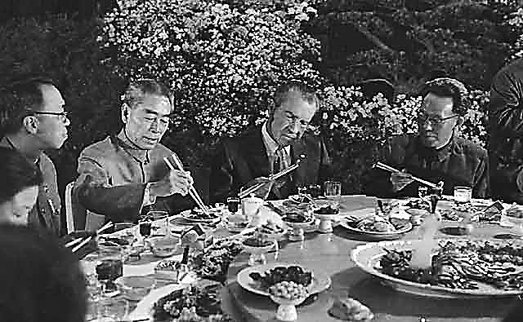
U.S. Relations with China
because communist China is a nation of a billion people, the country obviously cannot be ignored
US took advantage of the split between China and the USSR
in order to improve relations with China, Nixon visited China in February in 1972
This led to the opening of diplomacy and trade with the Chinese
President Nixon strolls along the Great Wall of China in 1972 and struggles with chop sticks at a dinner with Chinese Premier Chou Enlai below

Slide 23
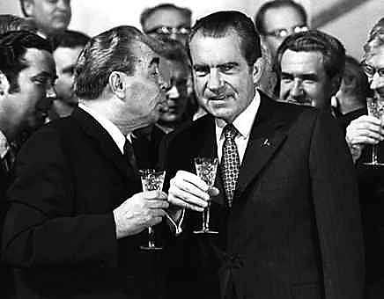
Relations with the Soviet Union
to ease relations with the Soviet Union, Nixon visited Moscow in May, 1972
SALT –
the Soviet Union and the U.S. signed SALT (Strategic Arms Limitation Treaty) that limited the number of each country’s nuclear weapons (#10)
President Nixon and Soviet General Secretary Leonid Brezhnev toast an agreement between their two nations in 1972

Slide 24
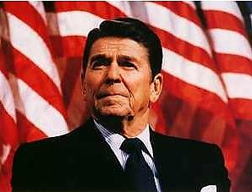
Demise of Détente
By the 1980s, relations between the superpowers deteriorated again
US had opened a full diplomatic relationship with China, including the selling of weapons to China
Soviet invasion of Afghanistan soured relations much further
Tough anti-communist stance taken by Ronald Reagan further increased tensions

Slide 25
“Star Wars” (#10)
The Strategic Defense Initiative (SDI) was proposed by U.S. President Ronald Reagan on March 23, 1983
Nicknamed the “Star Wars” program after the futuristic movie that had recently come out
It was to use ground and space-based systems to protect the US from attack by strategic nuclear ballistic missiles
It resulted in an arms build up by the Soviet Union that took money from consumer goods production leading to social unrest

