Slide 1
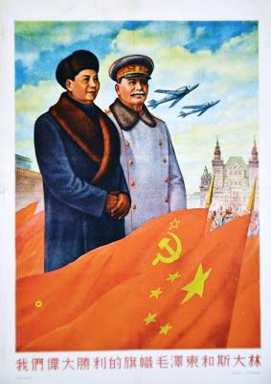
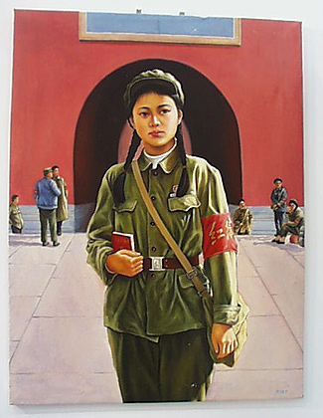
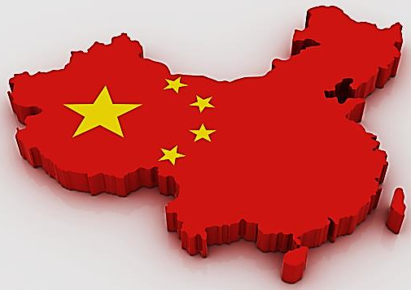
Modern World History Assign. #4-2 China Under Mao

Slide 2
Chapter 14, Section 3 Imperial China Collapses
After the fall of the Qing dynasty, nationalist and Communist movements struggled for power.

Slide 3
China Ripe for Revolution (#1)
China faced years of humiliation at the hands of foreigners
Foreigners controlled China’s trade and resources
Many wanted to modernize, but the Qing Dynasty was not doing it
Nationalist movements that might start revolutions were the only avenue to achieving change

Slide 4
Nationalists Overthrow Qing Dynasty (#2)
The Kuomintang (Nationalist Party) pushed for modernization and nationalization
Their first great leader was Sun Yixian
In 1911, the Revolutionary Alliance (forerunner of Kuomintang) overthrew the last emperor of the Qing dynasty

Slide 5
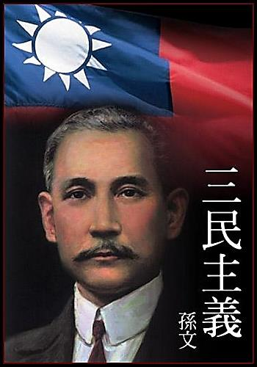
Government under the Nationalists (#3)
Shaky Start for the New Republic
1912 Sun became president of the Republic of China
“Three Principles of the People”
nationalism—an end to foreign control
people’s rights—democracy
people’s livelihood—economic security for all Chinese

Slide 6
China after the Revolution (#4)
General Yuan Shikai takes over presidency after Sun steps down
Shikai betrays democratic ideals
Local revolts break out
In 1916 civil war breaks out after Shikai’s death
Provincial warlords held real authority in the provinces

Slide 7
World War I Spells More Problems
In 1917, the Beijing government declared war against Germany
They believed the Allies would return Chinese territories controlled by Germany to China
Instead, the Allies gave Japan those territories under Treaty of Versailles
May Fourth Movement – demonstration of students angry about the Treaty of Versailles begins in Beijing May 4, 1919
demonstrations spread to other cities in China and were joined by workers, shopkeepers, and professionals
Sun Yixian and Kuomintang share the movement’s aims of establishing a modern, strong nation
Many Chinese intellectuals reject Sun Yixian’s belief in western democracy in favor of Soviet communism

Slide 8
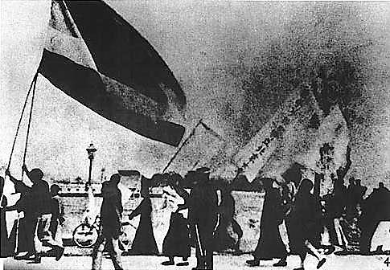
Students in Beijing rallied during the May Fourth Movement.

Slide 9
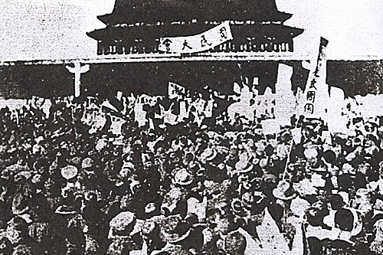
Protestors dissatisfied with the Treaty of Versailles for China

Slide 10
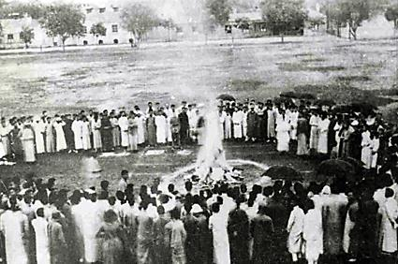
Tsinghua University students burn Japanese goods.

Slide 11
Mao Zedong’s Brand of Communism (#5)
In 1921 a group in Shanghai (including Mao Zedong) organizes the Chinese Communist Party
Mao Zedong develops his own brand of communism
Lenin based his in the organization of Russia’s cities.
Mao brought the revolution to the rural country, with peasants as the revolutionaries

Slide 12
The Communist Party in China
Lenin Befriends China
Sun Yixian’s government is in south China
He becomes disillusioned with Western democracies
The Kuomantang (Nationalists) allied with the Communist Party hoping to unify the Chinese people
Lenin seized the opportunity and sends military advisors and equipment to China in 1923

Slide 13
Two Sides Form in China (#6)
Peasants Align with the Communists
Sun Yixian died in 1925, and Jiang Jieshi (Chiang Kai-shek) heads the Kuomantang or Nationalists
Jiang (son of a middle-class merchant) feared communist goal of forming a socialist gov ernment
Jiang promised democracy, but his government became corrupt
Peasants threw their support toward the Chinese Communist Party and Mao as he gave them land
Jiang
Jieshi

Slide 14
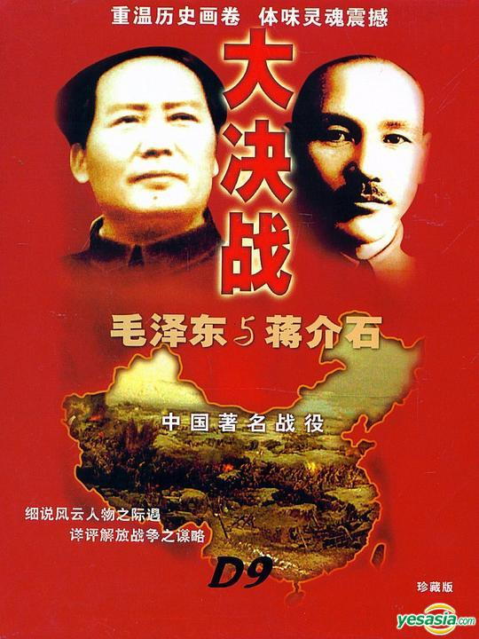
The Civil War in China
Nationalists and Communists Clash
Briefly Jiang set aside differences and fought warlords alongside the Communists, but later turned against the Communists
April 1927 Nationalists groups moved on Shanghai and killed many Communists
In 1928 Jiang became president of the Nationalist Republic of China
Great Britain and the United States recognized his government
The Soviet Union did NOT recognize his government
Civil War breaks out and lasts until 1949

Slide 15
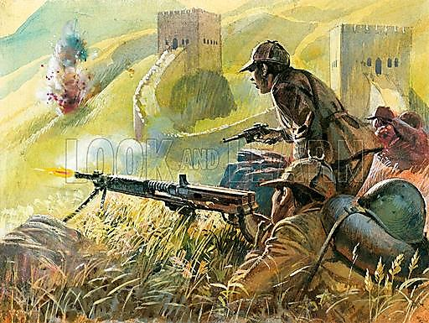
Civil War Rages in China
In 1930 a bloody civil war was raging
Mao and Communists established themselves in south-central China
Mao recruited peasants into the Red Army and trained them in guerilla warfare
Nationalists attacked communists but failed to drive them out

Slide 16
Civil War Rages in China (#7)
1933 Jiang gathered an army of 700,000 to surround the Communist stronghold
Long March –
In a daring move, 100,000 Communist forces fled 6,000 miles on the Long March to northern China between 1934 and 1935
Mao and survivors settle in caves in northern China
Gradually the communists gained new followers

Slide 17
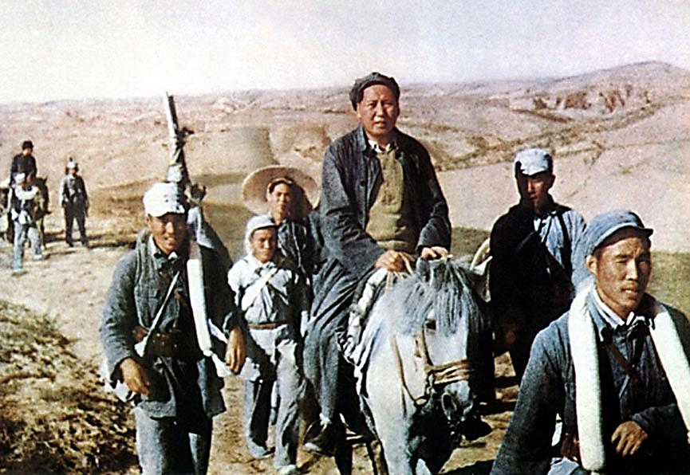

Slide 18
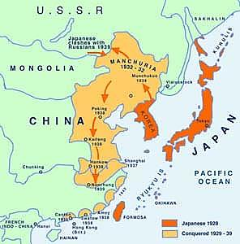
Civil War Suspended (#8)
Japan took advantage of China’s weakened situation during the civil war and invaded Manchuria, an industrial province in northeastern China
In 1937, Japan launched an all-out invasion of China, and held large parts of China by 1938
The Japanese threat forced an uneasy truce between the Jiang’s and Mao’s forces, and they united to fight the Japanese

Slide 19
Chapter 17, Section 2 Communists Take Power in China
2
After World War II, Chinese Communists defeat Nationalist forces and two separate Chinas emerge.

Slide 20
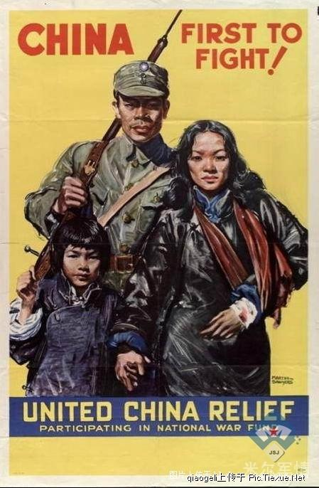
China in World War II
World War II in China
Mao Zedong—leads Chinese Communists against Japanese invaders, who gain supporters due to their effective guerrilla warfare tactics
Jiang Jieshi (a.k.a. Chiang Kai-shek)—leads Chinese Nationalists in WWII
Nationalists run the government during the war and face the brunt of the Japanese attacks and are weakened by this
Nationalist and Communist Chinese resume civil war after WWII ends and the Japanese leave

Slide 21
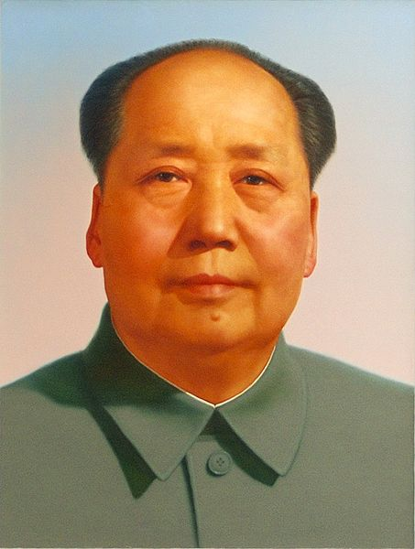
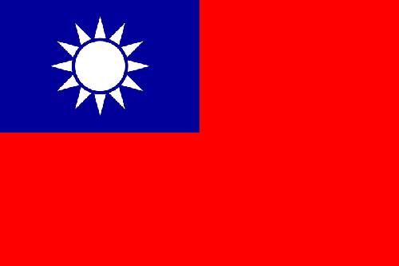
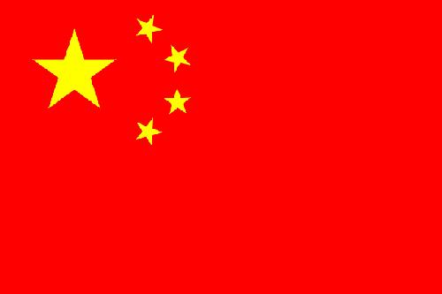
Communists vs. Nationalists
Mao Zedong
Jiang Jieshi (a.k.a. Chiang Kai-shek)

Slide 22
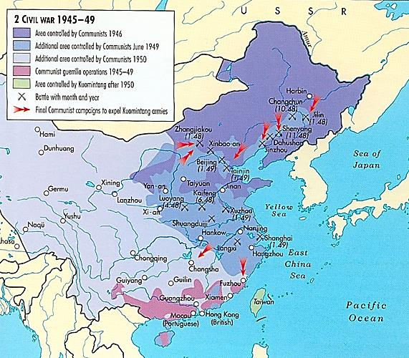
Civil War Ends in China (#9)
Civil War Resumes
Economic problems cause Nationalist soldiers to desert to Communists
Mao’s troops take control of China’s major cities
In 1949, the communists win and create the People’s Republic of China (PRC)
Nationalists flee to Taiwan (#10)
Nationalists

Slide 23
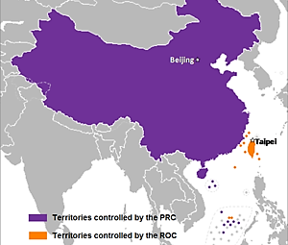
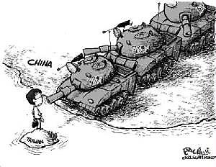
The Two Chinas Affect the Cold War (#9)
The Superpowers React
U.S. supports Nationalist state in Taiwan, called Republic of China
Soviets and China agree to help each other in event of attack
U.S. tries to stop Soviet expansion and spread of communism in China

Slide 24
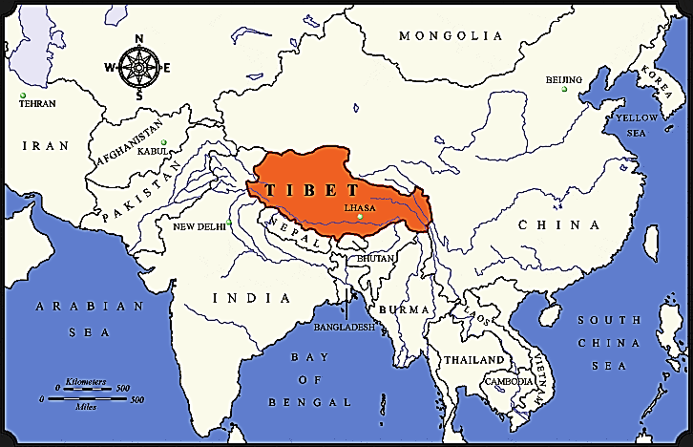
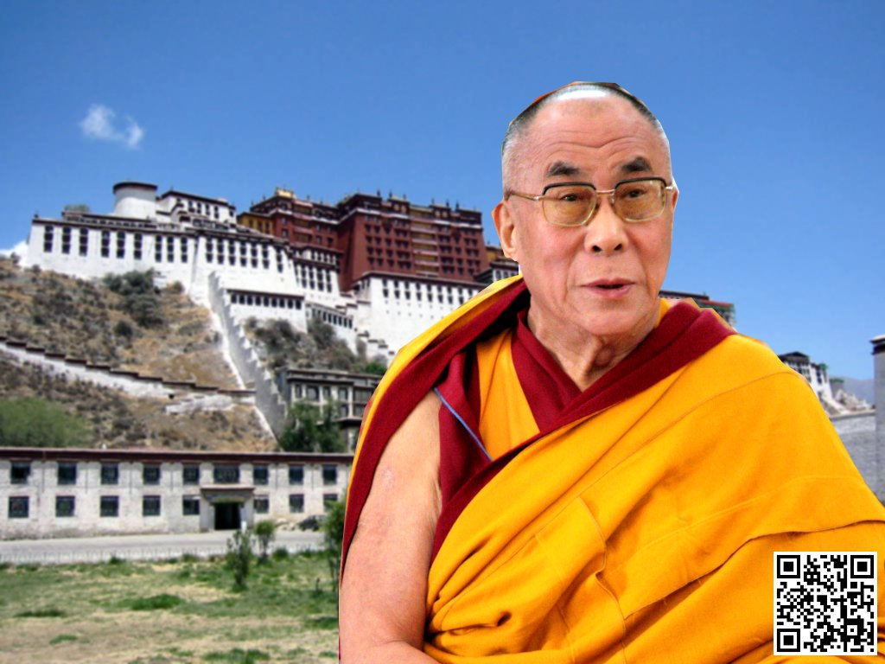
China Expands under the Communists (#11)
China Expands under the Communists
China takes control of Tibet and southern Mongolia
India welcomes Tibetan refugees fleeing revolt against Chinese (including the Dalai Lama)
China and India clash over border; fighting stops but tensions remain
Dalai
Lama

Slide 25
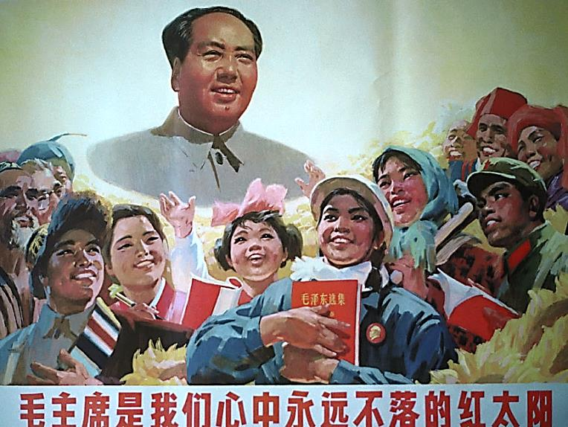
Mao’s Brand of Marxist Socialism (#12)
Chinese Communists organize national government and Communist Party
Mao’s Brand of Marxist Socialism
Farming:
Mao takes property from landowners and divides it among peasants
1 million landowners who resisted were killed
Later private land was taken and collective farms were set up with over 200 families each
Industry:
Government seizes private companies
5-year plans set high production goals

Slide 26
The Great Leap Forward (#13)
After success of the first Five-Year Plan, Mao proclaimed the “Great Leap Forward” program in 1958
Collective farms were expanded into communes that supported over 25,000 people
People shared dining rooms, dormitories, and nurseries for children
No one could own private items
They were governed by strict rules
Crop failures caused a famine which killed 20 million people and the program was ended in 1961

Slide 27
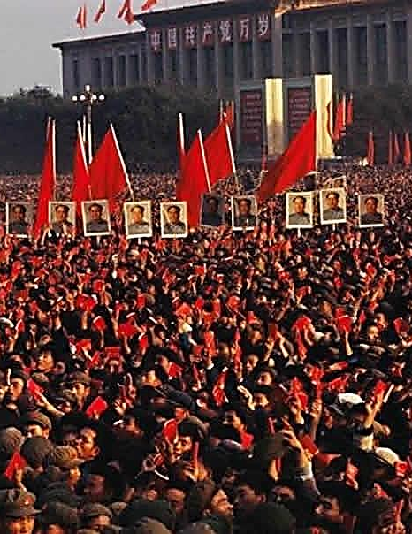
New Policies and Mao’s Response
China and Soviet Union clash over leadership of communist movement
After the failure of the Great Leap Forward, Mao reduces his role in government
Strict socialist ideas are moderated (farm families could live in their own homes and factory workers could compete for wages and promotions)
Mao decides that the new economic policies are weakening the communist goal of social equality
Mao urged young people to revive the revolution and millions of students, and young peasants and workers joined militia units (called Red Guards) that enforced strict communism in China

Slide 28
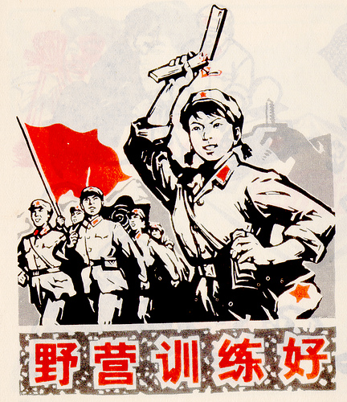
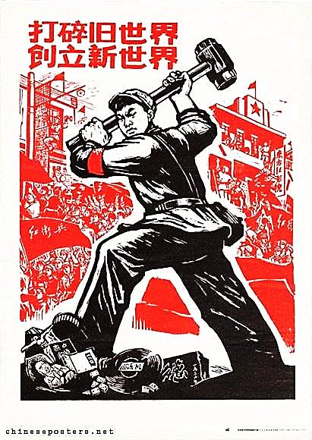
The Cultural Revolution (#13)
Cultural Revolution—an uprising movement led by the Red Guards to build society of peasants and workers in which all were equal
Red Guards—groups of violent and radical youth—closed schools, and executed or imprisoned many intellectuals, factory managers, professors, and others thought to be resisting
Chaos threatened farm and factory production and set China backwards
Finally in 1968, the Chinese army was ordered to imprison, execute, or exile most of the Red Guards to stop the violence and chaos

Slide 29
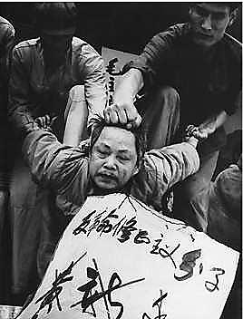
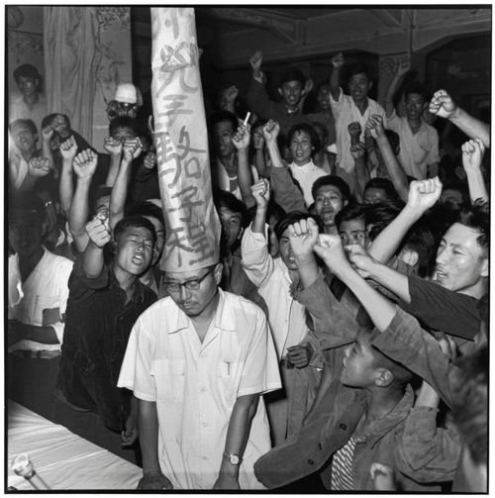
The Cultural Revolution

Slide 30
After Mao’s death, the Gang of Four—the radical group that controlled the power organs of the Chinese Communist Party throughout the Cultural Revolution—was arrested and judged responsible for the excesses and chaos that occurred in China as a result of this revolution

