Slide 1
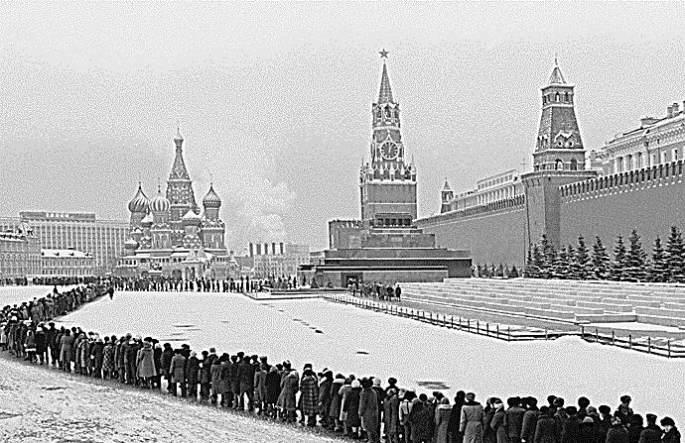
Modern World History Assign. #2-4 Stalinist Russia
Soviet citizens visit
Lenin’s tomb in Red
Square in Moscow

Slide 2
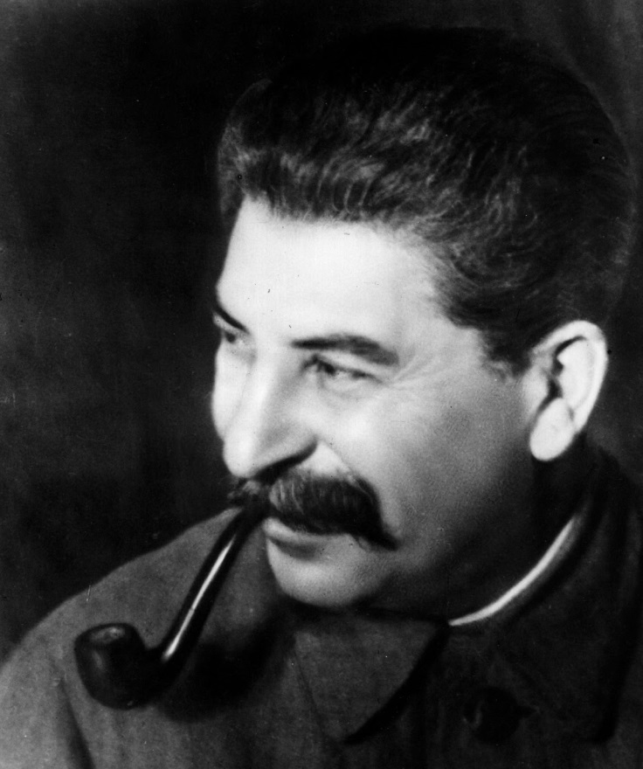
Lenin’s Death (#1 & #2)
Stalin
Lenin suffered a stroke in 1922 and died in 1924
Two leaders emerged that vied for power in the USSR after Lenin
Joseph Stalin – became general secretary of the Communist Party
Leon Trotsky – leader of the Red Army during the Russian Civil War
Stalin worked behind the scenes to put supporters into positions of power
After Lenin died Stalin gradually took control of the party
Trotsky was sent into exile in 1929 (assassinated in 1940 in Mexico on Stalin’s orders)
Trotsky

Slide 3
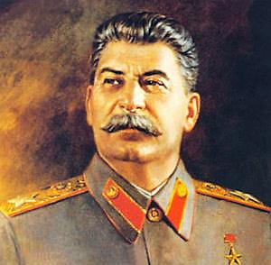
Totalitarianism (#3)
Totalitarianism – a government that takes total, centralized, state control over every aspect of citizens’ lives
Totalitarianism has a leader who appears to provide a sense of security and a direction for the future
Mass communication makes it possible to reach all aspects of citizens’ lives

Slide 4
TOTALITARIANISM (a govt. that has total control over its people)
Communism
government owns the businesses and land
Soviet Union
Shared
Characteristics
extreme
nationalism
one strong leader
one political party
strong military
secret police
censorship
propaganda
indoctrination
(teaching young
people accepted
ideas of the govt.)
Fascism
individual people own the businesses and land
Germany, Italy

Slide 5
What ONE word differentiates between Liberal and Conservative?
Left
Right
Radical
Liberal
Moderate
Conservative
Reactionary

Slide 6
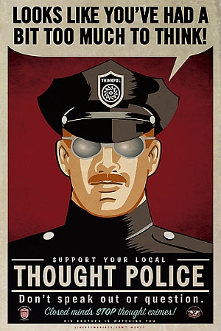
Police Terror (#5)
Totalitarian dictators used police terror to force obedience and to crush opposition
Secret police spied on citizens, intimidated them, and used brutal force and sometimes murder to achieve goals
In USSR millions of so-called traitors were arrested and executed

Slide 7
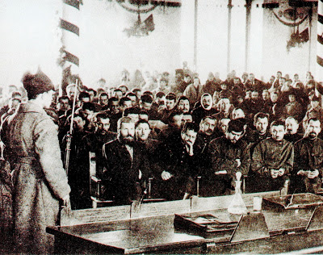
Great Purge (#7)
In 1934 Stalin turned against even Communist Party members who he thought could be potential threats to his power
Great Purge – a campaign of terror starting in 1937 that was directed at eliminating anyone who threatened his power
Thousands of old Bolsheviks that helped stage the 1917 revolution stood trial
When the purge ended in 1938 Stalin had absolute control of the USSR
Somewhere between 8 and 13 million people were killed in the Great Purge

Slide 8
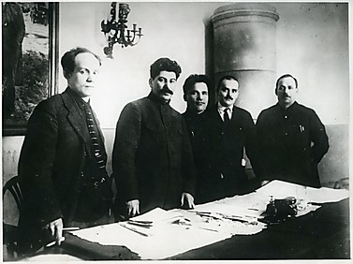
Propaganda and the Purge
Go to page 447 in your textbook.

Slide 9
Propaganda (#6)
Totalitarian states spread propaganda – biased or incomplete information used to sway people to accept certain beliefs or actions
Control of mass media and the arts
Expressing dissent against propaganda was an act of treason and could result in arrest, imprisonment or execution

Slide 10
Censorship (#8)
Stalin’s government controlled all newspapers, motion pictures, radio, and other sources of information
Writers, composers, and artists were censored
Individual creativity was not tolerated unless it conformed to the views of the state
Media needed to glorify the achievements of Stalin, communism, and his economic programs
Pravda – Official Newspaper of
the Communist Party in USSR

Slide 11
Indoctrination (#8)
Soviet government controlled all education from nursery schools to universities
Professors, teachers, and students who questioned the communist party could be severely punished
Education stressed values of sacrifice and hard work
State sponsored youth groups trained future Communist Party members

Slide 12
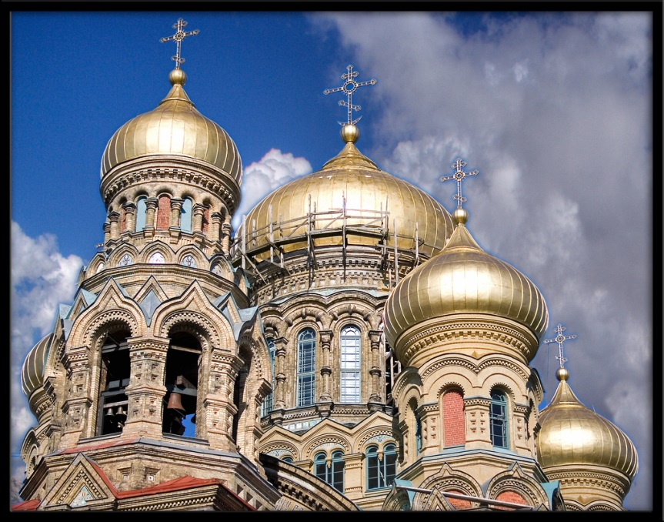
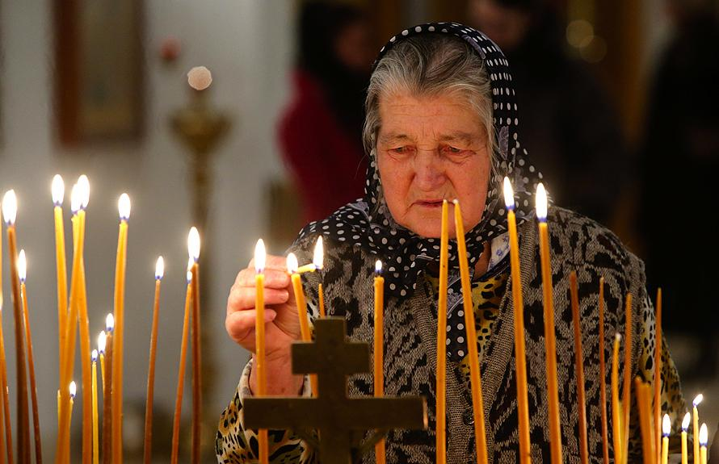
Religious Persecution (#8)
Communists aimed to replace religious teachings with the ideals of communism
Religion was seen as a threat to total loyalty to communism
Religious groups faced persecution especially the Russian Orthodox Church (churches were destroyed and religious leaders were killed or sent to work camps
Many Russians still practiced their religion more discreetly
A woman lights a candle as she prays at a church where victims of Soviet dictator Josef Stalin's purges are buried on the outskirts of Moscow

Slide 13
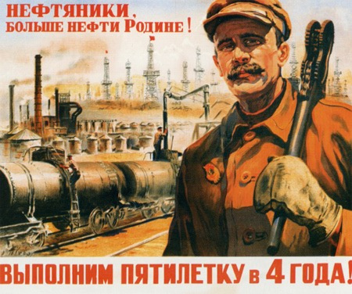
Five-Year Plans (#9 & #10)
Command economy – a system in which the government makes all the economic decisions and leaders determine the country’s needs and determine how to fulfill them
Five-Year Plans – set impossibly high quotas to increase the output of steel, oil, coal, and electricity
To try to meet these quotas the government limited production of consumer goods (leading to shortages in housing, food, clothing, and other desired goods)
They usually fell short of the quotas, but overall made significant increases in production

Slide 14
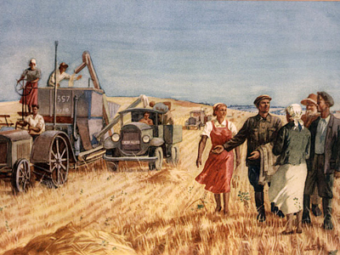
Agricultural Reforms (#11)
The government seized 25 million acres of privately owned land n 1928 and combined them into large, government-owned farms called collective farms
Hundreds of families worked on these farms and produced food for the state, and received wages for their work (like workers in factories)
The government expected production to go up as these farms would share modern machinery
Resistance was strong, especially among kulaks, a class of wealthy peasants
Between 5 and 10 million peasants were killed by Soviet secret police for resisting
Despite this resistance, by 1938 the country was producing twice the wheat that it produced prior to collectivization

Slide 15
Women in the Soviet Union (#12)
Women’s roles increased in Russia under communism
They were given equal rights by the Bolsheviks following the 1917 revolution
Under the five-year plans, women were expected to work in the factories and in the fields (while the government provided child care)
Women given expanded educational opportunities in fields like engineering, science, and medicine
Women had it tough as they were required to work, but were still expected to take on traditional roles of taking care of the home and children

Slide 16
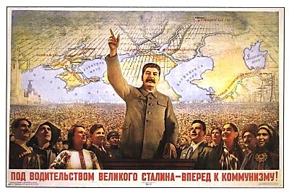
“Under the leadership of the great Stalin – forward to Communism!”

