Slide 1
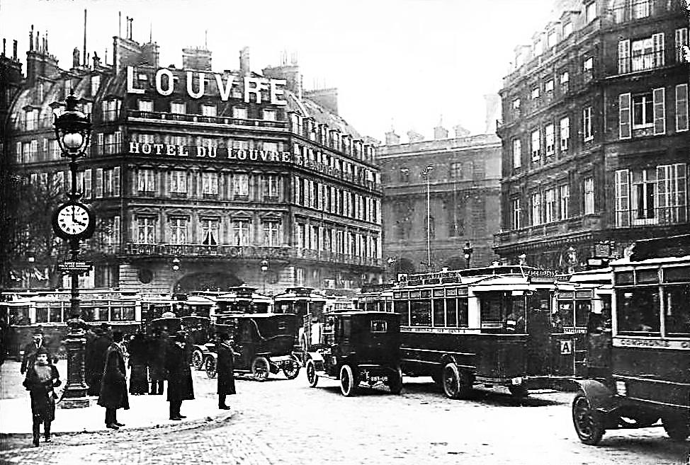
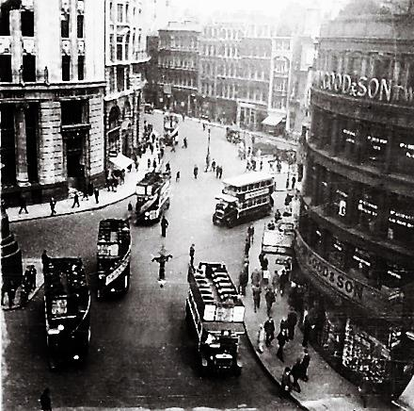
Modern World History Assign. #2-1 Chapter 15, Section 1 “Postwar Uncertainty”
1920s London
1920s Paris

Slide 2
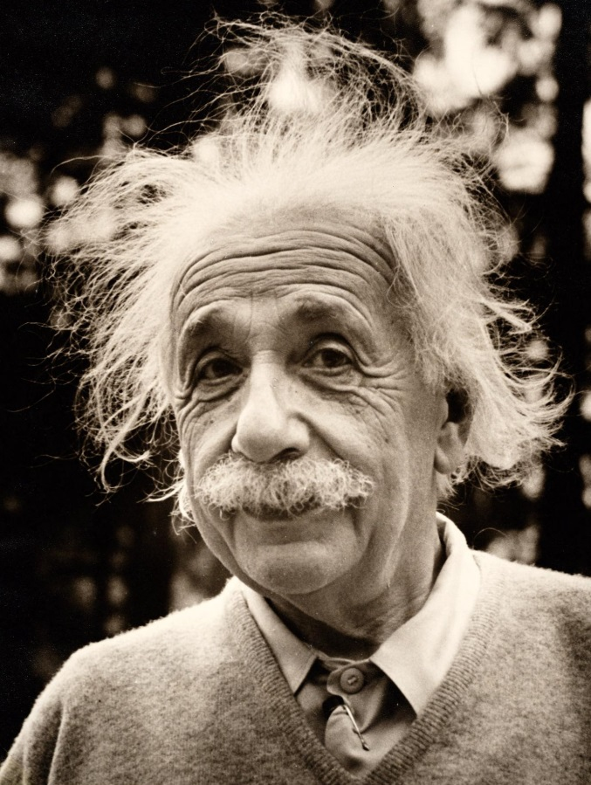
Albert Einstein (#1)
German born physicist
Theory of relativity
Time and space not constant
They can change when measured relative to an object moving near the speed of light
His findings led later physicians to the discovery of atomic energy (leading to atomic bombs)
Show videos #1 & #5

Slide 3
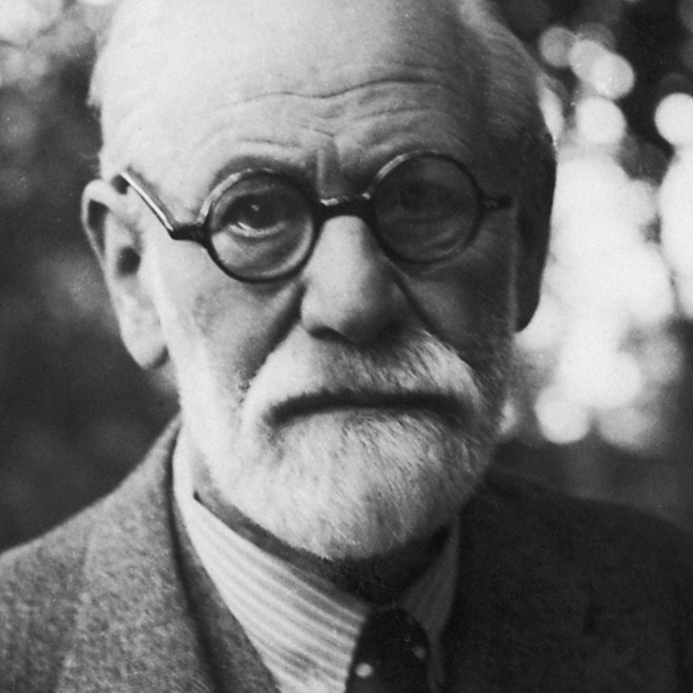
Sigmund Freud (#1)
Austrian physician who treated patients with psychological problems
Believed much of human behavior was irrational and comes from the unconscious mind
The unconscious mind is driven by pleasure-seeking drives
Leads to the field of psychoanalysis

Slide 4
Postwar Literature (#2)
The brutality of WWI led writers to question accepted ideas of reason and progress
Some began to question the future and express doubts about traditional religious beliefs
They created disturbing visions of the present and the future
In the US, some of these authors went to Europe and became known as the “Lost Generation” – like F. Scott Fitzgerald and Ernest Hemingway

Slide 5
Existentialism (#3)
Existentialism – philosophy born in the 1920s by thinkers searching for meaning in the uncertain world
Jean Paul Sarte – French philosopher
there is no universal meaning to life
each person makes their meaning through their choices and actions

Slide 6
Existentialism (#4)
Friedrich Nietzsche – German philosopher
people’s creativity and actions had been stifled by reason, democracy, and progress
world needs people who could aspire to ancient heroic values of pride, assertiveness, and strength (Übermensch)
His ideas attracted growing attention and had an impact on politics in Germany in the 1930s
The German prefix über can have connotations
of superiority, transcendence, excessiveness, or
intensity. Mensch means human being. Some
translate it as “Superman.”

Slide 7
Romanticism, Realism, Expressionism
Use Ch. 8, Section 4 on Revolution in the Arts presentation to show where we are at in art history when WWI hits

Slide 8
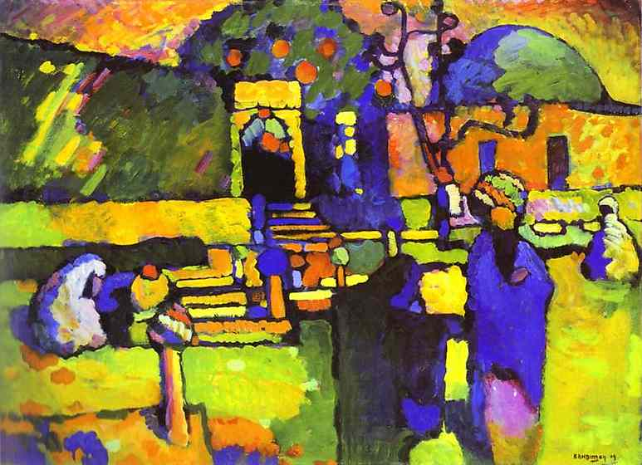
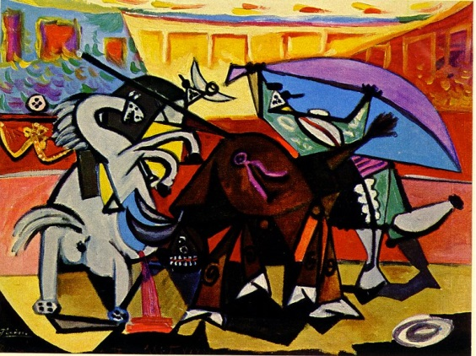
New Directions in Art (#5)
Artists rebelled against earlier realistic painting styles
Depicted emotion and imagination instead
Expressionism – bold colors and distorted shapes
Cubism – natural shapes in geometric forms with sharp angles and edges
Surrealism – tried to link dreams to real world (objects in unrealistic ways)

Slide 9
Expressionism – Wassily Kandinsky

Slide 10
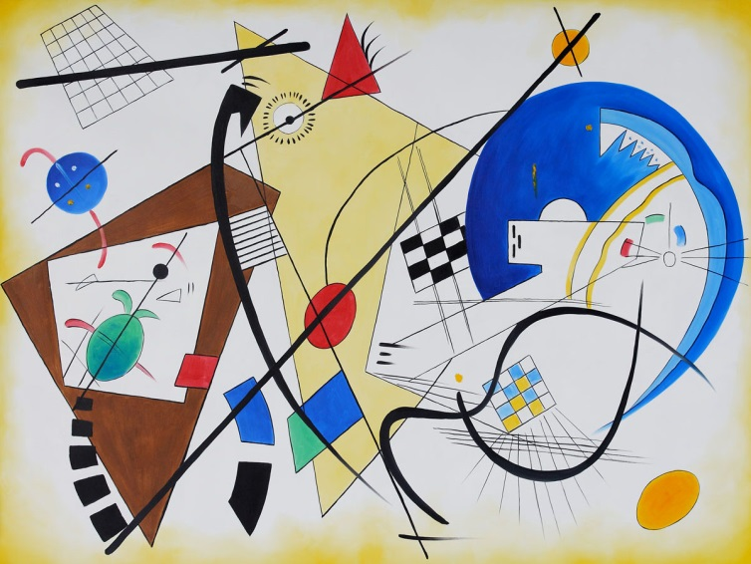
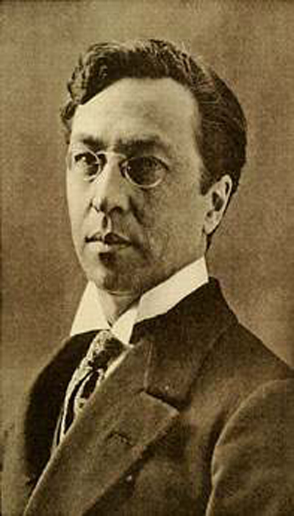
Moving Toward Abstract – Wassily Kandinsky

Slide 11
Abstract – Wassily Kandinsky

Slide 12
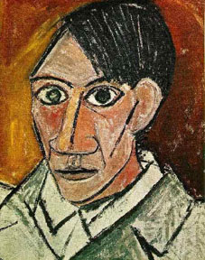
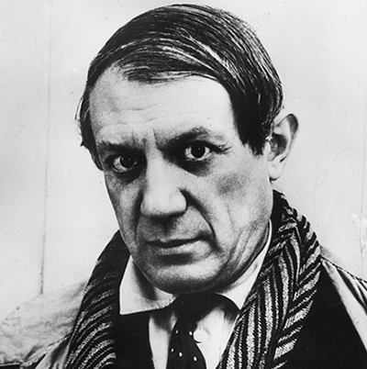
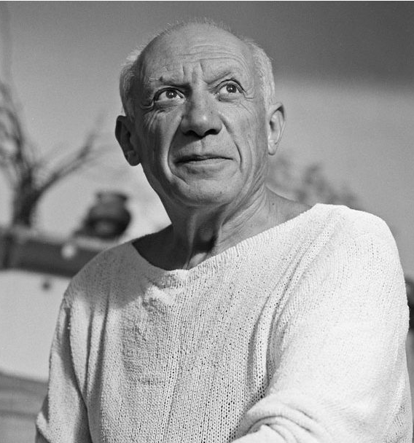
Cubism – Pablo Picasso

Slide 13
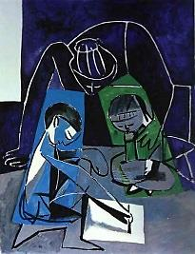
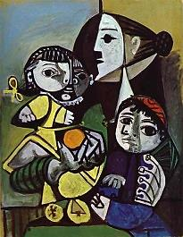
Cubism – Pablo Picasso

Slide 14
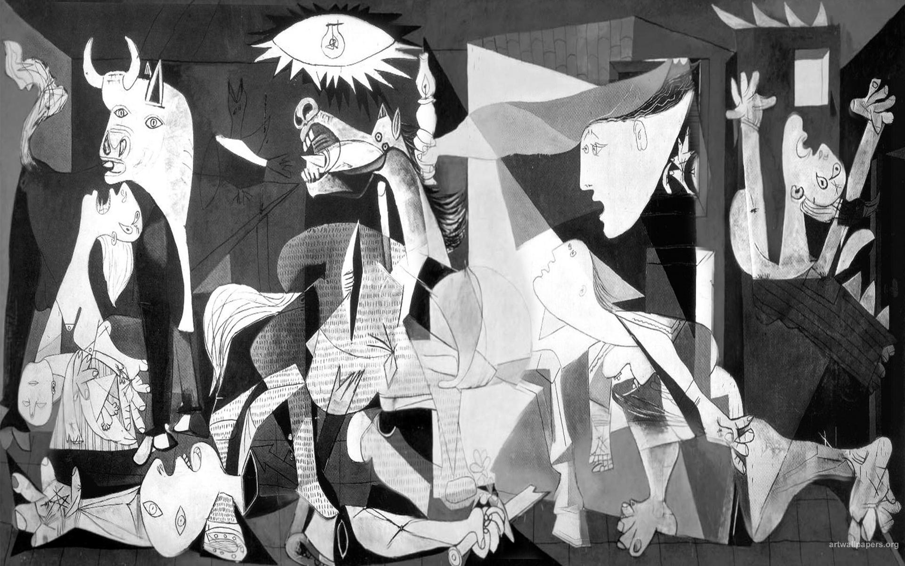
Cubism – Pablo Picasso

Slide 15
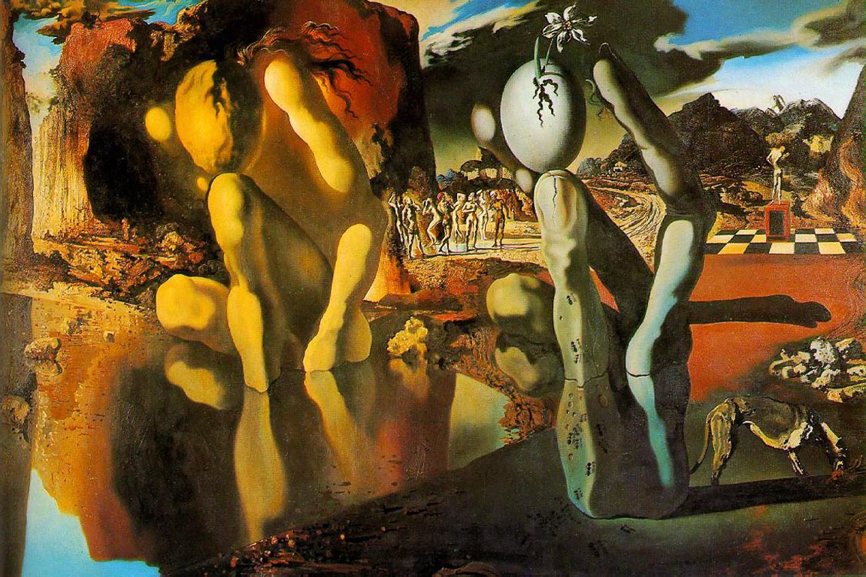
Surrealism – Salvador Dali

Slide 16
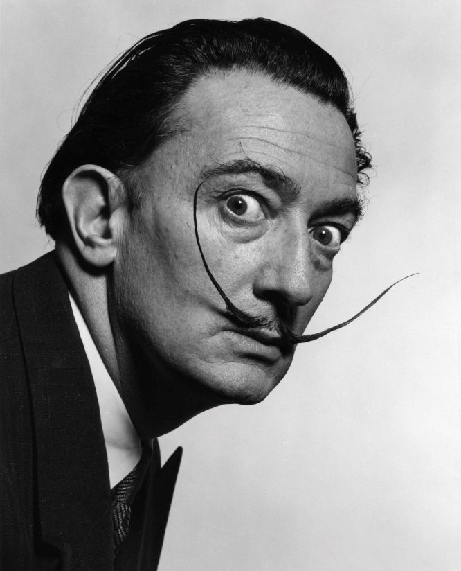
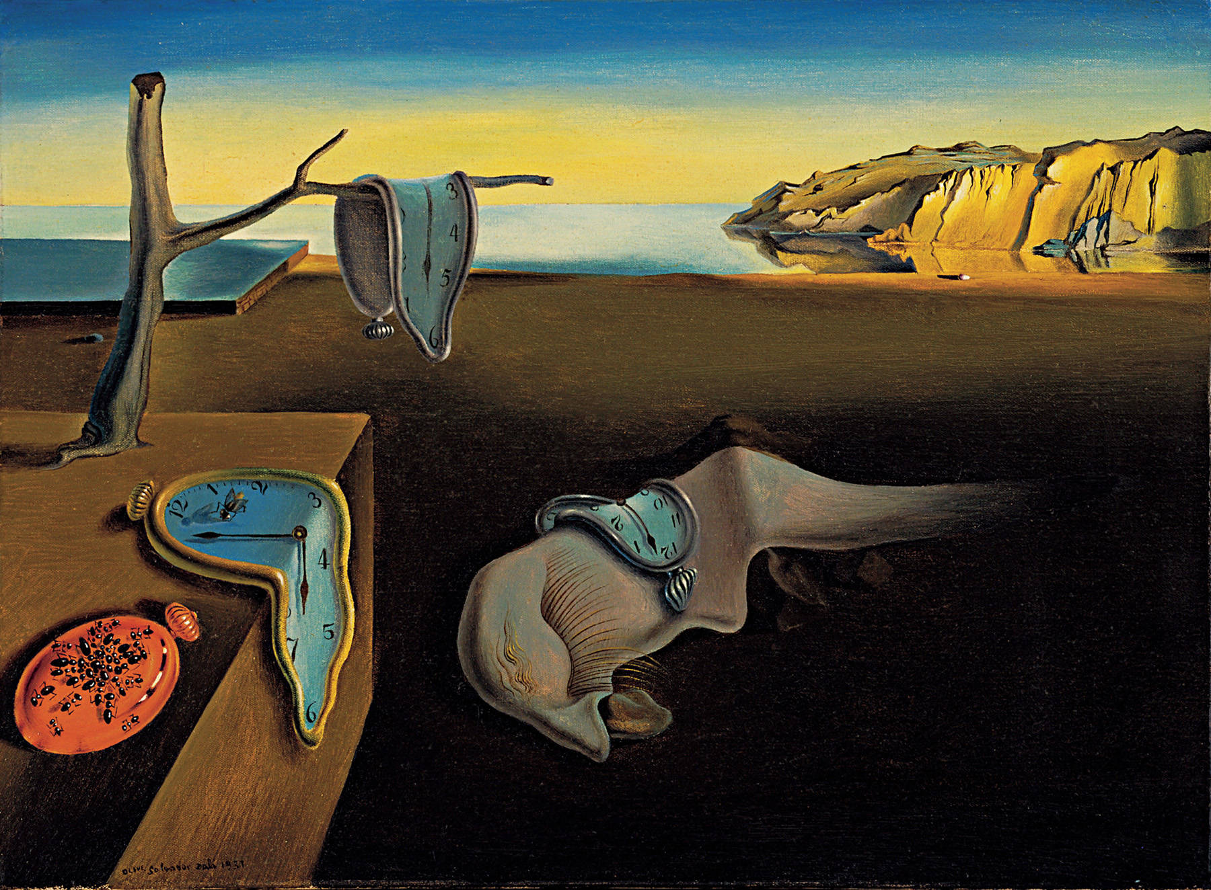
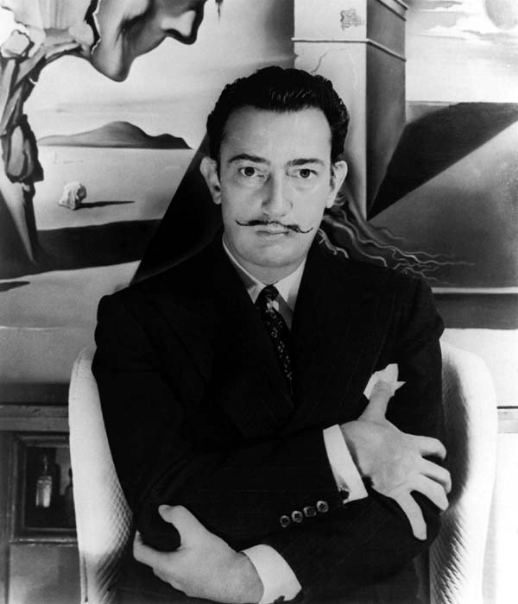
Surrealism – Salvador Dali

Slide 17
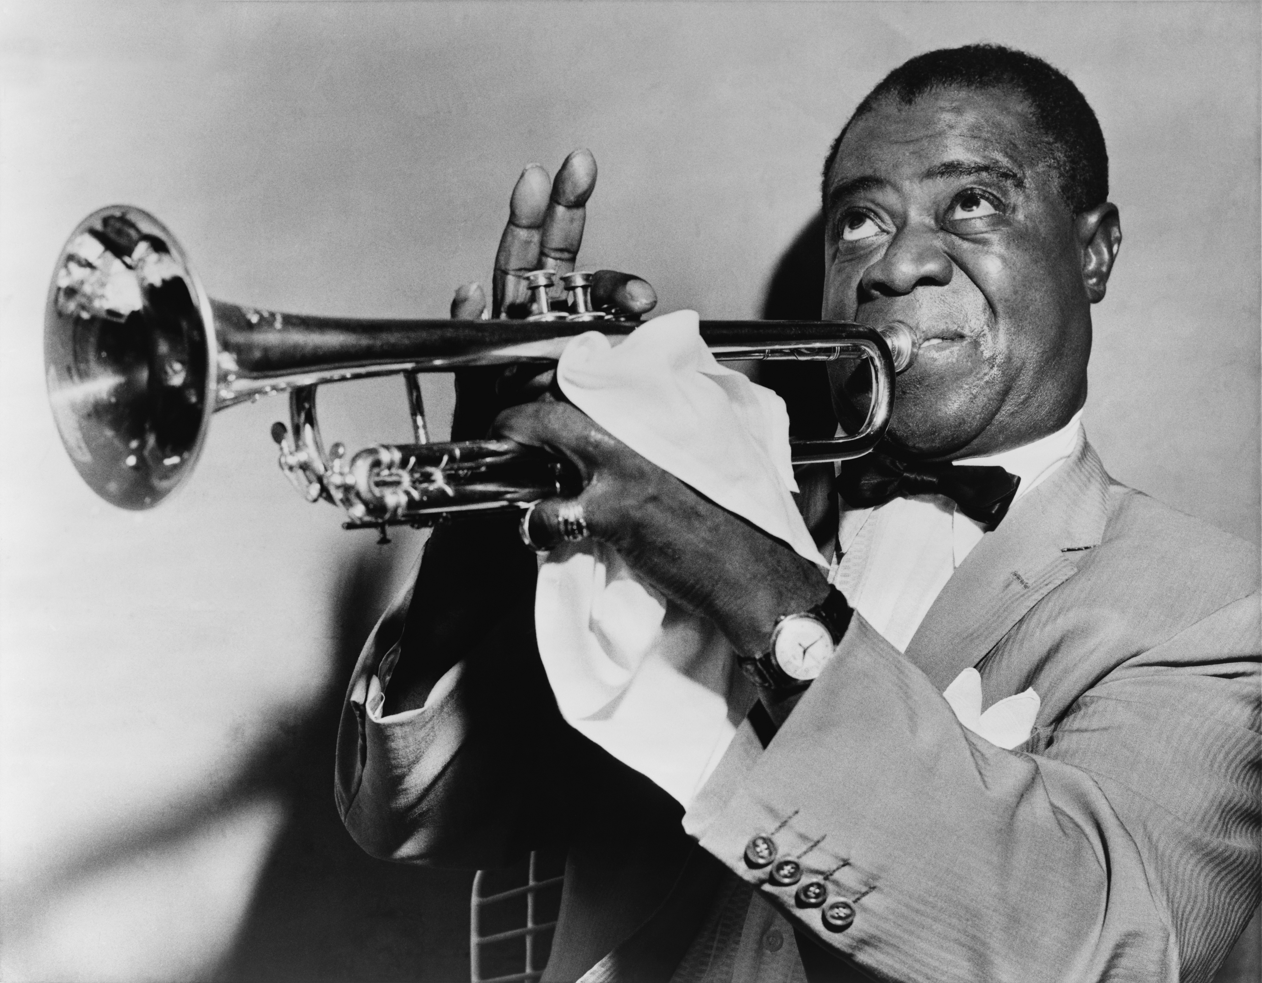
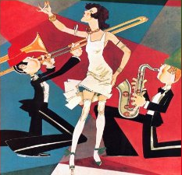
New Directions in Music (#5)
Composers began rejecting traditional harmonies and rhythms, even in traditional music forms like for ballet and opera
Jazz – New popular music style began in the U.S. mostly by African Americans and had a lively, loose beat

Slide 18
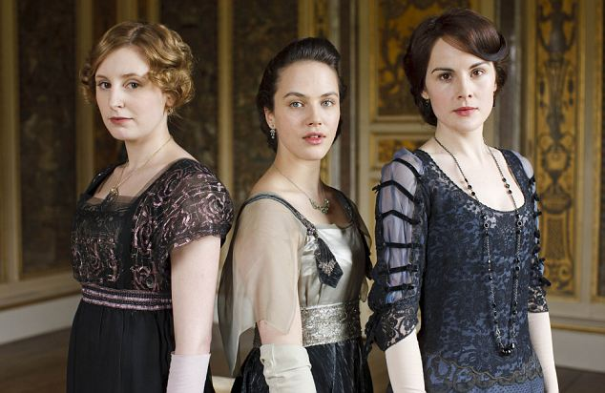
Women’s Roles and Behaviors Change (#6)
Young people enjoyed new freedoms and broke from the past to experiment with new values
Women took on new roles in WWI, and this helped them gain the right to vote in many countries
Some women wore shorter, looser clothes and cut their hair shorter
Some women began to push for birth control
Many women found new careers in fields such as medicine, journalism, and education

Slide 19
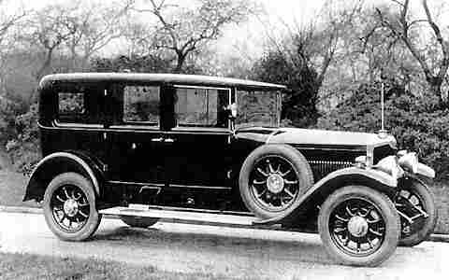
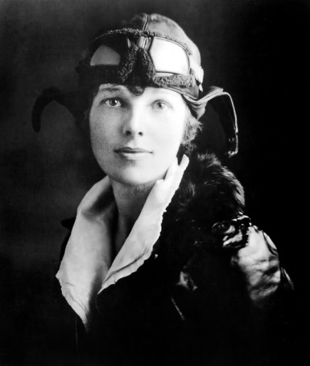
Transportation in the 1920s (#7)
Cars improved with electric starters, air-filled tires, and more powerful engines
Prices dropped, so more people could afford cars
This allowed more people to live further from jobs in suburbs, and travel for pleasure
Air transportation increased
Charles Lindbergh became the first to fly non-stop across the Atlantic Ocean in 1927
Amelia Earhart became the first woman to do so in 1932

Slide 20
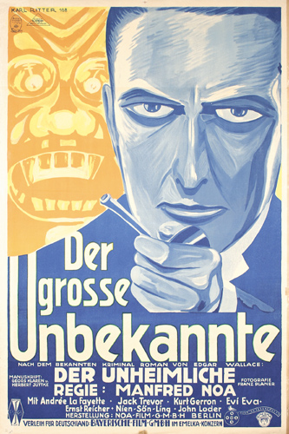
Popular Entertainment in the 1920s (#8)
Radio developed in 1895 (by Guglielmo Marconi of Italy)
1st commercial radio station in 1920 (KDKA in Pittsburgh)
Soon every city had at least one radio station
Movies also incredibly popular in the 1920s in both Europe and U.S.
Silent movies until the first “talkies” in late 1920s

Slide 21
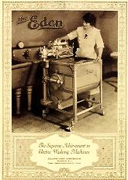
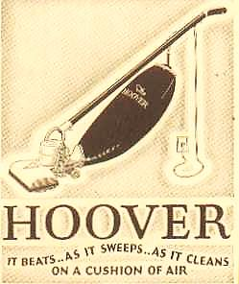
New Consumer Products in the 1920s (#9)
Electricity became more readily available in homes
Installment plan buying
More advertising (radio)
Labor-saving appliances
Washing machines, irons, radios, refrigerators, fans, coffee pots, cameras, toasters, vacuum cleaners, etc.

