Slide 1
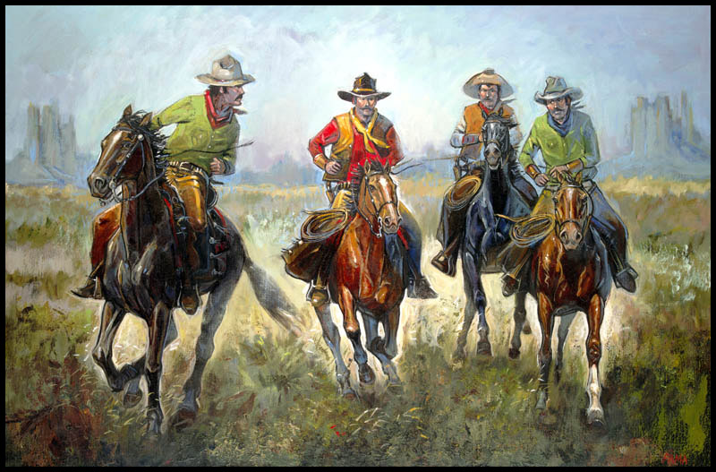
Modern US History Ch. 18, Section 1 Miners, Ranchers, and Railroads

Slide 2
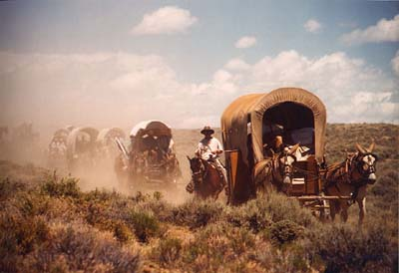
Mining Boom Brings Growth
Prior to the Civil War most Americans saw the Great Plains and the west as the Great American Desert and there were few attempts to settle there until after the war (#1)
frontier – an undeveloped area (which for the US by 1850 extended to the Pacific Ocean)
More and more people moved to the west and claimed land for mining, ranching and farming, which was further aided by the building of railroads there (#2)

Slide 3
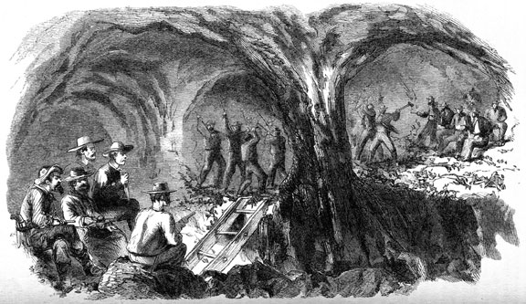
Big Business
Comstock Lode – a huge deposit of gold and silver found in Nevada in 1859 that lured thousands of miners there
to remove the silver and gold found deep in the rock expensive mining equipment was needed, which made mining big business in the west as only large mining companies could afford it (#2)
Mining deep under ground was dangerous with unsafe equipment, dusty air, explosions and cave-ins, which along with low pay led miners to form unions (#3)

Slide 4
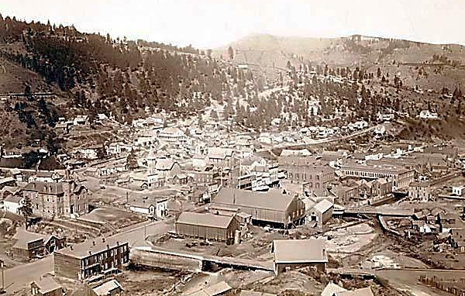
Settlers & New Towns
Miners came to the west from the eastern US and also from countries all over the world including many experienced miners from Mexico (Settlers #1)
boomtowns – communities that grew suddenly when a mine opened that had stores, saloons and boarding houses
Few women or families lived in boomtowns, but those that did helped to turn some of them into successful permanent towns (New Towns #2)

Slide 5
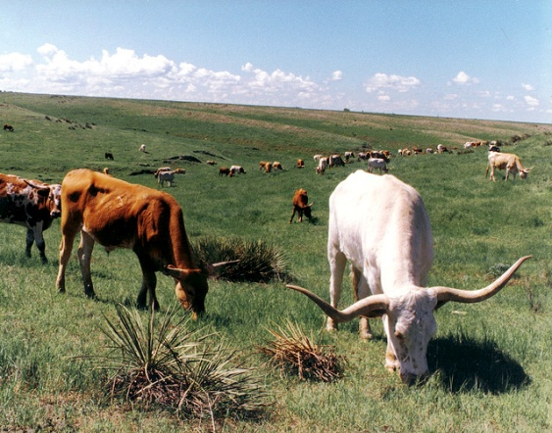
The Cattle Kingdom
Cattle ranching was another industry that grew in the west, especially raising longhorns which could survive in dry western Texas (#1)
Joseph McCoy – built pens for cattle in the railroad shipyards of Abilene, Kansas for shipping cattle to eastern markets which started the long drive of cattle from Texas to Kansas (#2)
Cattle Kingdom – nickname for the region of the Great Plains extending from Texas to Canada where ranchers raised cattle on the open range in the late 1800s

Slide 6
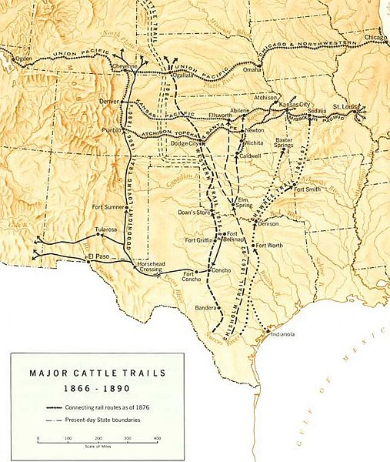
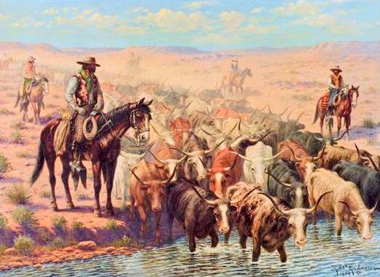
Importance of Cowboys
Cowboys took care of the ranchers' cattle and borrowed the techniques and tools of Mexican vaqueros like the saddle, lariat rope, and hats (#1)
cattle drive – the long journeys where cattle were driven to market or to other grazing areas which could last months and cover hundreds of miles
Chisholm Trail – one of the earliest and most popular routes for cattle drives, which ran from San Antonio, Texas to Abilene, Kansas
Law officials tried to keep order in the cattle towns where rowdy cowboys sometimes misbehaved (#3)

Slide 7
End of the Open Range
Cattle ranchers eventually competed with farmers who used barbed wire to fence off their lands over the open range lands, which led to sometimes deadly range wars (#1)
The cattle industry also suffered in the 1880s due to overgrazing of lands by the increasingly large herds and unusually severe winters, which led to the financial ruin of many ranchers (#2)
Eventually railroads were built to Texas ending the need for the long drive

Slide 8
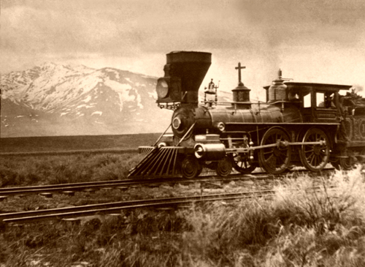
The Transcontinental Railroad
As Americans moved west they needed ways to get supplies and information across the country (#1)
Pony Express – a system of messengers on horseback that began in 1860 which was eventually replaced by telegraph lines
transcontinental railroad – a railroad that would cross the continent connecting east with west
Pacific Railway Acts – gave railroad companies loans and large land grants to pay for the building of railroads across the west (#3)

Slide 9
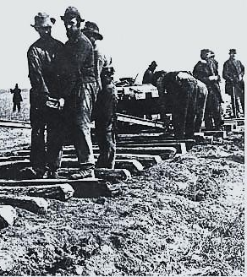
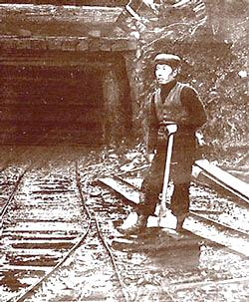
Great Race
In 1863 the Central Pacific company pushed east from Sacramento, California while the Union Pacific pushed west from Omaha, Nebraska (#1)
Union Pacific hired mostly Irish immigrants and Civil War veterans, while the Central Pacific hired mostly Chinese immigrants (#2)

Slide 10
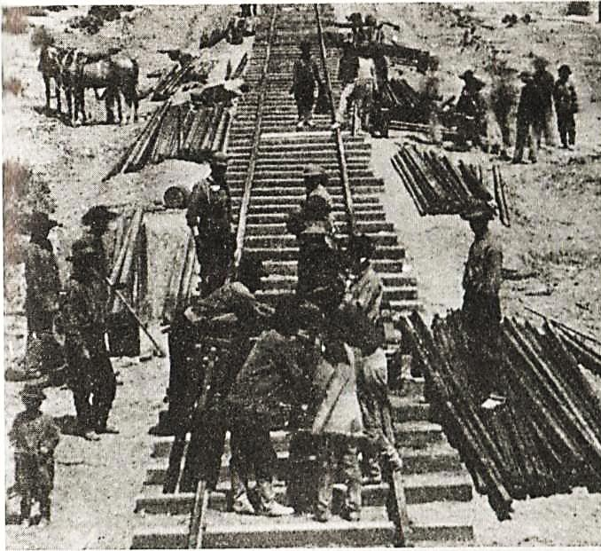
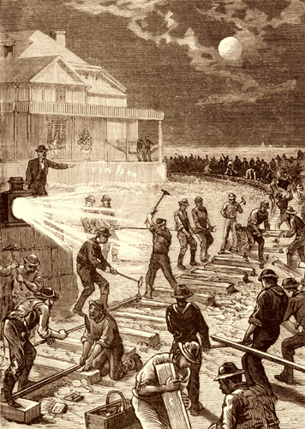
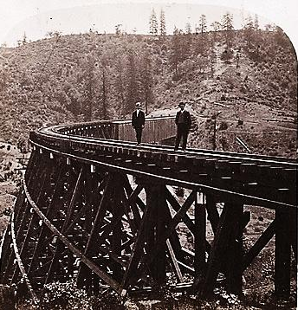
Great Race (continued)
Central Pacific workers faced harsh winters and dangerous explosions as they cut through high Sierra Nevada mountains (#3)
Union Pacific workers faced harsh weather on the Great Plains and were expected to lay 250 miles of track every 6 months (#4)
Buffalo hunters like William “Buffalo Bill” Cody provided food for the railroad workers (#5)

Slide 11
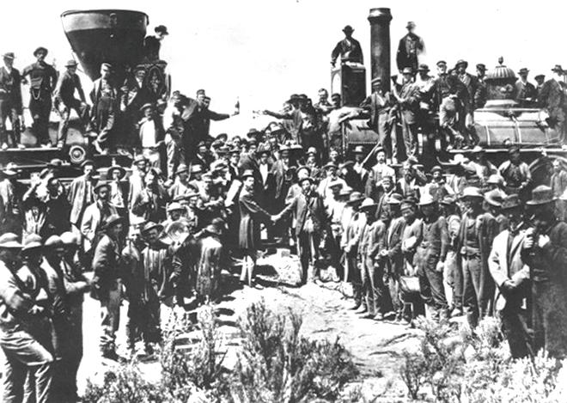
Golden Spike
The two companies to completed the line at Promontory Point, Utah in 1869 with the driving of a ceremonial golden spike (#1)
The transcontinental railroad was just the first of many lines to be constructed in the west over the next several years (#2)

Slide 12
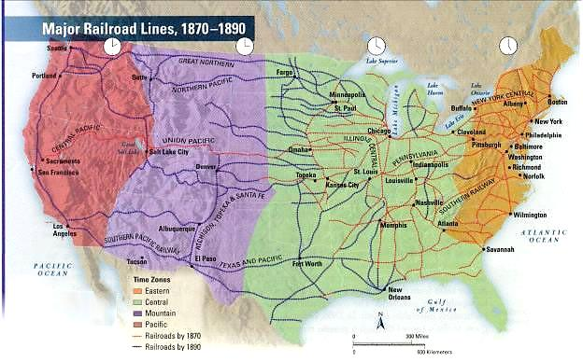
Effects of the Transcontinental Railroad
Increased settlement of the west
Increased business activity and east-west trade
Helped make the railroad industry one of the most powerful in the country
Railroad schedules united areas of the country and led to the creation of time zones

