Slide 1
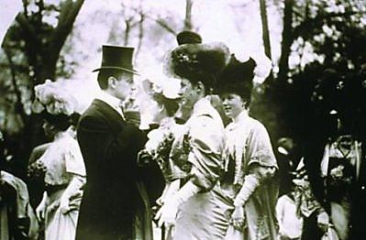
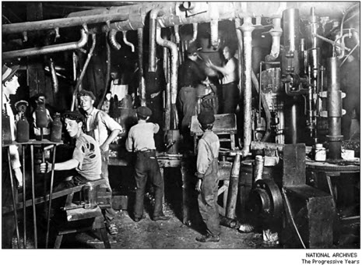
Chapter 21, Section 1 “The Gilded Age and the Progressive Movement”

Slide 2
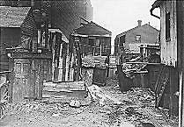
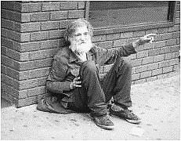
The Problems of the late 1800s
Poverty
The spread of slums
Poor working conditions in factories
Economic depression
Corrupt politicians
Corporations with lots of control

Slide 3
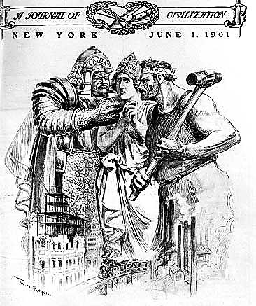
Solutions to the Problems
SOLUTION TO THE PROBLEMS? – A reform movement known as Progressivism
The Progressives had 3 Major Goals
1. Expand Democracy
2. Protect Social Welfare
3. Create Economic Reform

Slide 4
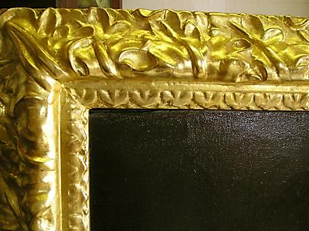
Gilded Age
The term came from a novel by Mark Twain by the same name
The novel highlighted the inequality between wealthy businessmen who profited during the industrial revolution and the workers who endured bad working conditions, long hours, and low pay

Slide 5
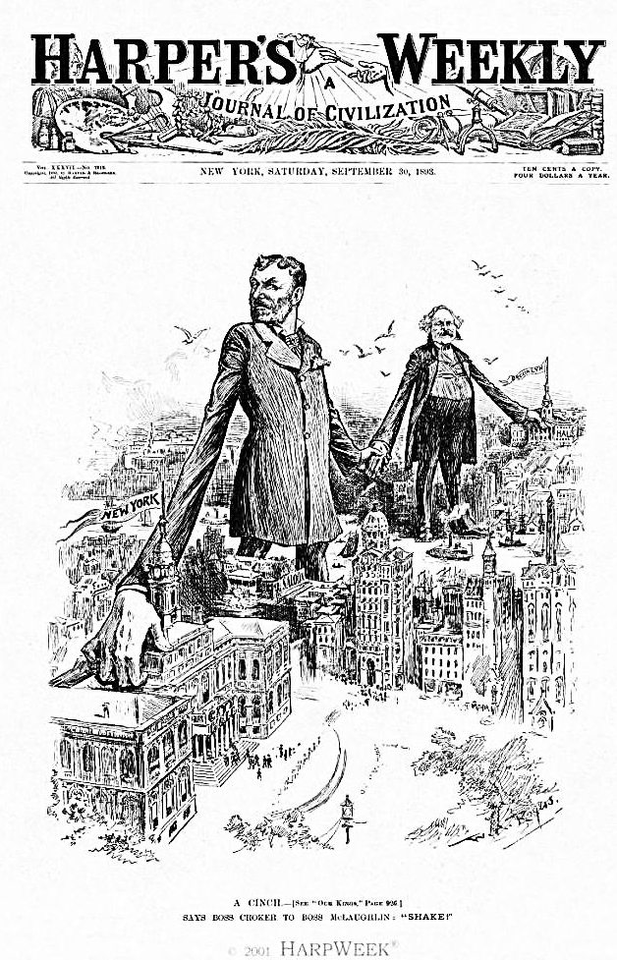
Political Machines
Powerful organizations that used both legal and illegal methods to get their candidates elected to public office in the late 1800s in order to control local and state government
They used their power to steal millions from govt. (construction kick-backs)
They built parks,

Slide 6
Political machines were able to get the support to remain in power in a variety of ways.
Stuffed ballot boxes with extra votes for their candidates
Paid people to vote a certain way
Bribed vote counters
Political party bosses traded favors for votes
Drew support from immigrants who they often helped find housing and jobs
Police forces were hired by the machine so they did not interfere

Slide 7
Organization of Political Machine
City Boss – Usually the mayor, this person controlled thousands of municipal jobs, including police, fire and sanitation departments. The boss also controlled business licenses, and inspections, and had a lot of influence over courts and other municipal agencies.
Ward Bosses – Working beneath the city boss, they helped the poor and gained votes by doing favors or providing services. In return for votes they would provide city jobs, contracts, or appointments.
Precinct Workers – They worked to gain voters’ support on a city block or in a neighborhood and reported to the ward boss, and were usually 2nd generation immigrants themselves.

Slide 8
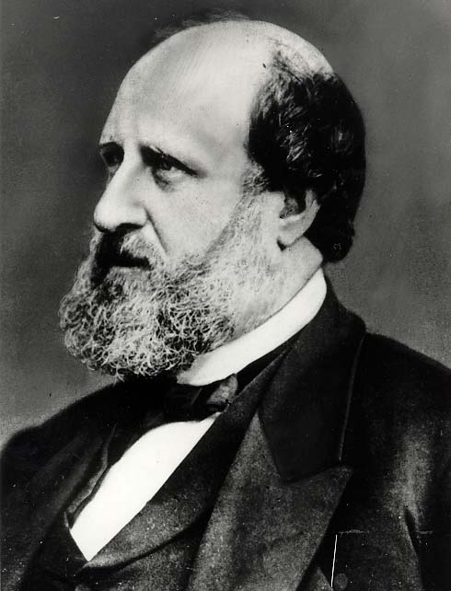
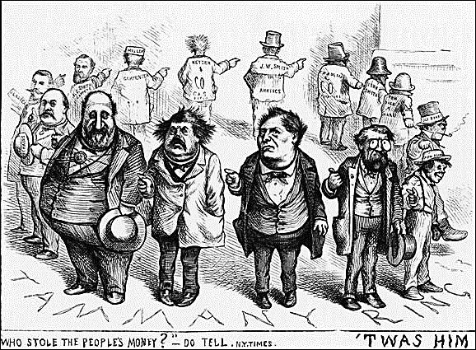
William Marcy “Boss” Tweed
Became head of New York City’s Tammany Hall in 1863
Tammany Hall was the powerful Democratic political machine
Between 1869 and 1873, the Tweed Ring pocketed as much as $200 million from the city in kickbacks and payoffs (nearly $8 billion in today’s $)

Slide 9
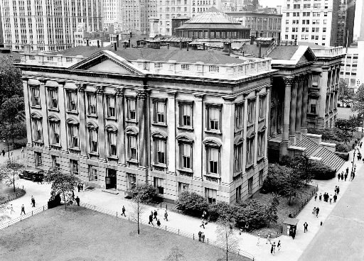
Example of Boss Tweed’s Corruption
For example, the construction cost of the New York County Courthouse, begun in 1861, grew to nearly $13 million – about $178 million in today's dollars, and nearly twice the cost of the Alaska Purchase in 1867.
A carpenter was paid $360,751
(roughly $4.9 million today)
for one month's labor in a building
with very little woodwork
a plasterer got $133,187
($1.82 million) for two days' work

Slide 10
Pendleton Civil Service Act – law passed in 1883 that set up a merit system for awarding federal jobs (often requiring applicants to take an exam) to get the most qualified people the job, which eliminated some of the corruption in govt. from the patronage system

Slide 11
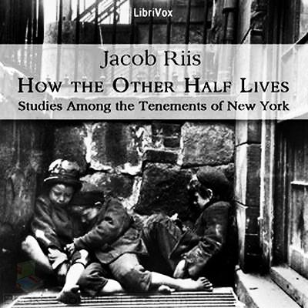
Progressives – a group of reformers in the late 1800s that tried to improve society and solve the problems caused by rapid industrial and urban growth
Muckrakers – journalists during the progressive era who wrote stories that described problems in society (such as child labor, racial discrimination, slum housing or corruption in business and govt.), which influenced voters and politicians to back reforms addressing these problems

Slide 12
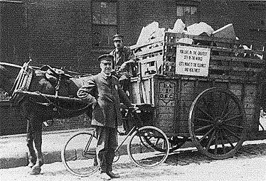
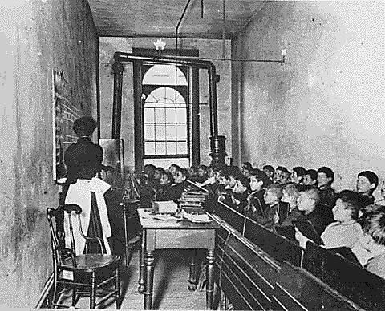
Progressive reformers had many successes in helping the urban poor.
They pushed for safer building codes and laws such as the N.Y. State Tenement House Act which required running water in housing
Created settlement houses which helped those in slum neighborhoods
Built new public parks
Began to address problems such as pollution, impure water, and garbage collection which caused death rates to drop
Set up kindergartens and passed laws requiring children to go to school

Slide 13
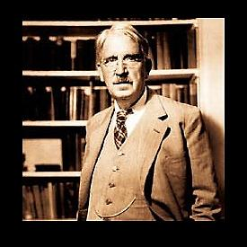
John Dewey – a philosopher and writer of the progressive era that was a key supporter of early childhood education and wanted children to learn problem-solving skills, not just the memorization of facts
He believed that education was the key to democracy as it requires well-informed population, which was especially true in the era of mass immigration in which he lived

Slide 14
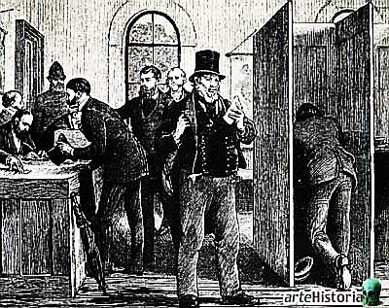
Expanding Democracy & Voting Reforms
Govt.-prepared Ballots: listed all
candidates (as opposed to the ones
issued by political machines listing
only their candidates)
Secret Ballot: ensured privacy for voters
Direct Primary: voters choose candidates, not party bosses
Initiative: voters propose laws directly through petition
Referendum: voters get to approve or reject a law that has been proposed or passed by a governing body
Recall: voters directly remove somebody from elected office before their term in office is over
17th Amendment: U.S. Senators are now elected directly by the voters (instead of by state legislatures)

Slide 15
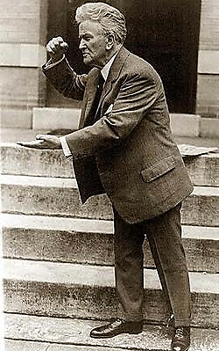
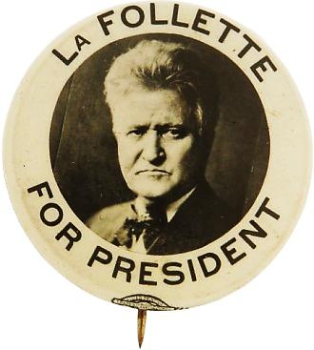
Robert La Follette – Progressive Republican known as “Fighting Bob”
Served as a Congressman, then Governor, then Senator for Wisconsin
Spearheaded many Progressive reforms
Decreased power of political machines
Fought for clean government
Fought for laws that made politicians accountable
Had university professors and experts help write laws
His model for progressive reforms was copied by other states and became known as the “Wisconsin Idea”
Unsuccessfully ran for President in 1912 and 1924

