Slide 1
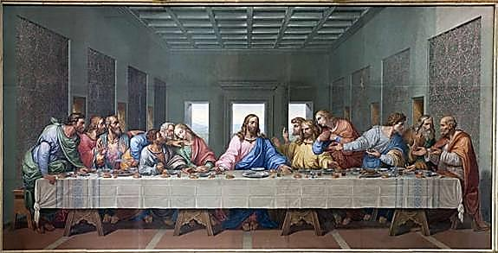
Modern World History Christianity

Slide 2
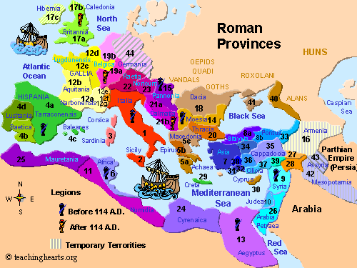
Jews and the Roman Empire
Jews had trouble with the idea of honoring the Roman Emperor as a god
Jews refused to pay Roman taxes at times and mounted several rebellions (between 3rd c. BCE and 1st c. CE) which they lost
Some Jews believed that a savior (messiah) would come and deliver them from Roman rule

Slide 3
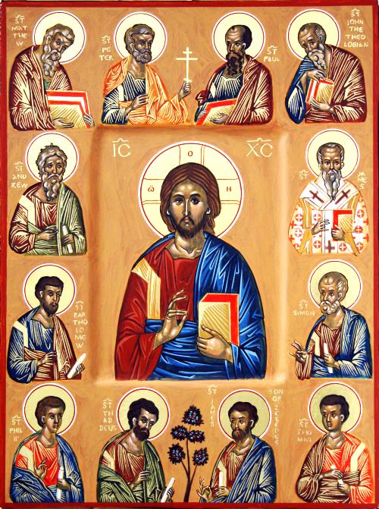
Jesus of Nazareth
Jewish teacher from Nazareth, born c. 3 CE
Teachings:
monotheism
10 Commandments
personal relationship with and devotion to God
love for one another
Repent sins and live in God’s eternal kingdom (heaven)
Jesus’ closest followers were known as his disciples (later the apostles)
They wrote and account of his life that became the first four Gospels of the New Testament

Slide 4
Death of Jesus
Seen as a threat to Roman authorities (Why?)
Executed by crucifixion (What is that?)
Jesus was reported to have risen 3 days later and communicated to some of his followers before ascending into heaven

Slide 5
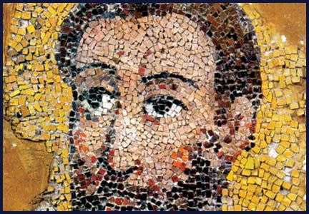
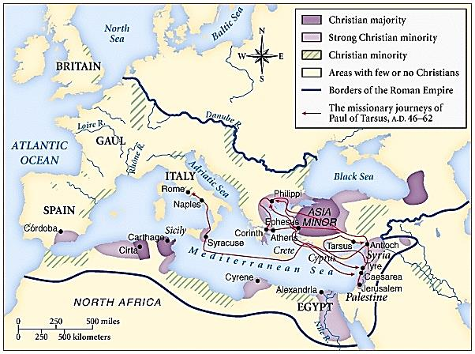
St. Paul of Tarsus
Jesus’ early followers who spread his teachings even after his death were known as apostles or disciples
Paul was the greatest of them by travelling around eastern Med. Sea spreading the beliefs (though he was executed later for it)
Disciples taught:
Jesus was son of God and had died for our sins
Put faith in God above all else
Follow strict moral standards
Salvation can be achieved by faith

Slide 6
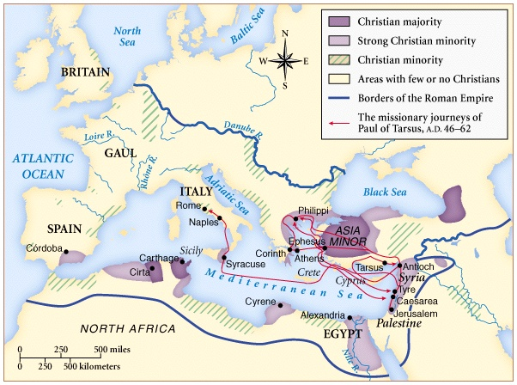
The Rise of Christianity

Slide 7
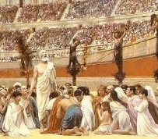
Persecution of Christians
Early years: Christians persecuted by Romans
Christians refused to worship Roman gods so Romans used them as scapegoats for other problems like famine or fire
Peter and Paul put to death
Others were exiled, imprisoned, or executed as well
Martyrs – people who are willing to sacrifice their lives for the sake of a belief or cause

Slide 8
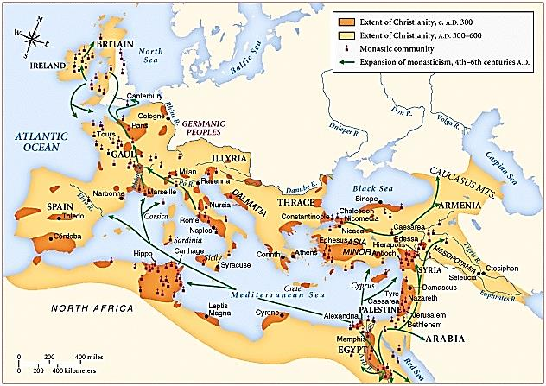
Appeal of Christianity
Embraced all people (men, women, poor, etc.)
Gave hope to the powerless
Appealed to those who hated the extravagances of Imperial Rome
Offered a personal relationship with a loving God
Promised eternal life after death

Slide 9
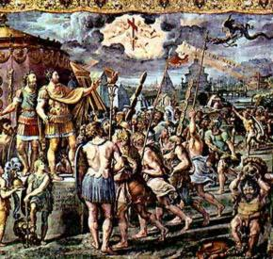
Constantine
Constantine – the first Roman Emperor to make Christianity legal
He did so because before a crucial battle against rivals for his throne he prayed for help from the Christian God
He won an important victory and made Christianity legal
He himself was baptized shortly before his death

Slide 10
Christianity Definitions
Roman Catholic
Eastern Orthodox
Bishop – a priest who supervised several local churches
Pope – father or head of the Christian church who was the Bishop of Rome and the Roman Catholic Church
Heresy – any belief that appeared to contradict the basic teachings of the Church
Patriarch – bishop of Constantinople who was the leader of the Eastern Orthodox Church who was under the power of the emperor
Excommunication – the declaring of someone(by the Pope or the Patriarch) to be outcast from the Church)
Schism – means split (refers to the permanent split between the Eastern Orthodox Church and the western Roman Catholic Church

Slide 11
The Great Schism Differences Between the 2 Branches
Roman Catholic
Eastern Orthodox
Services in Latin
Pope authority over bishops
Pope authority over kings and emperors
Priests can’t marry
Divorce not permitted
Services in Greek
Patriarch and the top bishops head the church
Emperor claims authority over the Patriarch and the bishops
Priests may be married
Divorce allowed under certain circumstances

