Slide 1
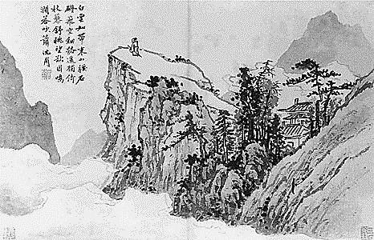
Modern World History Chinese Philosophies Confucianism, Daoism, and Legalism

Slide 2
Period of Warring States
During this time there was no unified rule in China (the ancient dynasties of rulers had collapsed)
Conflict between the many regional powers created chaos and confusion
Philosophies were born to combat this in order to create social order

Slide 3
Confucianism
Started by Confucius (551-479 BCE) during the Warring States Period in China
Basic teachings in a collection called the Analects
Offers solutions to the problems plaguing China
Focus on life rather than the afterlife
Social order arose from proper ordering of relationships
Fill govt. positions with well-educated and conscientious individuals (called junzi)
Does not advocate a specific deity
Emphasizes worship of ancestors

Slide 4
Basic Beliefs of Confucianism
Ren – attitude of kindness, respect, loyalty
Li – sense of proper behavior based on respect for elders and superiors
Xiao – filial piety or respect for elders, family ancestors
Goal is to promote harmony on Earth through good relationships
Five Relationships

Slide 5
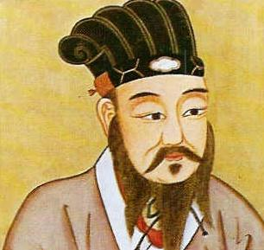
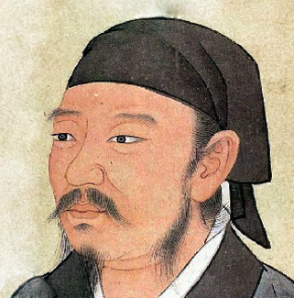
Advocates of Confucianism
Mencius
Believed human nature was good
Advocated benevolent govt.
Rulers should tax lightly, avoid war, and support education and social harmony
Advocate of ren
Xunzi
Believed humans acted on own self-interest and wouldn’t sacrifice for the state
Advocated clear, well-publicized standards of conduct
Did believe humans could improve and restore society
Advocate of li

Slide 6
Social Impact of Confucianism
Becomes foundation of Chinese government
Reinforced importance of patriarchal relationships
Reinforced family as the center of Chinese society
Emphasized education as path to success
Japan, Korea, Taiwan, Singapore are influenced by Confucian ethic

Slide 7
Daoism (Taoism)
Founded by Laozi (6th cent. BCE?) during the Warring States Period
Everything revolves around the universal force called the Dao (“The Way”)
Goal: Create societal harmony by living according to the natural laws of the universe (live in harmony with nature)
Retreat from the world of politics and ambition (live simply) as they haven’t solved the problems of the world

Slide 8
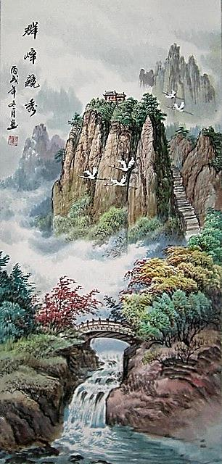
Impact of Daoism
Idea that the less govt. the better
Encourages respect for nature
Heavily influenced Chinese art and literature
Landscape paintings
Yoga and meditation
Hygiene and cleanliness
Medicine
Daoism and Confucianism can co-exist as they are not exclusive and the self knowledge and respect for nature aspect of Daoism appealed to Confucians

Slide 9
Greatest Daoist Master

Slide 10
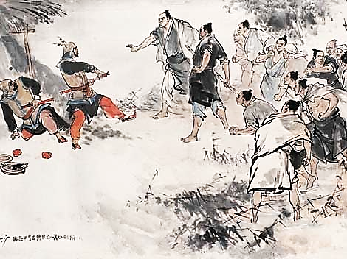
Legalism
Neither Confucianism and Daoism created social order
Legalism beliefs
A highly efficient and powerful government is the key to social order
Punishments are useful to maintain social order (clear laws and strict and swift punishment)
Thinkers and their ideas should be strictly controlled by govt.
Legalism was not popular, but was effective in creating social order

Slide 11
Yin and Yang
A concept depicted as a circle with two halves that live in harmony
Yin – earth, female, passive
Yang – heaven, male, active
Early Chinese thinkers thought pain was caused by the imbalance in the body between the forces of yin and yang
Acupuncture helped to restore this balance by releasing blocked energy

Slide 12
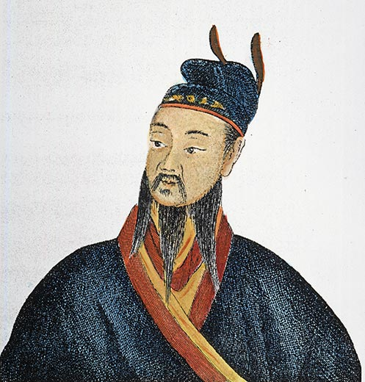
The First Emperor
Shi Huangdi – the Qin ruler who employed Legalism to subdue warring states and unify his country
Defeated neighbors
Crushed resistance to his rule
Forced noble families to live in the capitol, then seized their land, and sent his ministers to rule their provinces
Doubled China’s size

Slide 13
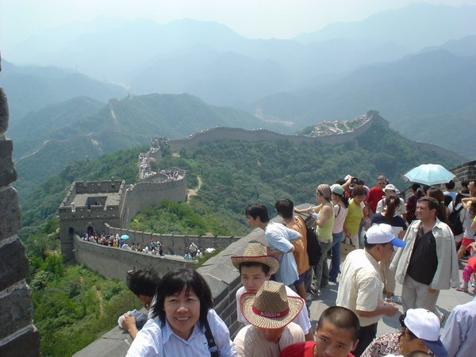
Great Wall of China
Original wall built in ancient dynasty to keep northern invaders out
The walls had gaps in them
Shi Huangdi ordered the completion of the wall to fill the gaps
Hundreds of thousands of peasants were forced to give their labor to work on the project

Slide 14
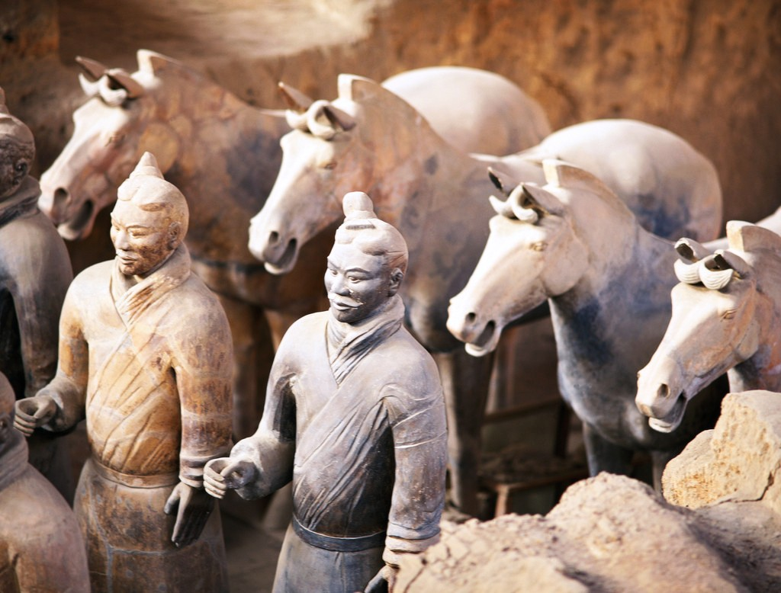
End of Qin Dynasty
Shi Huangdi died relatively young
His death left chaos
Peasants, who were upset with high taxes, forced labor, and severe punishments, rebelled
Rival leaders fought for control in the ensuing civil war
Terra cotta army found in Shi Huangdi’s tomb

Slide 15
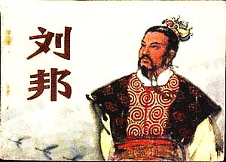
Han Dynasty
Liu Bang – won the civil war following Shi Huangdi’s death and began a new dynasty of rulers that lasted over 400 years (roughly coinciding with the Roman Empire)
He followed Shi Huangdi’s policy of establishing centralized government with hundreds of local ministers in the provinces reporting to his central government
Unlike Shi Huangdi, he lowered taxes and softened the harsh punishments to gain popular support
The Chinese people appreciated the peace and stability his rule brought

Slide 16
Han Civil Service
To run this huge empire required over 100,000 workers (civil servants)
To fill many of the positions applicants were tested in their knowledge of Confucianism
Confucianism supported qualities seen as helpful in governing (truthfulness, respect, diligence, kindness, etc.)
Some peasants would raise the money to train one of their sons to see if they could pass the exams (to lift them out of poverty)
In reality, only sons of wealthy landowners had much of a chance to get these good jobs

