Slide 1
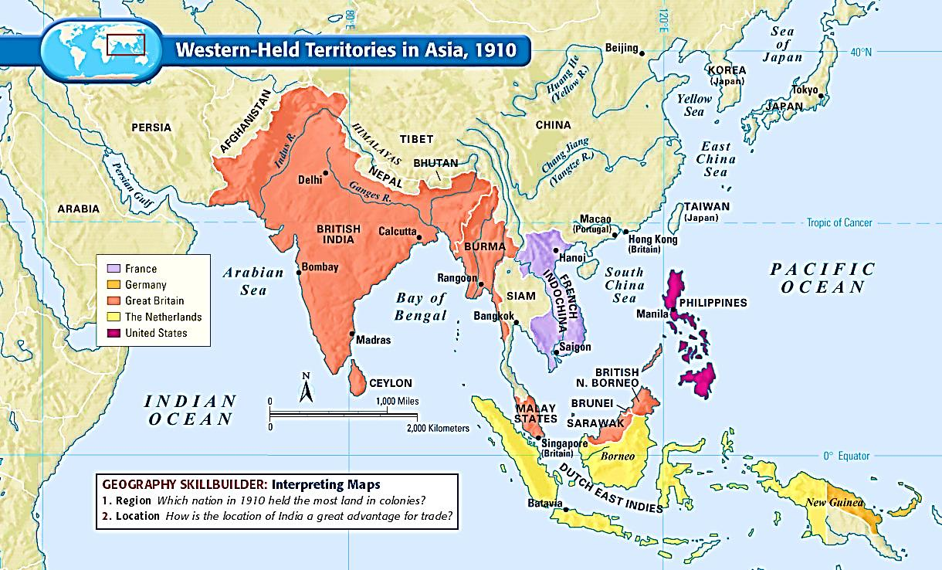
Modern World History Chapter 11, Section 5 Imperialism in Southeast Asia

Slide 2
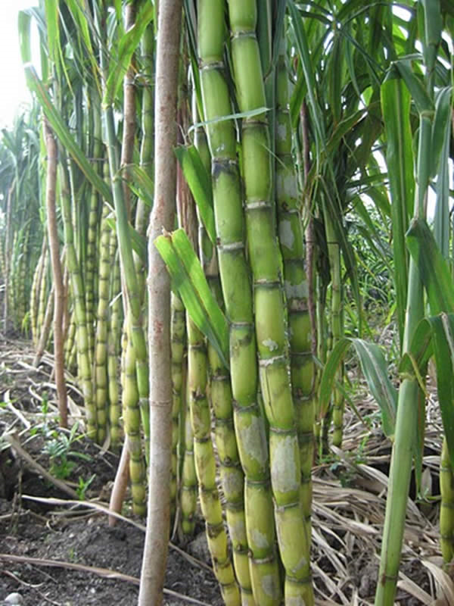
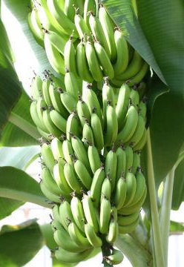
European Powers Invade the Pacific Rim
Pacific Rim – the countries that border the Pacific Ocean
SE Asia important as it is in a strategic location on sea route to China
SE Asia a source of minerals, oil, and tropical agricultural products (sugar cane, coffee, cocoa, rubber, coconuts, bananas, pineapples)

Slide 3
European Powers Invade the Pacific Rim
Dutch – using the Dutch East India Company they took control of most of Indonesia (Dutch East Indies) by the early 18th century and profited off of plantations, and oil and tin
British – tried to compete with the Dutch and took Malaysia, Singapore, and Burma to profit mostly off of tin and rubber
French – invaded Vietnam after 7 French missionaries were killed there; later took Laos and combined it with Vietnam to create French Indochina

Slide 4
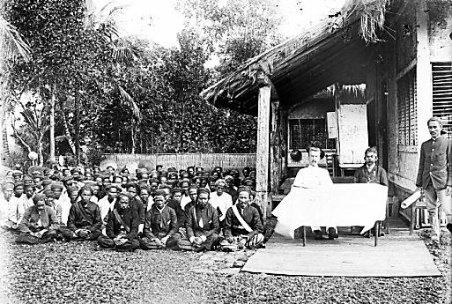
Colonial Impact on Southeast Asia
Economies grew as cash crops were valued on the world market (though most of profits fell into European hands)
Roads, railroads, and harbors improved
Education, sanitation, and health improved
Millions of people from other parts of Asia migrated there for jobs (leading to racial and religious clashes after independence )

Slide 5
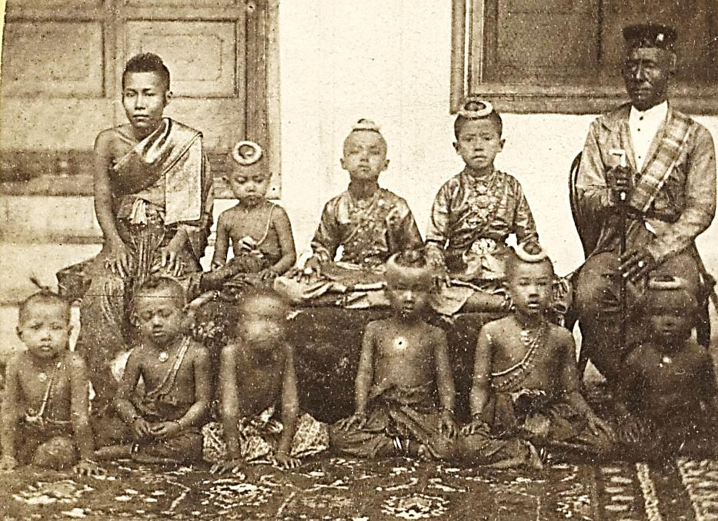
Siam Remains Independent
Siam maintained its independence by skillfully positioning itself as a neutral zone between British Burma and French Indochina
King Mongkut and his son Chulalongkorn modernized Siam by building schools, reforming the legal system, ending slavery, building railroads and telegraph lines
Siamese people escaped the social turmoil, racists treatment, and economic exploitation of other countries controlled by foreigners

Slide 6
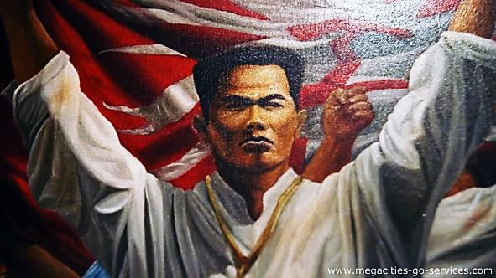
US Imperialism – Philippines
The Philippines had been a Spanish colony until the US took it over in the Spanish American War in 1898
Filipino nationalists led by Emilio Aguinaldo declared independence and fought against the US
The US won and promised the would eventually give them self-rule
Like other colonies, the US helped modernize the Philippines, but cash crop farming led to food shortages
US granted the Philippines independence following WWII, but the US maintained naval bases there

Slide 7
US Imperialism – Hawaii
US businessmen who owned sugar plantations in Hawaii dominated the islands politically and economically
The US passed a tariff law that made sugar from Hawaii less profitable unless Hawaii was annexed by the US
Queen Liliuokalani called for a new constitution that would take power from the planters and give it back to the Hawaiians
The planters led by Sanford Dole overthrew the queen and declared Hawaii a republic
US soon annexed Hawaii

