Slide 1
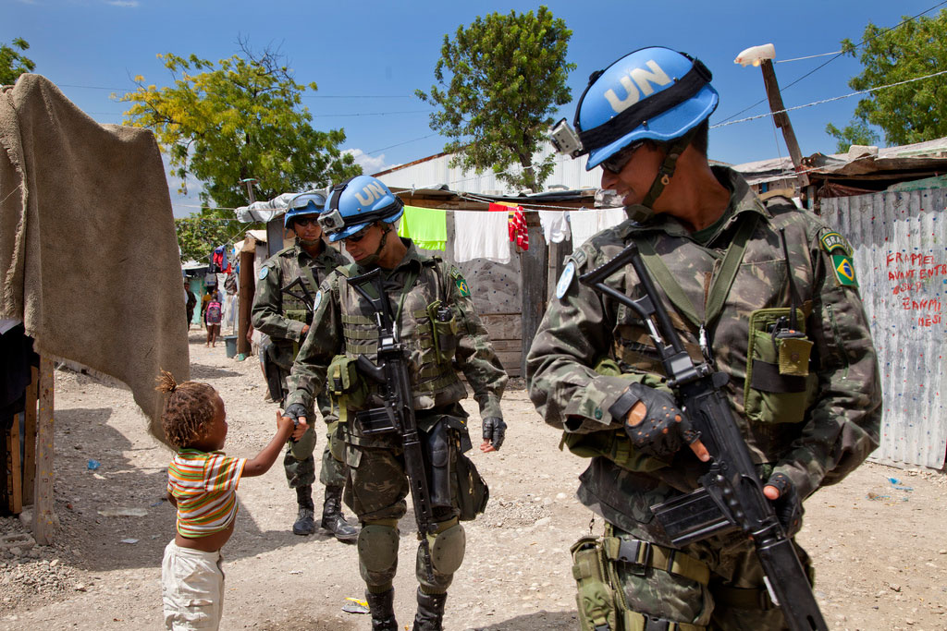
Modern World History Global Security Concerns Assign. #6-3 (first half)

Slide 2
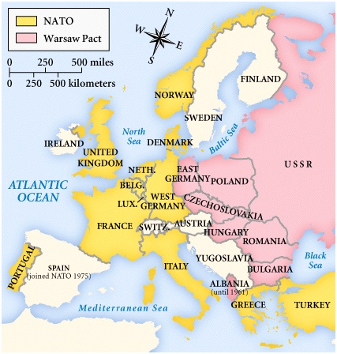
Collective Security After WWII (#1)
United Nations (U.N.)
North Atlantic Treaty Organization (NATO) – alliance of democratic, capitalist nations led by the U.S. during the Cold War
Warsaw Pact – alliance of communist nations led by the Soviet Union during the Cold War
South East Asia Treaty Organization (SEATO) – created collective security of nations in SE Asia
Africa and Europe attempt to create organizations to allow for economic and political economic security as well

Slide 3
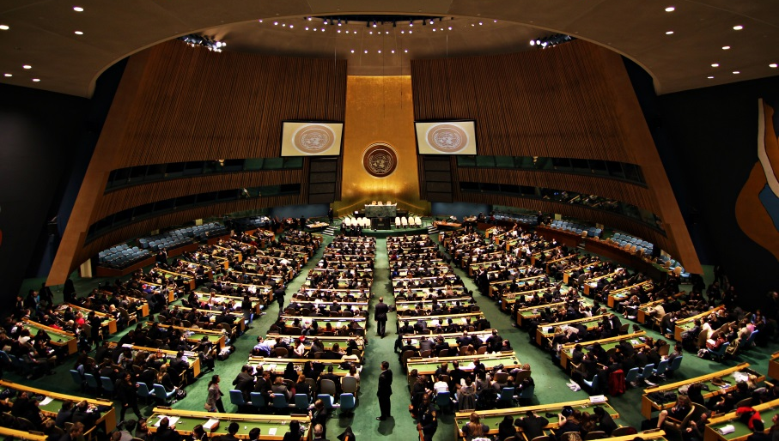
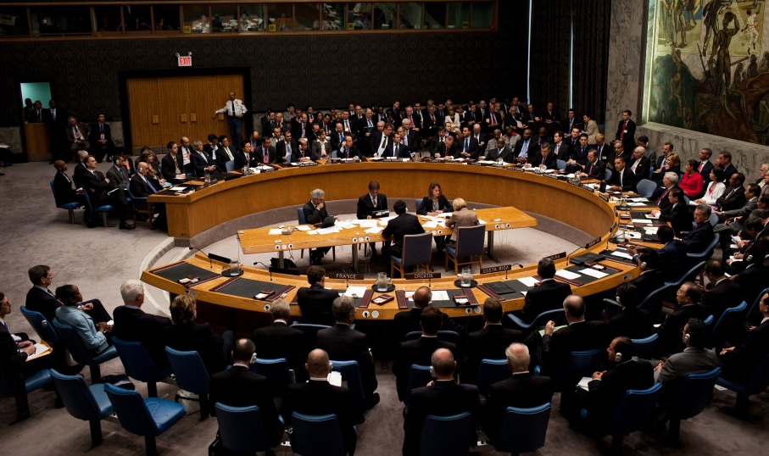
United Nations (#2)
The U.N. was created as part of the Yalta Agreement at the end of WWII, and is located in New York City
It had limited ability to solve problems during the Cold War and due to veto power of Security Council members
It provides a public forum for negotiating to solve problems between nations
Its separate agencies handle problems related to food, economic trade, children, women, and genocide

Slide 4
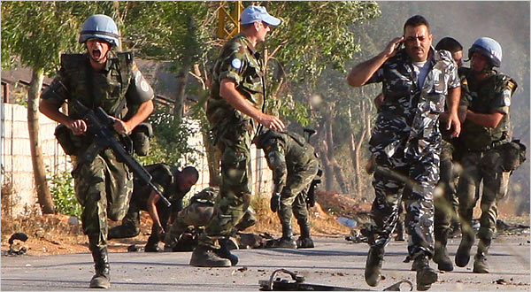
United Nations Peacekeeping Missions (#2)
U.N sends peacekeeping forces made up of soldiers from around the world to keep the peace
These forces monitor elections, stop genocide, and allow for peace negotiations between warring sides

Slide 5
Weapons of Mass Destruction (#3)
Weapons of Mass Destruction (WMDs) include nuclear, chemical, and biological weapons and are designed to kill thousands, even millions, of people
Nuclear Non-Proliferation Treaty – signed by many nations since 1968 to try to stop the spread of nuclear weapons to new nations
BLUE – Nuclear free nations
RED – have nuclear weapons and signed the NPT
PINK – have nuclear weapons and have not signed the NPT
WHITE – protected by U.S. nuclear weapons

Slide 6
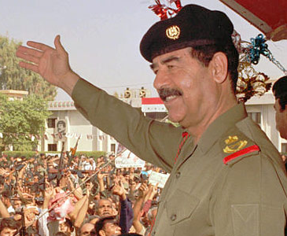
Saddam Hussein’s Rule
Saddam Hussein was dictator of Iraq
He had political opponents executed
He used chemical weapons against Iraqi citizens who were part of the minority group called Kurds
He invaded the small neighboring nation of Kuwait in 1991
Saddam Hussein

Slide 7
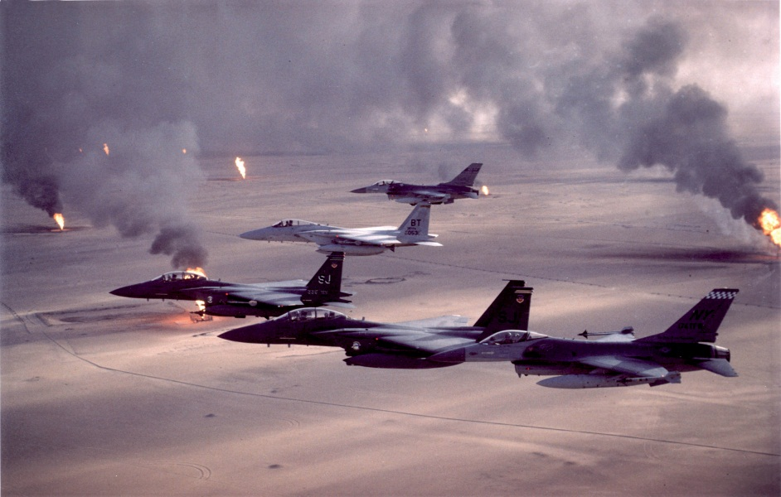
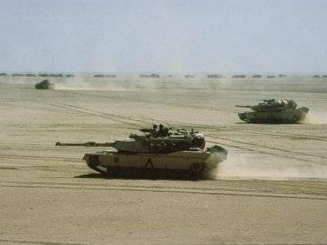
The Persian Gulf War
The U.S. led a coalition of nations backed by the United Nations in military action against Iraq
Iraqi forces were first pushed out of Kuwait and then U.N. forces moved toward the Iraq capitol, Baghdad

Slide 8
Operation Desert Storm (U.S. name for Persian Gulf War military action)

Slide 9
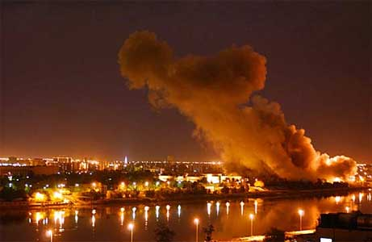
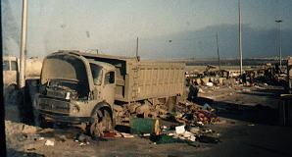
Saddam Hussein Stays in Power (#4)
Before taking over Baghdad and removing Saddam Hussein from power, the U.N. votes to stop military action
Rules are placed on Saddam Hussein and his govt. which he repeated breaks over the next 12 years
No planes in “no fly zones near borders”
Allow Weapons Inspectors to check for WMDs
U.S. responds 3 different times with missile strikes on military targets in Iraq

Slide 10
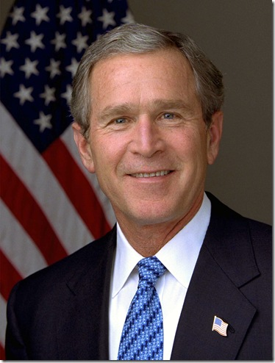
Iraq War (#4)
The U.S. becomes fed up with Saddam Hussein and his govt. for violations of the cease fire agreement that ended the Persian Gulf War
The U.N. does not vote to invade Iraq (France uses its veto power to block it)
The U.S. sets up its own coalition of nations to invade Iraq in 2003
Iraq military quickly defeated
President George Bush

Slide 11
Part of War on Terror?
The major arguments of the Bush Administration for going to war with Iraq was that Iraq was connected to Al Qaeda terrorists and that Iraq possessed WMDs
No WMDs were found
U.S. Govt. concludes in 9/11 Report that links to Al Qaeda in Iraq are minimal and that Al Qaeda involvement goes up only after U.S. troops arrive

Slide 12
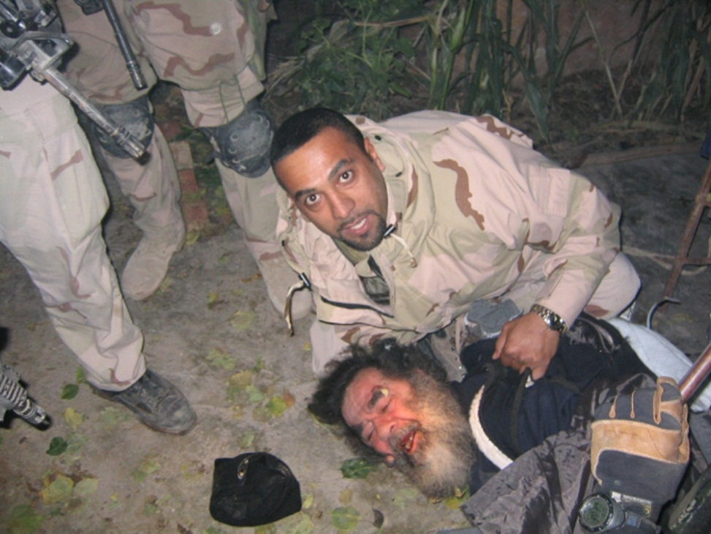
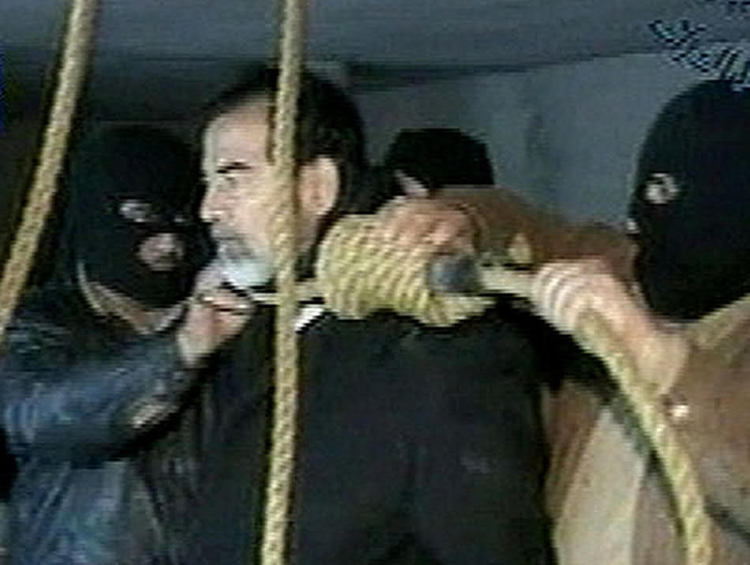
A Troubled Democracy in Iraq
A new democratic govt. is set up
Saddam Hussein was captured, tried and executed by the Iraqis
Different factions in Iraq fight for a majority control of the new govt.

Slide 13
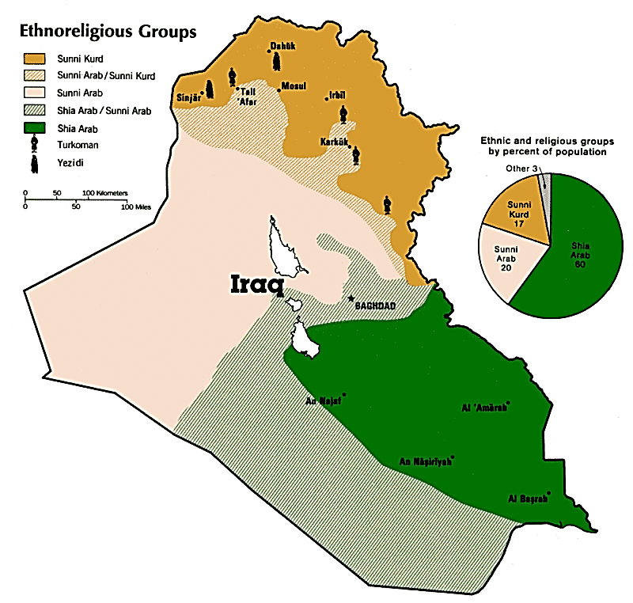
Fight for Control of Iraq
Conflict between the 3 major ethnic and religious groups there makes governing Iraq difficult
Sunni Muslims (who had supported Saddam)
Shia Muslims (the majority group)
Kurds (the smallest group, but in oil rich area)
Radicals from each of the ethnic and religious groups continue to fight the new Iraqi govt. and U.S. forces
A troop surge in 2007 by Pres. Bush is seen as successful in stabilizing the Iraqi govt.’s control of the nation

Slide 14
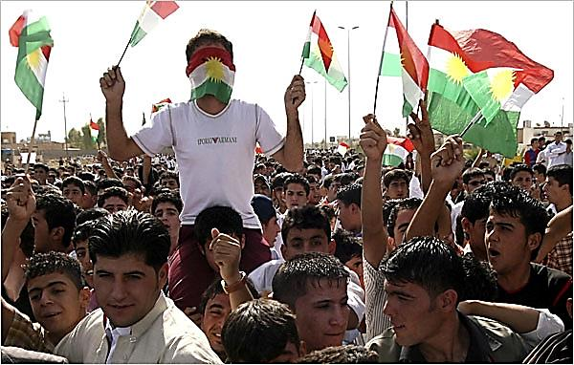
The Kurds (#5)
Kurds are an ethnic group in Southwest Asia
They are a minority in three nations (Iraq, Iran and Turkey)
They have faced discrimination in each of these nations
Nationalist groups of Kurds strive for a new nation for themselves (see top left)
They were attacked with chemical weapons by Saddam Hussein in Iraq in the 1980s to wipe them out
Their land is desired by other groups due to the oil reserves located there

Slide 15
Status of Women (#6)
In non-Western nations women faced discrimination in jobs and were denied access to education
Women were often victims of violence and abuse in nations torn by civil war and ethnic conflict
Since the 1970s, however, more nations passed laws protecting the rights of women
Still, women face gender inequality throughout the world

