Slide 1
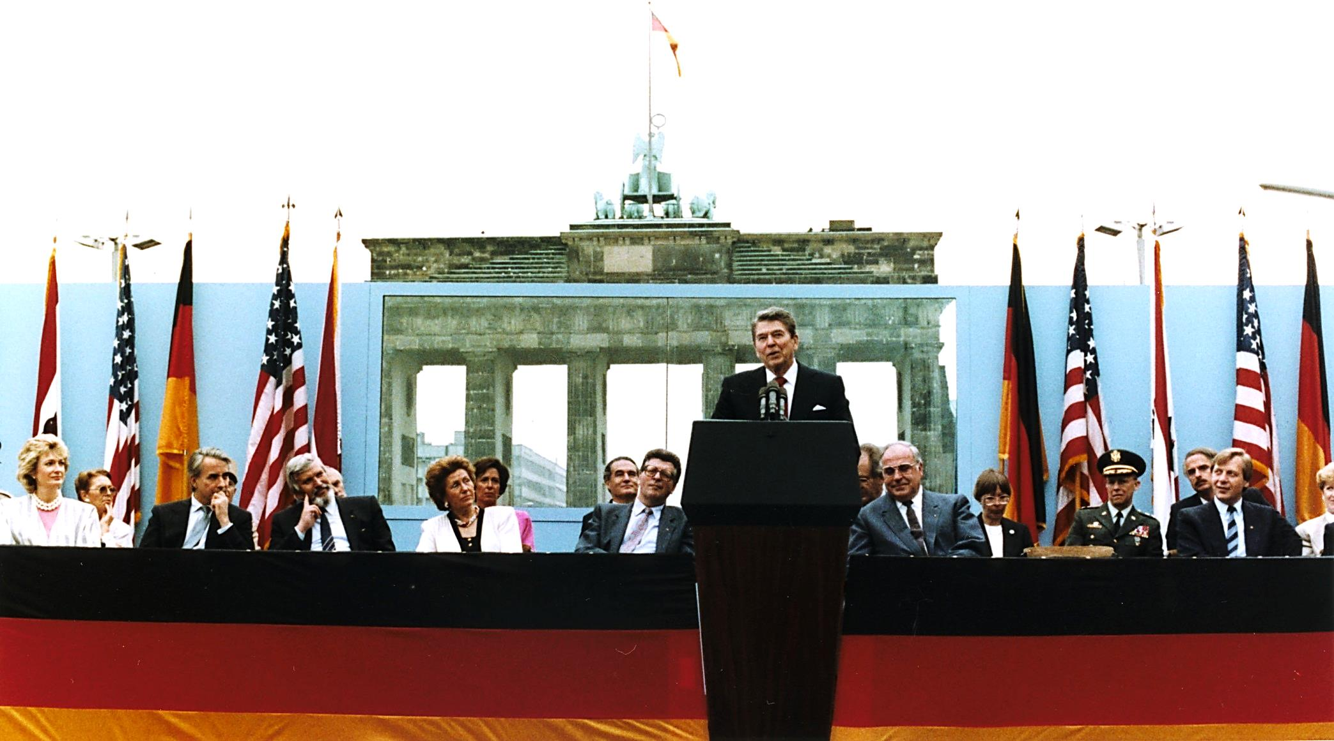
Modern World History Cold War Ends Assign. #4-5
“Mr. Gorbachev, tear down this wall!”

Slide 2
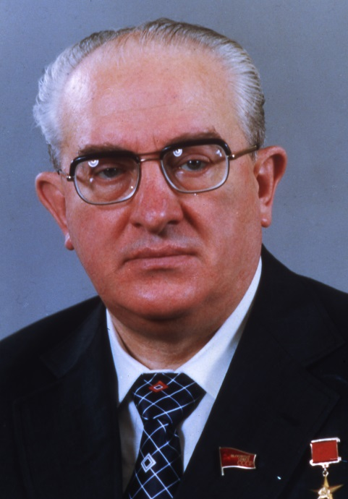
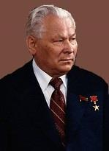
Leonid Brezhnev (#1)
Nikita Khrushchev was voted out of power after the Cuban missile crisis
He was replaced by Leonid Brezhnev, who quickly adopted repressive domestic policies
Strict enforcement of limits to free speech and worship
Many arrests to those who opposed the communist government
Following Brezhnev’s death in 1982 the aging Soviet leadership tried to maintain control
However, two straight leaders died within a year of taking power
Leonid Brezhnev
Yuri Andropov
Konstantin Chernenko

Slide 3
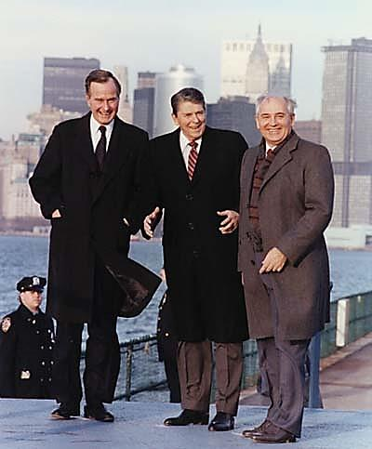
Mikhail Gorbachev (#2)
The Soviet Politburo turned to a younger man, Mikhail Gorbachev, to take over in 1985
Gorbachev was 54 years old and was praised for his youth, energy, and political skills
Soviet society had rarely changed under past Soviet leaders
People felt like Gorbachev symbolized a chance for change
The Soviet Union needed some changes as it faced serious economic problems
By the late 1980s serious economic weakness had become evident low productivity, shoddy workmanship, and severe environmental pollution
A smiling Soviet leader?

Slide 4
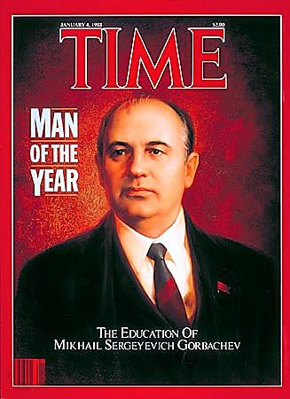
Gorbachev’s Reforms (#3)
Perestroika
a political movement within the Communist USSR’s party which allowed more independence in the markets including giving more powers to the managers of factories (making them almost private enterprises)
Glasnost
a policy where there was less censorship and greater freedom of information in the government
Democratization
the bringing of a taste of democracy to the Soviet Union, such as allowing the freedoms of assembly, speech, and religion, the right to strike, and multicandidate elections
The intention of these reforms was not to get rid of communism, but help it fit the Russian people better
Instead they undermined not only the Soviet Union's authoritarian structures, but also the familiar sense of order and predictability

Slide 5
Gorbachev’s Foreign Policy (#4)
President Ronald Reagan began the most expensive military build-up in peacetime history
The Strategic Defense Initiative (SDI) was proposed by Reagan in 1983 which was to use ground and space-based systems to protect the US from attack by strategic nuclear ballistic missiles
It resulted in an arms build up by the Soviet Union that took money from consumer goods production leading to social unrest
Gorbachev realized the Soviet Union could not keep up with the U.S. so he supported arms control to lower costs

Slide 6
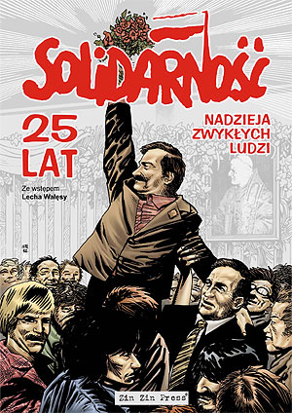
Solidarity in Poland (#5)
In 1980 workers at the shipyard in Gdansk led by Lech Wałęsa, signed an agreement with the government that ended a national strike
The key provision of these agreements was the guarantee of the workers' right to form independent trade unions and the right to strike
After the Gdańsk Agreement was signed, a new national union movement "Solidarity" swept Poland

Slide 7
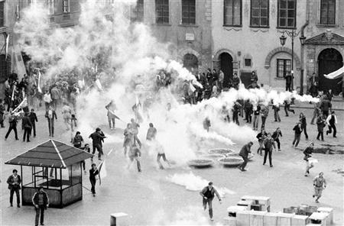
Crack-down in Poland
The discontent underlying the strikes was intensified by revelations of widespread corruption and mismanagement within the Polish state and party leadership
The Soviet Union brought troops and tanks to the border of Poland
The regime declared martial law, under which the army and riot police were used to crush the union
Virtually all Solidarity
leaders and many affiliated
intellectuals were arrested
or detained.

Slide 8
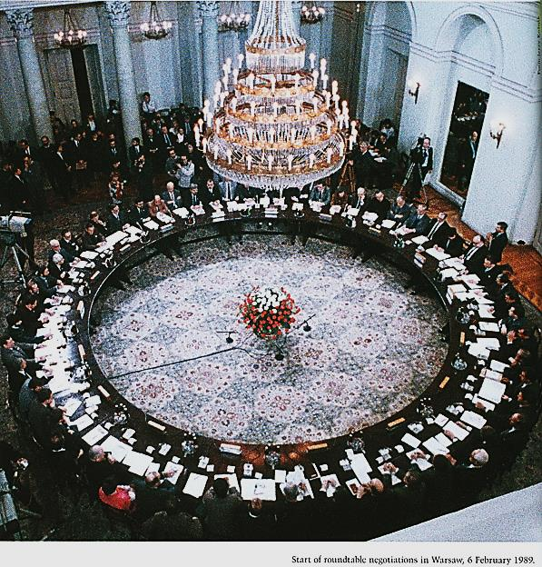
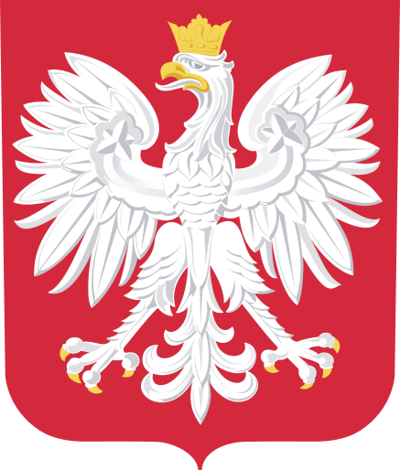
Polish Independence (#5)
The government's inability to forestall Poland's economic decline led to waves of strikes across the country in April, May and August 1988
With the Soviet Union increasingly destabilized, in the late 1980s the government was forced to negotiate with Solidarity in the Polish Round Table Negotiations
The resulting Polish legislative elections in 1989 became one of the important events marking the fall of communism in Poland

Slide 9
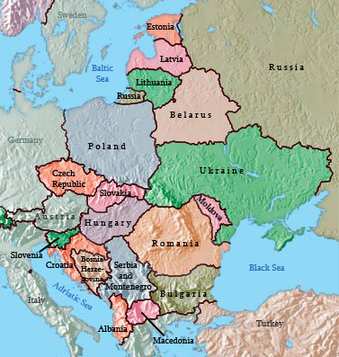
Other countries getting their Independence after Poland (#6)
The events began in Poland in 1989, and continued in Hungary, East Germany, Bulgaria, Czechoslovakia and Romania
In each nation there were campaigns of civil resistance demonstrating popular opposition to the continuation of one-party rule and contributing to the pressure for change
Romania was the only Eastern Bloc country to overthrow its Communist regime violently

Slide 10
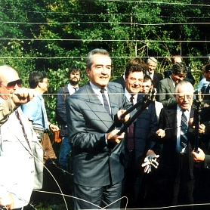
Hungary
Hungary was next to revert to a non-Communist government
Although Hungary had achieved some lasting economic reforms and limited political liberalization during the 1980s
In 1989 the parliament adopted legislation providing for multi-party parliamentary elections and a direct presidential election
The legislation guaranteed human and civil rights, ensured separation of powers among the judicial, legislative, and executive branches of government

Slide 11
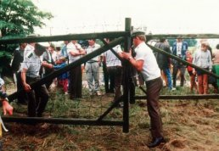
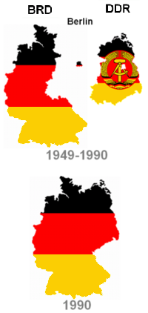
East Germany
When Hungary opened its border with Austria, East Germans found a way to get out by going through Hungary
When the East German government tried to block this, demonstrations took place across East Germany
Soviet leader Mikhail Gorbachev visited East Germany and urged the East German leader, Erick Honecker, to accept reforms
Without Soviet backing Honecker stepped down and the borders with Czechoslovakia were opened

Slide 12
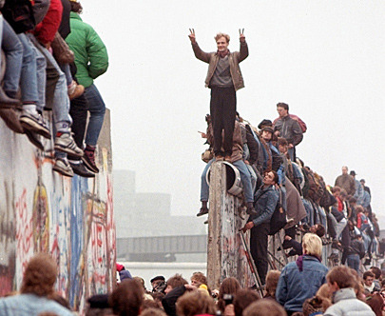
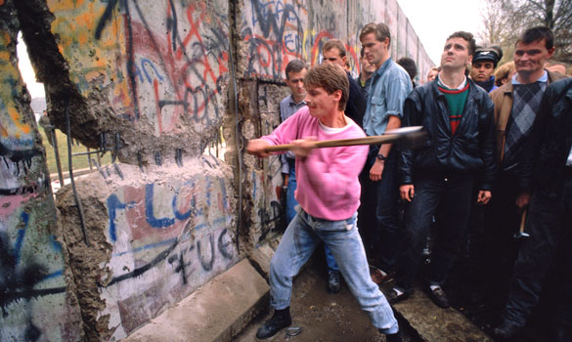
The Fall of the Wall
The wall stayed up for 23 years until November 9, 1989 when East Germany government announced that they were going to open part of the wall up to let people move from each side.
Many people from East Berlin ran to the wall to make their transfer to western Europe.

Slide 13
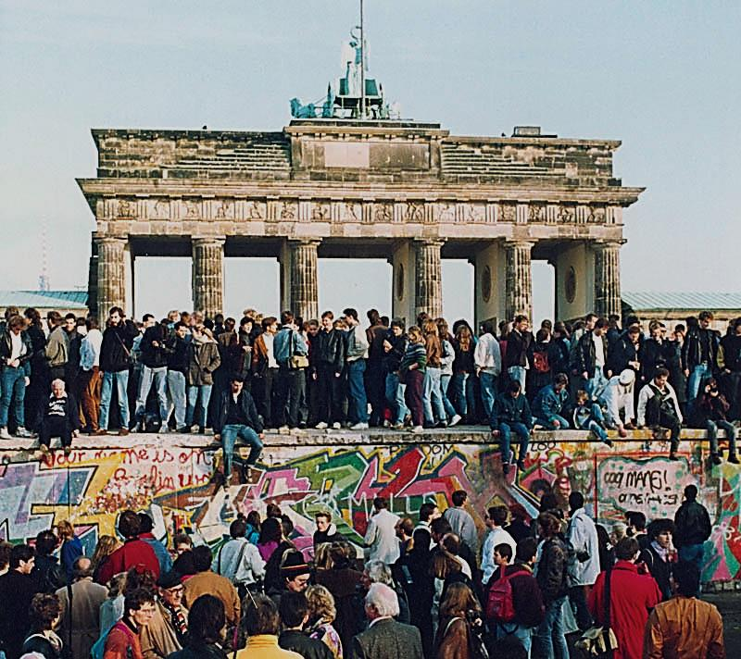

Slide 14
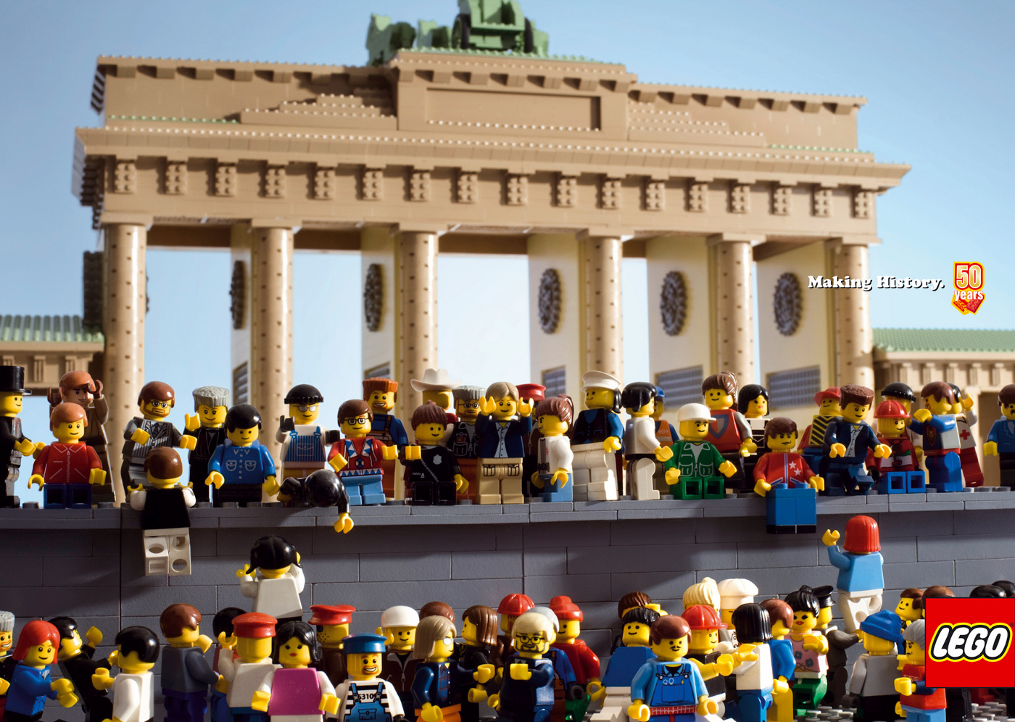

Slide 15
Reunification of Germany (#7)
With the tearing down of the Berlin Wall many people spoke about reunifying East and West Germany
Others feared a strong Germany (remember WWII?)
West German Chancellor Helmut Kohl assured the world that Germany had learned from its past and Germany was united in 1990
A reunified Germany faced many problems;
East Germany had been left in ruins during communist rule
It needed modern railroads, highways, telephone system, etc.
Inefficient factories in East Germany that couldn’t compete on the world market closed leading to high unemployment rates
Rebuilding East Germany would be expensive
West Germans were heavily taxed to pay for it
Inflation was also high

Slide 16
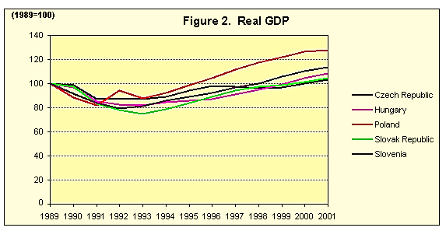
Economic Problems in Eastern Europe (#8)
Each nation attempted to install a market economy (privately owned businesses)
Each nation saw people becoming unhappy with the slow pace of change
Economic reforms led to struggles with unemployment, inflation, poverty, etc.

Slide 17
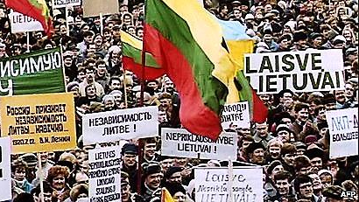
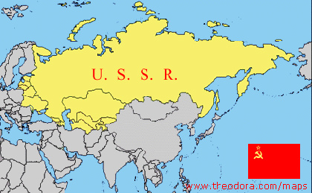
Break-up of the USSR (#9)
The Russian population long dominated the Soviet state
The smaller republics with Russian ethnic minorities saw what was happening in Eastern Europe and wanted independence themselves
At first Gorbachev opposes the independence of republics such as the Baltic states and imposes sanctions on Lithuania (1st to challenge)
Eventually as Estonia, Latvia and Lithuania declare themselves independent Gorbachev announces he will not intervene militarily
Other republics began to move toward independence as well

Slide 18
Gorbachev’s Unpopularity (#10)
An assault by Soviet troops on unarmed civilians in Lithuania and the lack of economic progress damaged Gorbachev’s popularity
Once Gorbachev made reforms to the system, the population wanted more change
Instead of wanting more small reforms by Gorbachev, people wanted a complete overthrow of the communist system of government

Slide 19
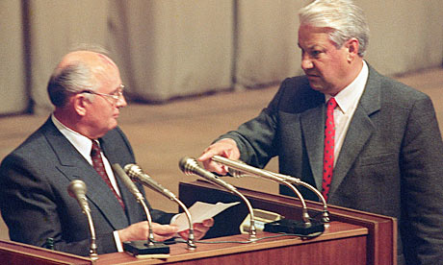
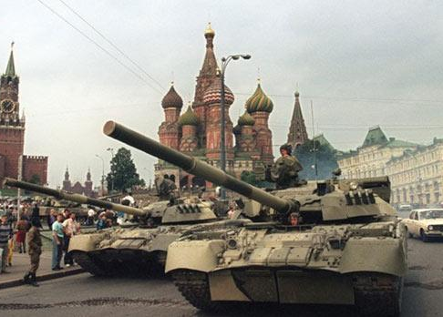
1991 August Coup (#11)
Hardliners in the Soviet leadership, calling themselves the 'State Emergency Committee,' launched the August coup in 1991 in an attempt to remove Gorbachev from power
During this time, Gorbachev spent three days (August 19-21) under house arrest at a dacha in the Crimea before being freed and restored to power
However, upon his return, Gorbachev found that neither union nor Russian power structures heeded his commands

Slide 20
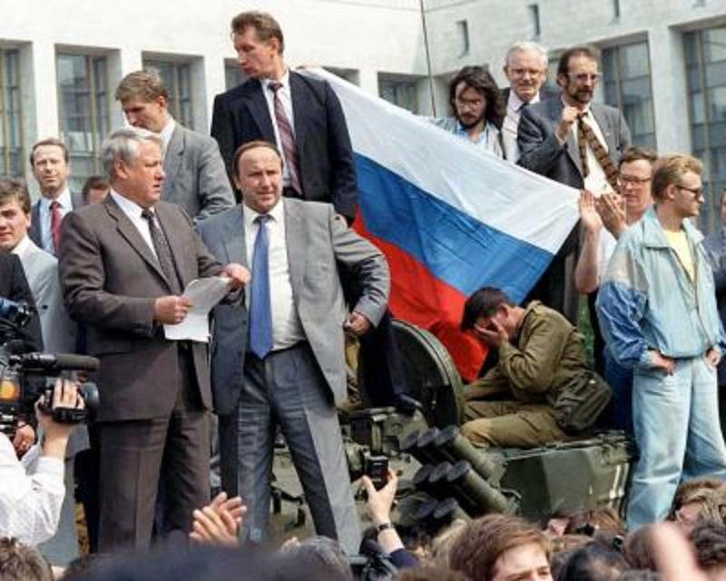
Boris Yeltsin
Boris Yeltsin was the President of the Republic of Russia within the USSR
During the August coup Yeltsin defied the military forces loyal to the hardliners who headed the coup and declared himself in charge
When Gorbachev returned power had swung over to Yeltsin, whose defiance had led to the coup's collapse

Slide 21
Dissolution of the USSR
The presidents of Russia, Ukraine and Belarus met in Belovezh Forest, near Brest, Belarus, on December 8, 1991 founding the Commonwealth of Independent States and declaring the end of the Soviet Union
After the dissolution of the USSR, Yeltsin was elected president of the Russian Soviet Federative Socialist Republic by the latter’s parliament and leaves the Soviet communist Party

Slide 22
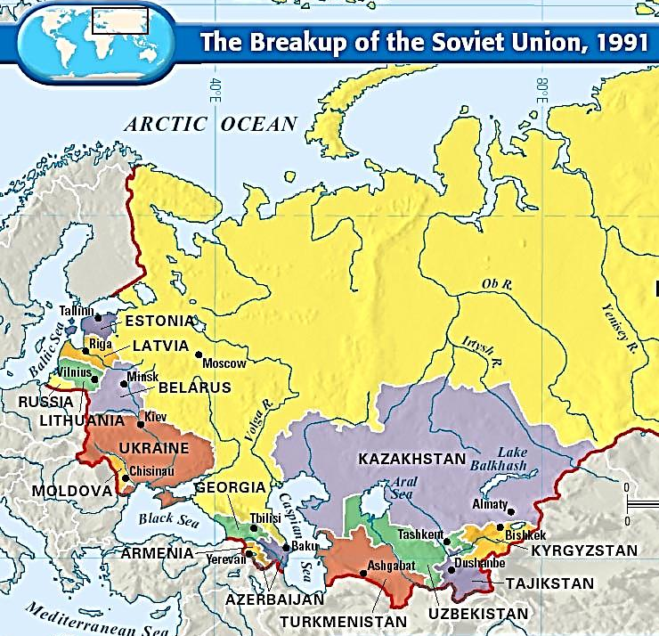
Future after the Soviet Union?
Cold War despite the threat of nuclear war kept the peace around the world relatively
Former communist nations and newly independent Soviet republics suffer growing pains switching to democracy and capitalism
Role of cold war alliances unclear (NATO)
Who has possession of all of USSR’s nuclear weapons?
What direction is Russia heading? Will it be an ally of the west?
RUSSIA

Slide 23
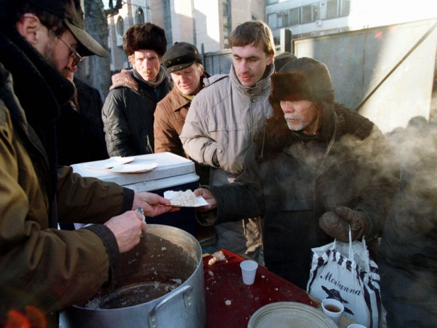
Russia Under Yeltsin (#12)
Yeltsin wanted to reform the Russian economy
“shock therapy” – abrupt shift to free-market economics, which included lowering trade barriers, removing price controls, and ending state subsidies to state-owned industries
This economic policy led to soaring prices with inflation rates of over 800%, and many factories that depended on state subsidies were forced to shut down putting thousands out of work (unemployment)
Chechnya, a largely Muslim area in southwestern Russia, fought a war for independence against Russia
The fighting in Chechnya raged throughout Yeltsin’s presidency
Yeltsin resigned in 1999, and named Vladimir Putin as acting president

Slide 24
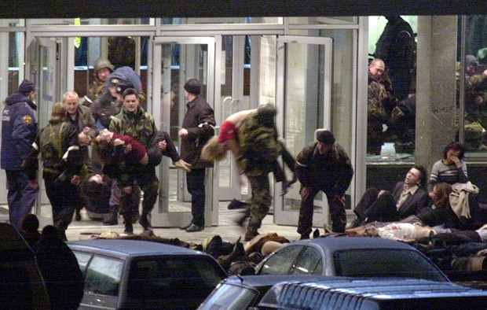
Russia Under Putin (#12)
Russia began to pull its troops out of the Chechnya region in 2002 as the war wound down
Chechen rebels seized a theater in Moscow and 150 people died in the rescue attempt by Russian forces
Economic problems also continued (unemployment, inflation, rising poverty)
Other problems: homelessness, domestic violence, population decline, lowering standard of living, shorter life expectancy
Putin won reelection and stayed in power, while opponents have been censored and arrested at times
Many worry that Russia is no longer a truly democratic nation
Russia has also seized land from former republics Georgia and Ukraine
Hostages carried out
of Moscow theater

