Slide 1
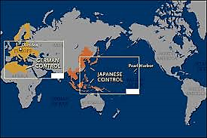
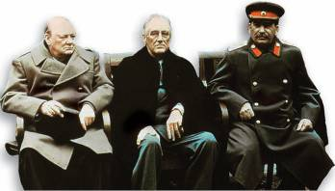
The Allied Victory Assign. #3-4 Chapter 16, Sections 4 & 5

Slide 2
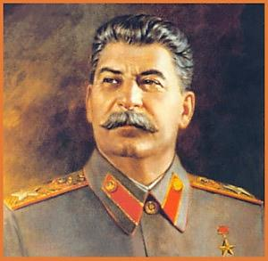
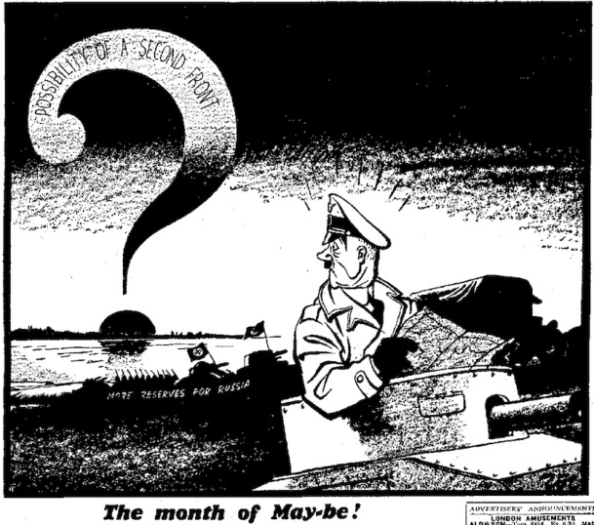
Second Front in Europe
Churchill wanted Britain and the U.S. to strike first at North Africa and southern Europe (#1)
The strategy angered Stalin. He wanted the Allies to open the second front in France (#1)
The Soviet Union, therefore, had to hold out on its own against the Germans
All Britain and the U.S. could offer in the way of help was supplies
Nevertheless, late in 1942, the Allies began to turn the tide of war both in the Mediterranean and on the Eastern Front

Slide 3
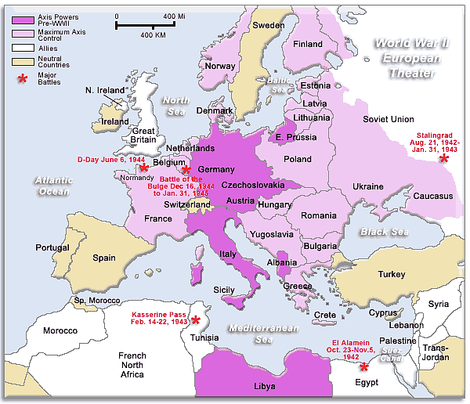

Slide 4
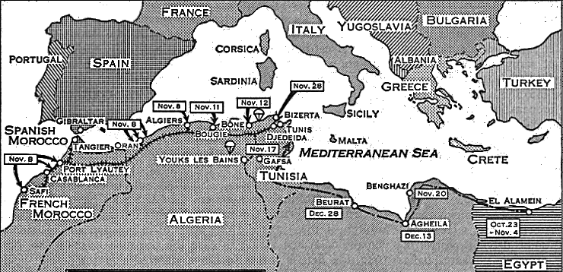
The North African Campaign (#2)
Rommel takes Tobruk, June 1942; pushes toward Egypt
British General Montgomery attacks at El Alamein, Egypt forces Rommel back
American forces land in Morocco, November 1942
General Dwight D. Eisenhower—American commander in Morocco
In May 1943, Rommel’s forces defeated by Allies

Slide 5
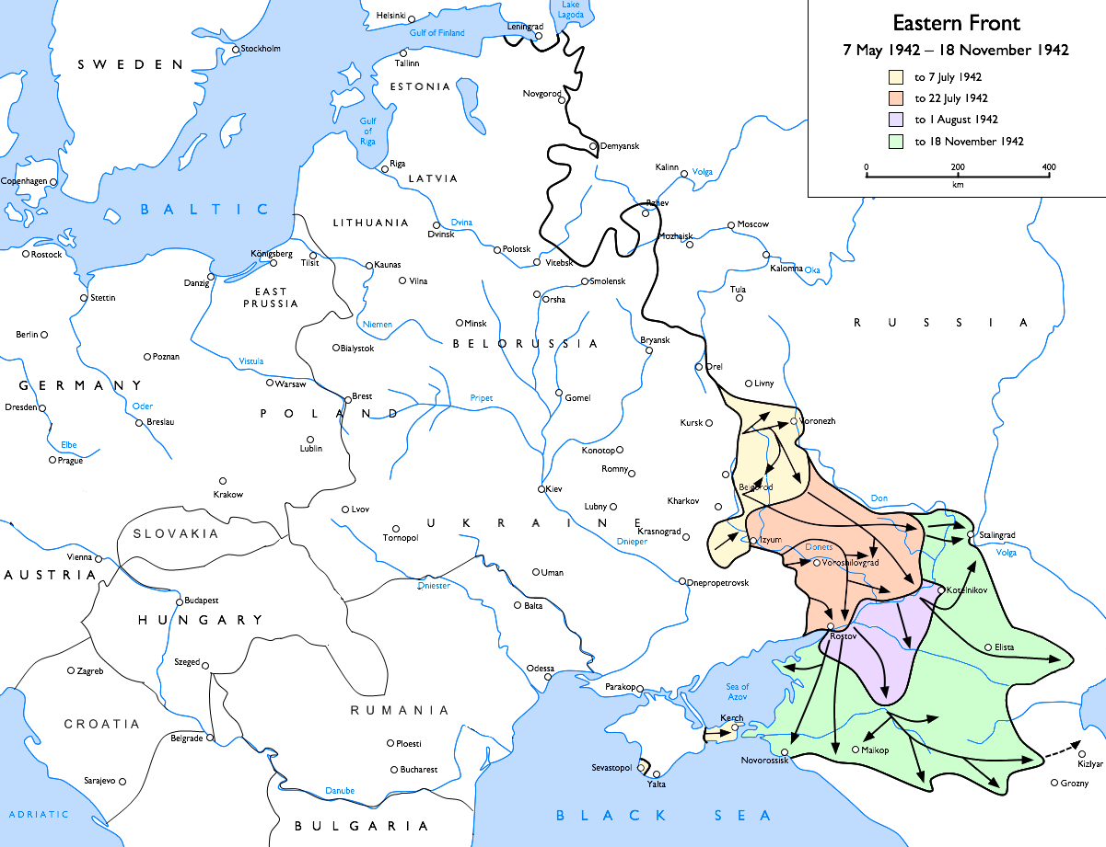
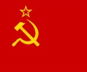
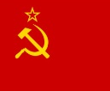
The Battle for Stalingrad
German army moves to capture Soviet oil fields
Battle of Stalingrad—Soviets, Germans battle for control of the city
German troops capture city, then surrender after a long battle.
Operation Barbarossa:
German Invasion of USSR
3 Prong Attack

Slide 6
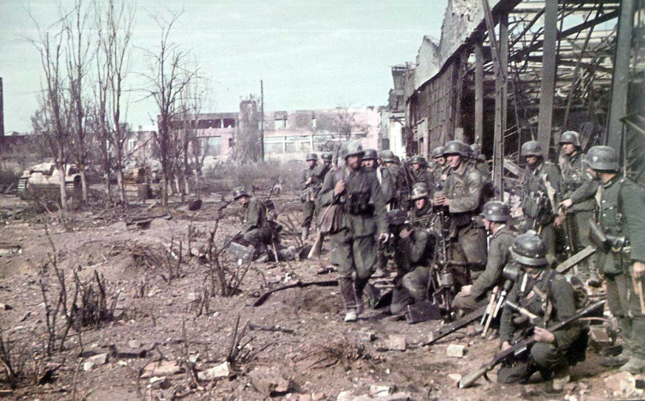
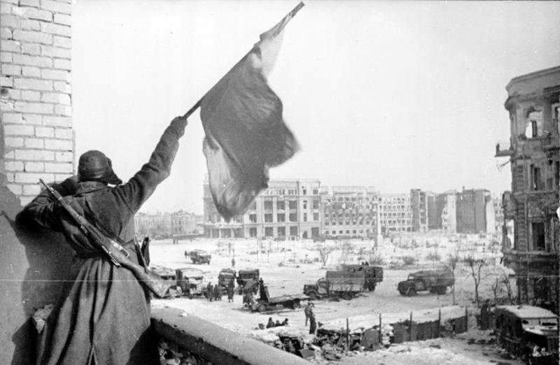
The Battle for Stalingrad
German army moves to capture Soviet oil fields (southern prong of Operation Barbarossa)
Battle of Stalingrad—Soviets, Germans battle for control of the city (watch Enemy at the Gates clip)
German troops capture city in late summer of 1942

Slide 7
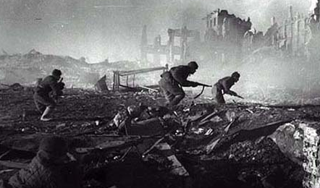
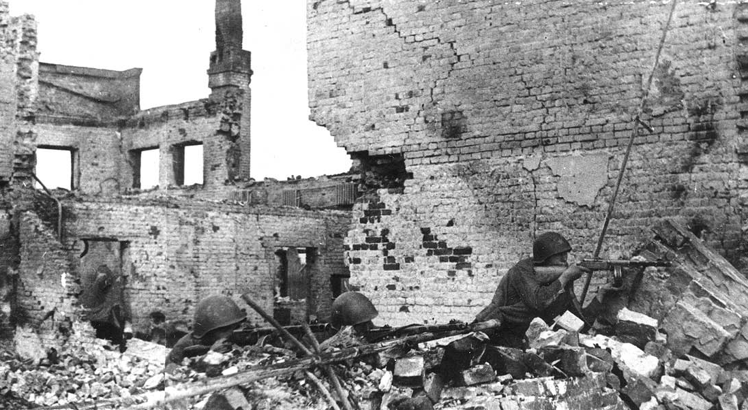
The Battle for Stalingrad
Marked by constant close quarters combat (8 min.) and disregard for military and civilian casualties, it is among the bloodiest battles in the history of warfare
The Soviet Union lost over a million lives in the battle, more than the U.S. loses in the entire war (in Europe and the Pacific)

Slide 8
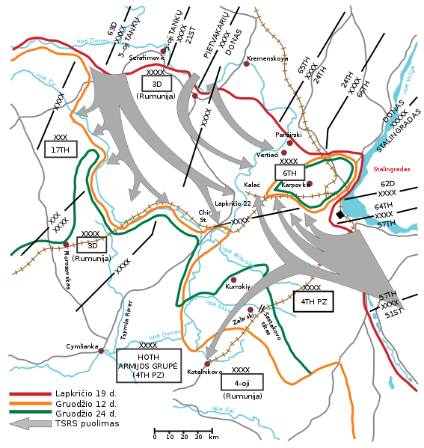
The Battle for Stalingrad (#3 & #4)
Soviet counter-attack finally surrounds the German 6th army in Stalingrad and cuts them off (#3)
Hitler refuses to allow them to surrender (#3)
German troops surrender in February 1943 after a long battle (#3)
Tank battle west of city 6 min.
It was a turning point in the European theatre of World War II (#4)
the German forces never regained the initiative in the East and withdrew a vast military force from the West to reinforce their losses (#4)

Slide 9
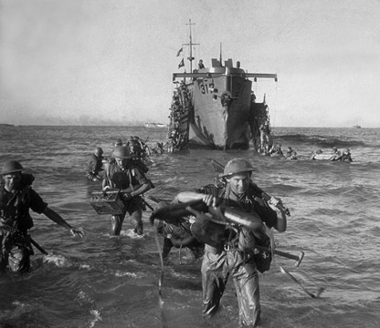
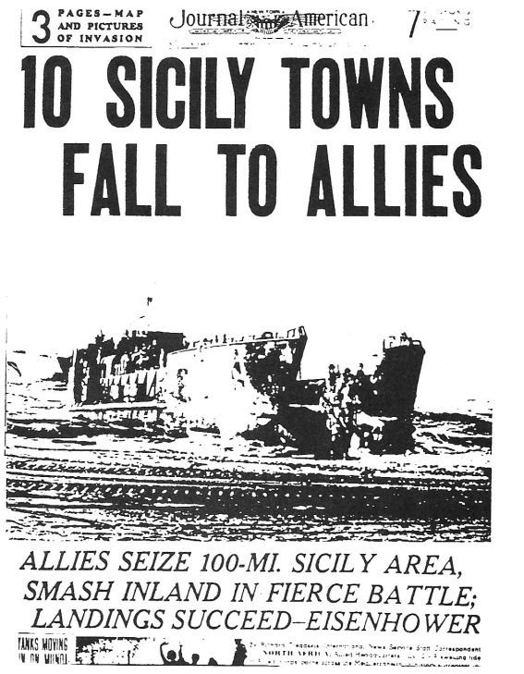
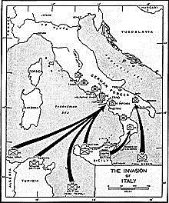
The Invasion of Italy (#5)
After victory in North Africa, Stalin again called for a second front against Germany in France
Instead, U.S. and British forces land on and capture Sicily in 1943
Mussolini loses power and Italy surrenders
The Germans still keep control of northern Italy
The fighting against the Germans there goes on until the war ends

Slide 10
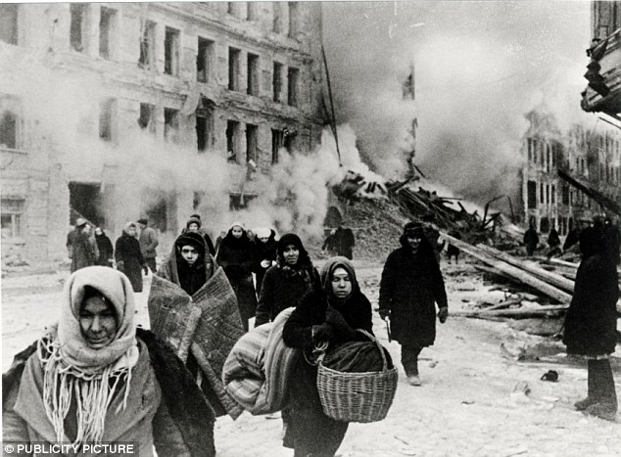
The Allied Home Fronts
Wherever Allied forces fought, people on the home fronts rallied to support them
In war-torn countries like the Soviet Union and Great Britain, civilians endured extreme hardships, and many lost their lives
Except for a few of its territories, such as Hawaii, the United States did not suffer invasion or bombing
Nonetheless, Americans at home made a crucial contribution to the Allied war effort

Slide 11
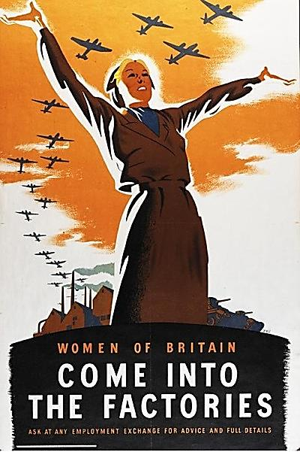
Mobilizing for War (#6)
Fighting the war requires complete use of all national resources
Factories convert from peacetime production to wartime production
17 to 18 million U.S. workers—many of them women—make weapons
People at home face shortages of consumer goods; scarce items are rationed
Propaganda aims to inspire civilians to aid war effort
Nations sold war bonds to raise money

Slide 12
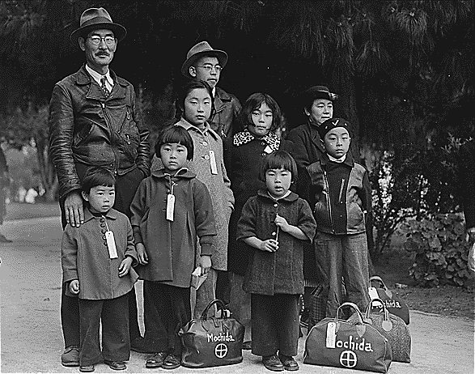
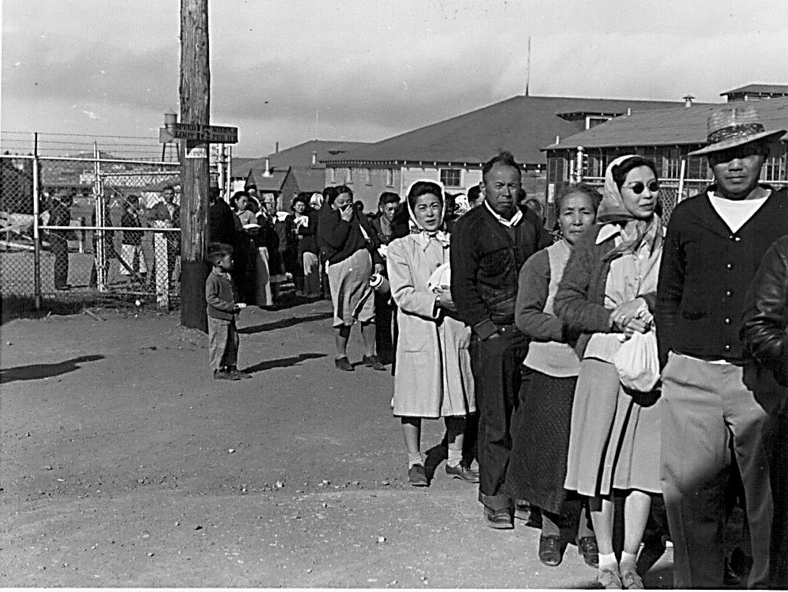
War Limits Civil Rights
Japanese Americans face prejudice and fear
Army puts Japanese Americans in internment camps in 1942 under order from FDR

Slide 13
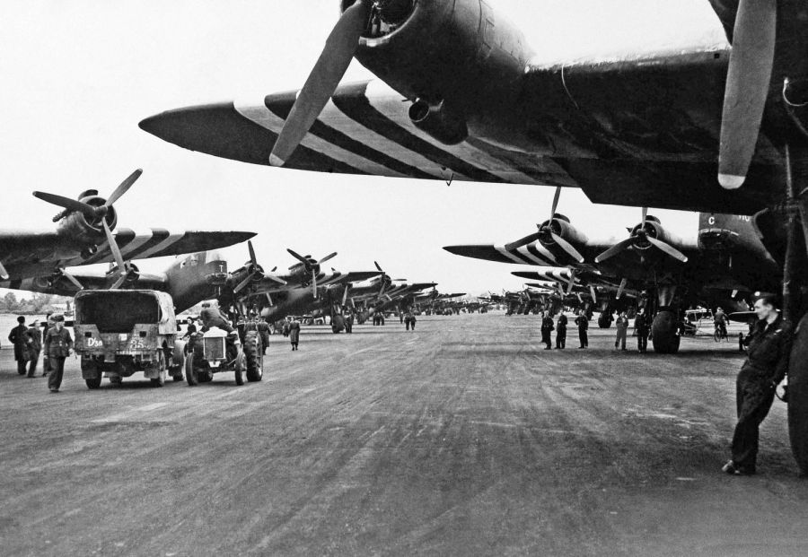
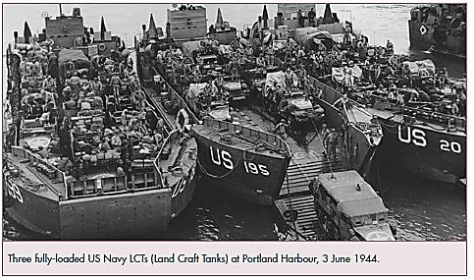
Victory in Europe
While the Allies were dealing with issues on the home front, they also were preparing to push toward victory in Europe
In 1943, the Allies began secretly building an invasion force in Great Britain
Their plan was to launch an attack on German held France across the English Channel

Slide 14
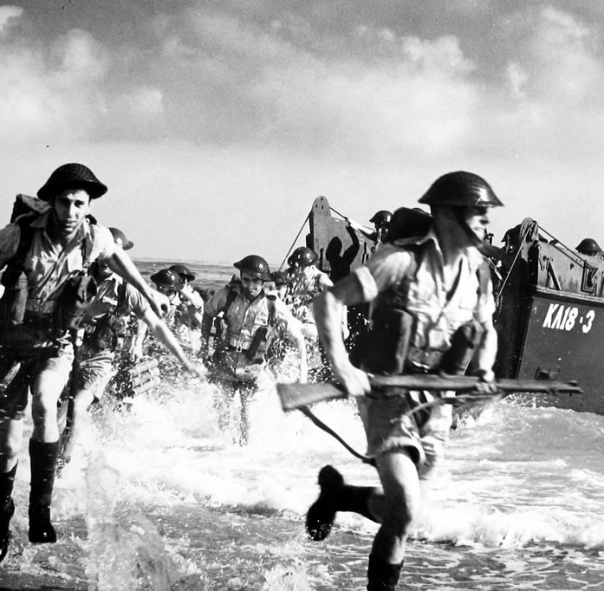
The D-Day Invasion (#7)
Allies plan invasion of France; use deception to confuse Germans
D-Day—June 6, 1944; day of “Operation Overlord” invasion of France
Thousands of planes, ships, tanks, and landing craft and 3 million troops took part
5 beaches stormed by British, Canadian, and American forces
Allied forces capture Normandy beaches despite heavy casualties

Slide 15
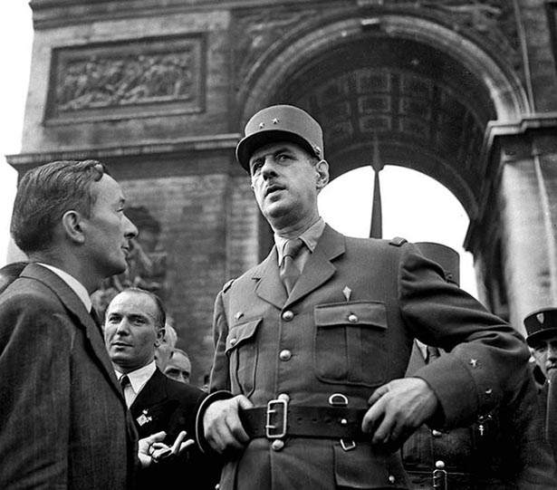
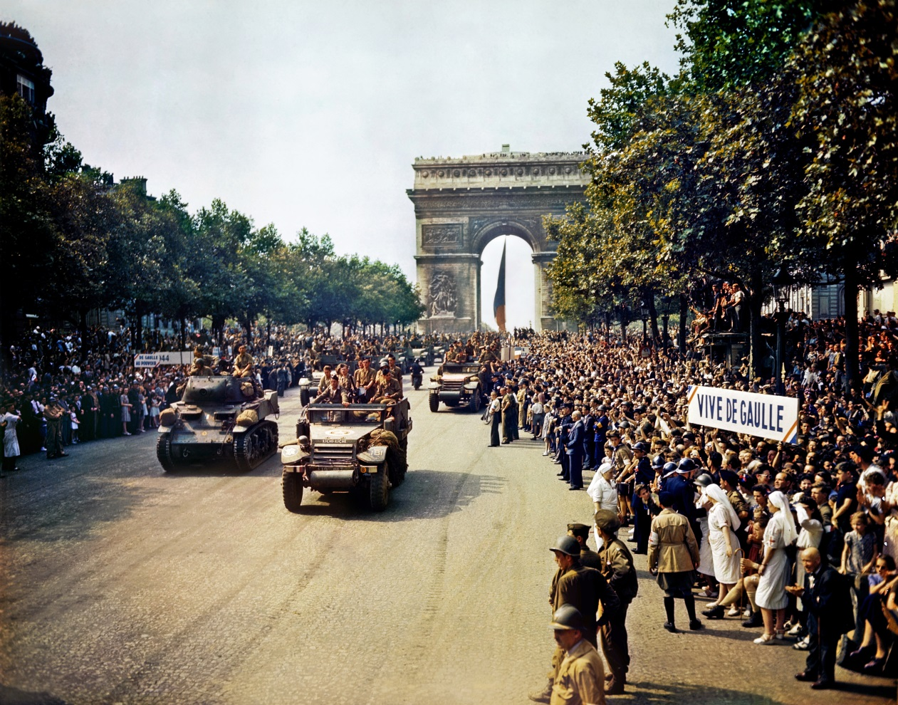
After D-Day
French
General
Charles
De Gaulle
arrives in
Paris with
the Allies
1 million more troops will land in the next month
Allies liberate Paris by end of August
France, Belgium and Luxembourg liberated in September
Allies prepare push for Germany, as Soviet Union pushes toward Germany in the east

Slide 16
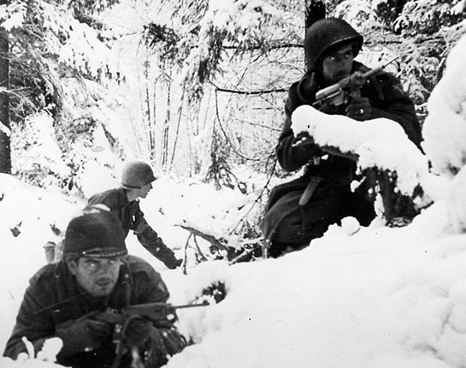
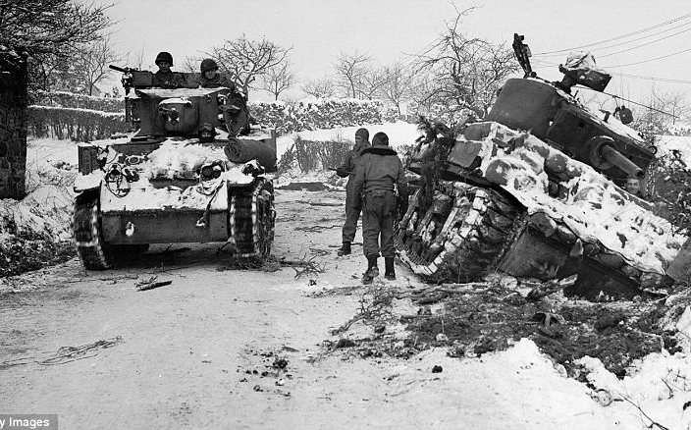
The Battle of the Bulge (#8)
With the Allies approaching their border in the west, the Germans counterattack in December of 1944
Hitler hopes to bust through Allied lines and split them and break up Allied supply lines
If successful in defeating this force he could possible negotiate for peace and avoid fighting on two fronts
Germans gain early success (and battle lines bulge), but they cannot burst through and are forced to retreat

Slide 17
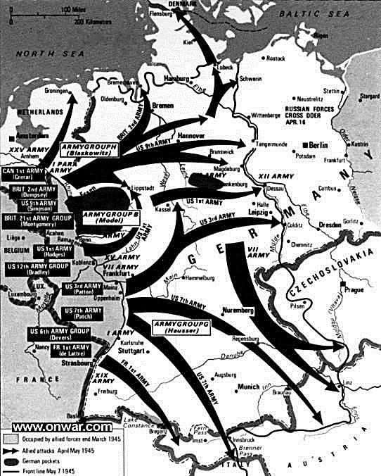
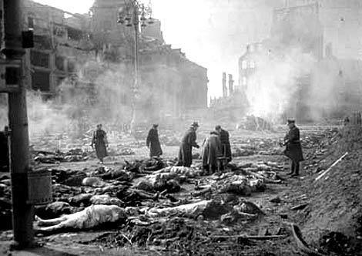
Following the Battle of the Bulge
The Allies push toward Germany from the west
German cities continue to get bombed, including fire-bombing of Dresden in Feb.
Soviets approach Berlin first
Dresden

Slide 18
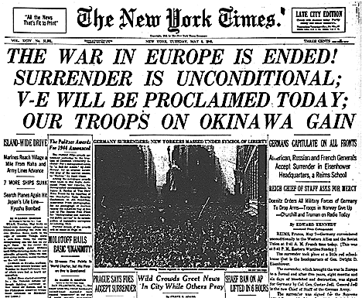
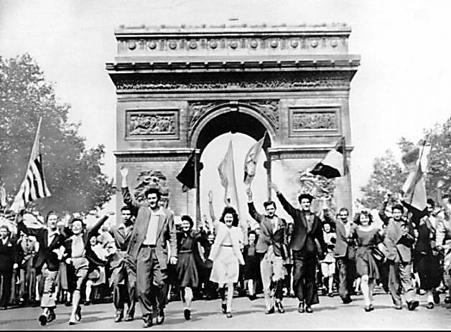
Germany’s Unconditional Surrender (#9)
By 1945, Allied armies quickly approach Germany from two sides
Soviets surround Berlin in April 1945
Hitler commits suicide
President Roosevelt dies in April; Harry Truman becomes president
On May 9, 1945, Germany officially surrenders, marking V-E Day

Slide 19
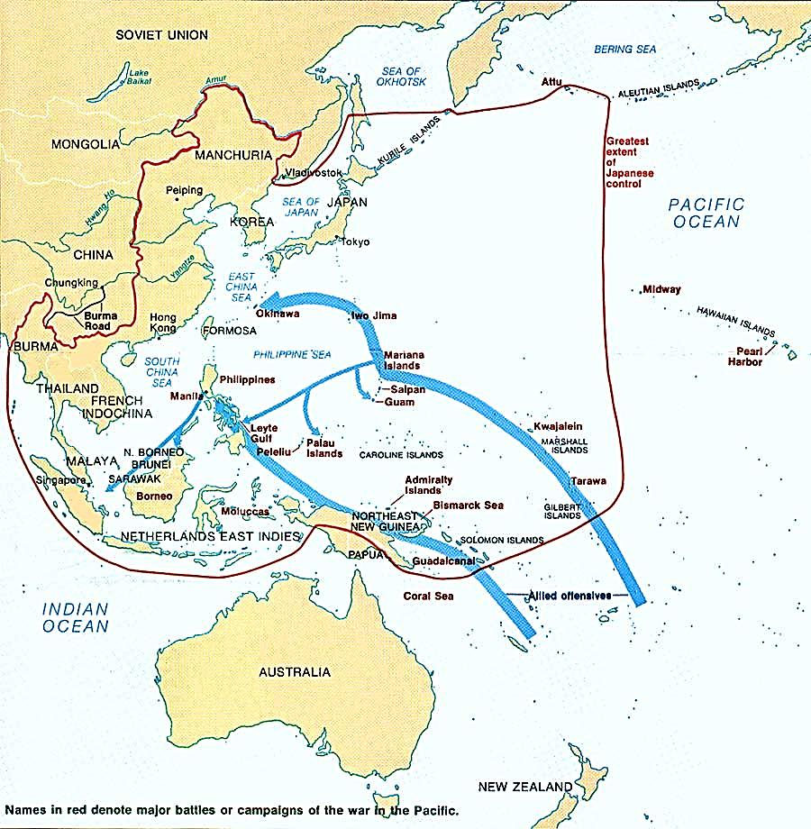
Victory in the Pacific
Although the war in Europe was over, the Allies were still fighting the Japanese in the Pacific
With the Allied victories at Midway and at Guadalcanal, however, the Japanese advances in the Pacific had been stopped
For the rest of the war, the Japanese retreated before the counterattack of the Allied powers

Slide 20
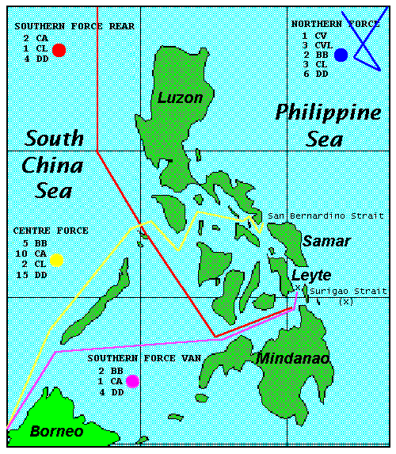
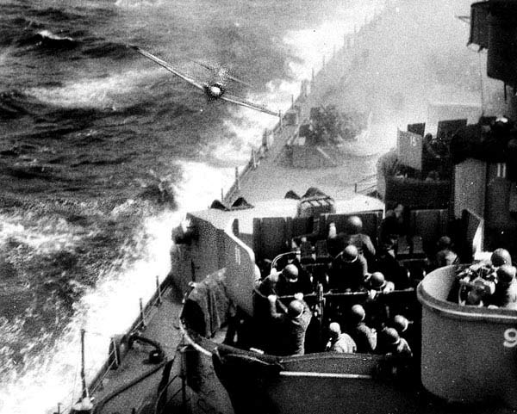
Japanese Strategy in the Pacific (#10)
The Japanese were desperate to turn the tide back and risked nearly their entire naval fleet in one battle
Battle of Leyte Gulf – in October 1944 the U.S. Navy destroyed nearly all of the Japanese naval fleet off the coast of the Philippines
After the Japanese navy was defeated by the U.S. in the Pacific the Japanese used kamikaze, or suicide pilots to sink ships

Slide 21
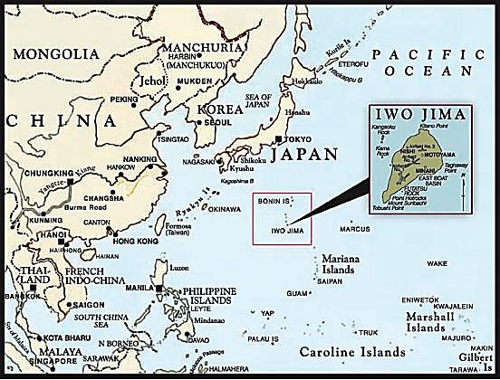
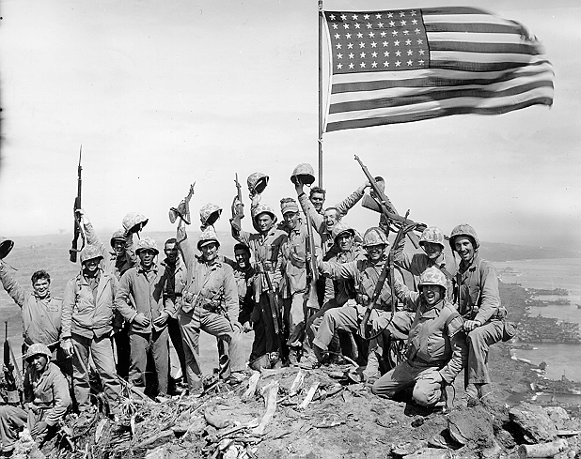
Nearing Japan (#11)
Iwo Jima and Okinawa – two islands that the U.S. took with heavy losses in their approach to Japan (though the Japanese suffered far greater losses)
These islands were close enough to Japan to send bombing missions from their air bases to Japan and back
As U.S. bombs Japanese cities it prepares plans for the invasion of Japan, which the Allies estimated could result in the loss of a half million lives (countless more Japanese losses) (#11)

Slide 22
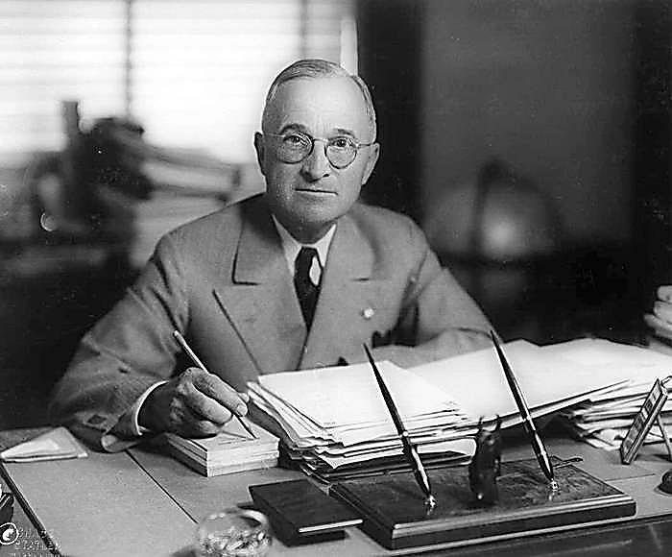
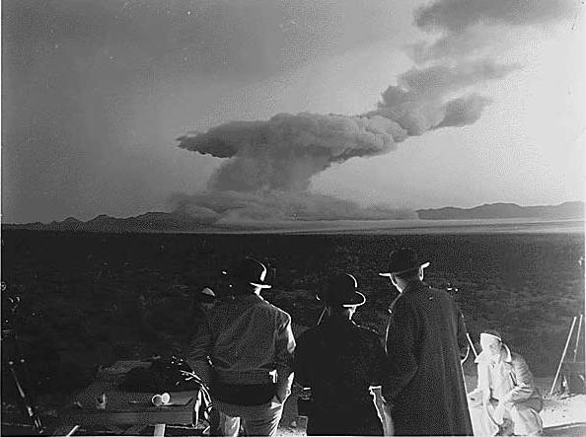
Manhattan Project
Manhattan Project – top secret project to build an atomic bomb
First one was successfully exploded in New Mexico in July of 1945
President Truman forced to make the decision to invade Japan, or use the atomic bomb to try to get Japan to surrender

Slide 23
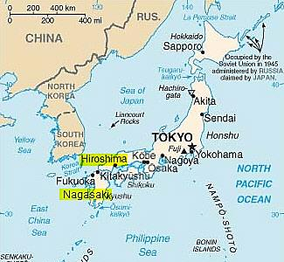
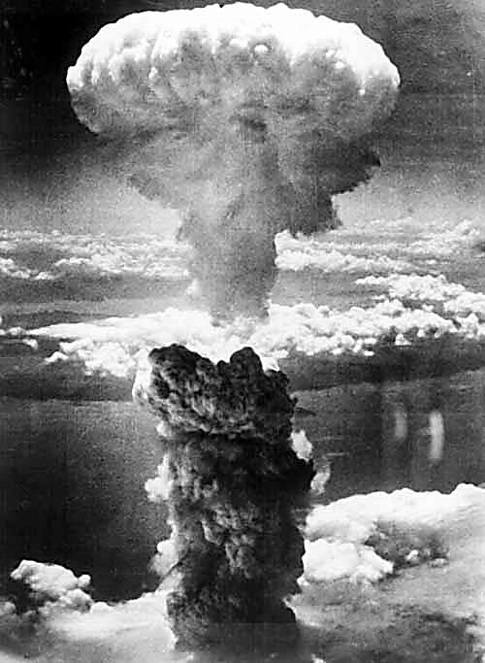
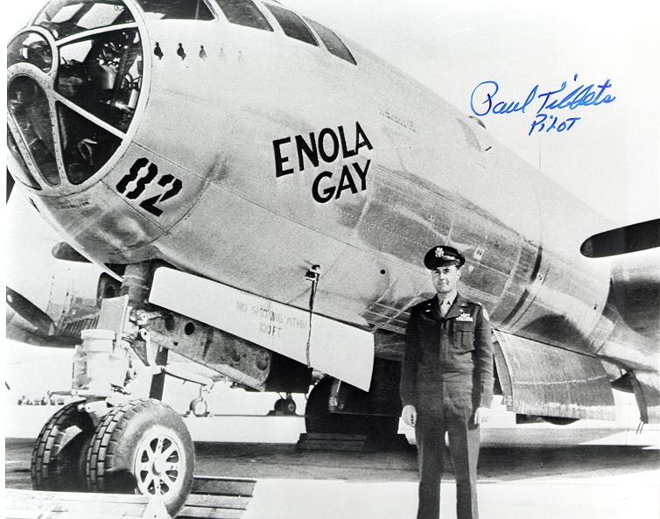
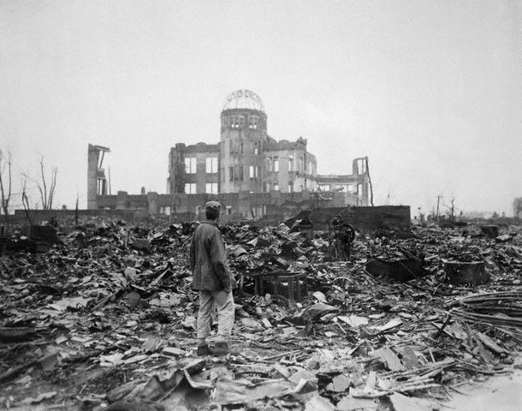
U.S. Uses Atomic Bombs on Japan (#11)
Hiroshima bombed August 6, 1945; about 75,000 die
Nagasaki bombed August 9, 1945: 70,000 die
Radiation fallout following the bombings kills thousands more

Slide 24
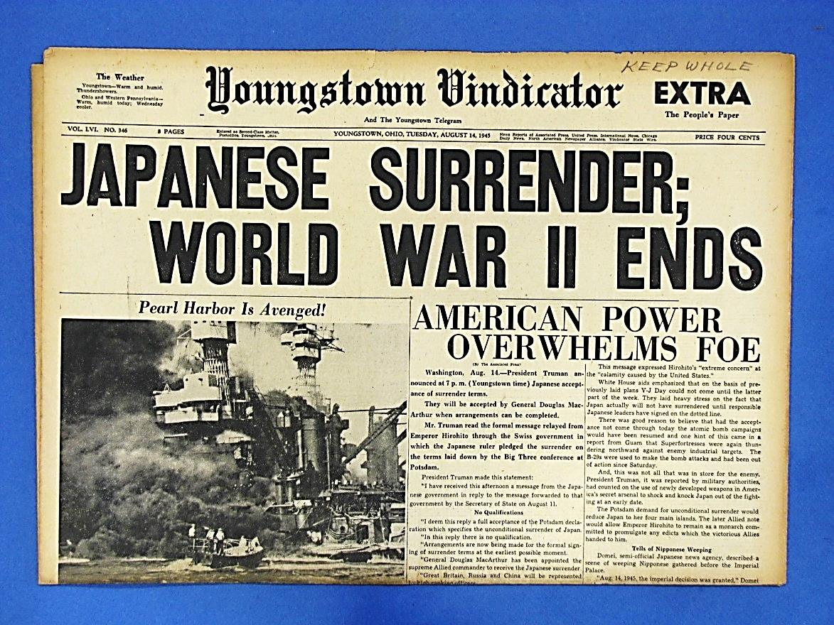
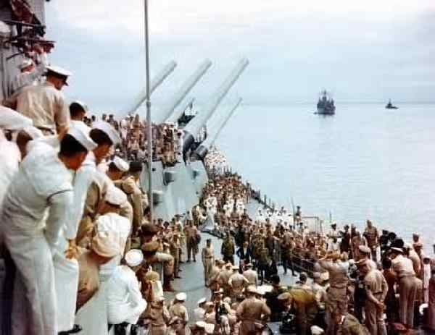
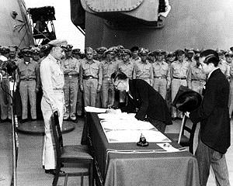
Japan Surrender
Japan surrenders on Sept. 2, 1945 (less than a month after the atomic bombings)
Signed in Tokyo Bay on the battleship USS Missouri

Slide 25
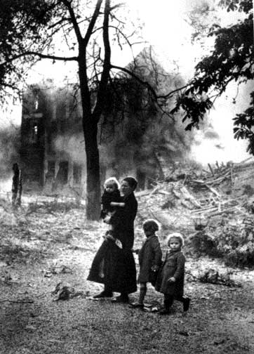
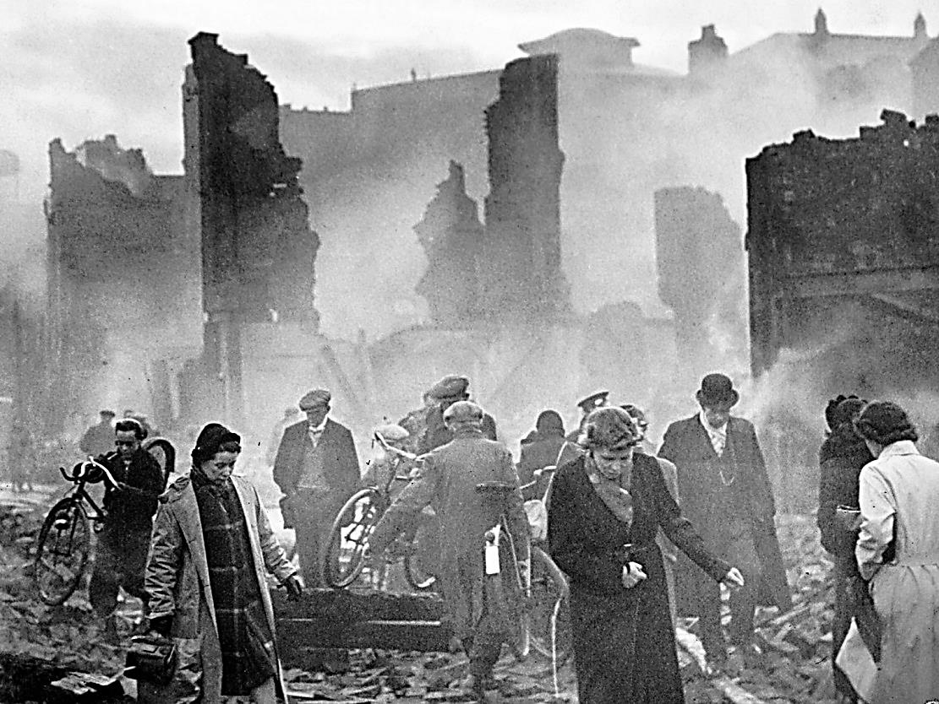
Devastation on Europe (#12)
40 million dead; 2/3 were civilians
Cities were left in ruins from bombings
50 million lost their homes and were starving
Billions in property damage
People left without water, electricity, and food
Agriculture completely disrupted in many places
Disease began to spread

Slide 26
Devastation on Japan (#14)
2 million lives lost
Major cities destroyed by bombing raids
Atomic bombs completely leveled Hiroshima an Nagasaki
People homeless, without food, and no work available
Japan lost its empire

Slide 27
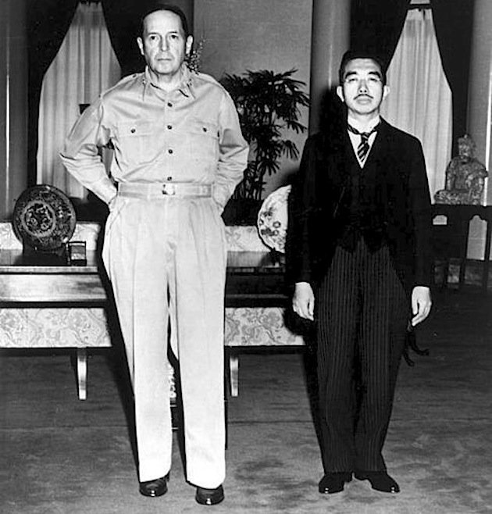
Rebuilding Japan (#15)
General Douglas MacArthur put in charge during US occupation of Japan following the war
Changes he put in place:
Demilitarized Japan – Japan was not allowed to have an army and wage a war of aggression
Democratized Japan – wrote a new constitution for Japan that allowed free elections and protected individuals rights
Rebuilt Japan’s economy – redistributed land to poor farmers, set up labor unions, and oversaw the rebuilding of Japanese industries

Slide 28
Costs of WWII (#16)

