Slide 1
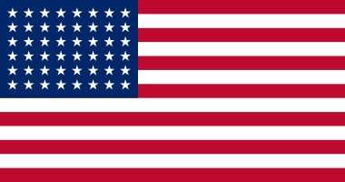
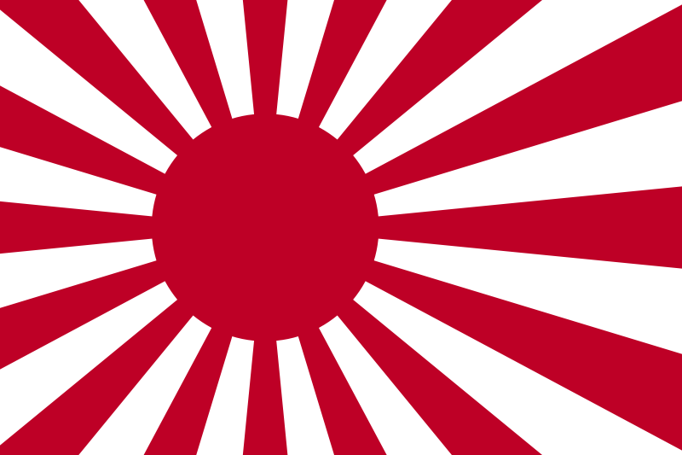
Japan’s Pacific Campaign
Modern World History
Chapter 16, Section 2
Assign. #3-3
vs.

Slide 2
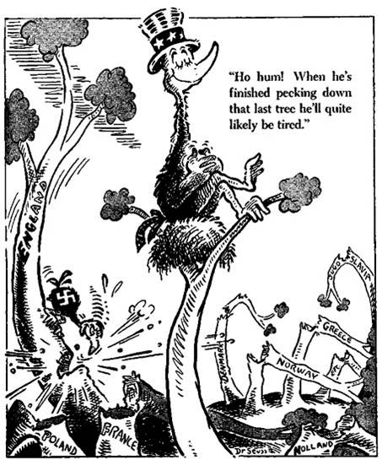
U.S. Isolationism (#1)
U.S. practices isolationism in the 1930s
Neutrality Acts –
  series of laws passed by the U.S. between 1935 and 1937 that made it illegal to sell arms or lend money to nations at war
Cash and Carry provision – added to the Neutrality Acts in 1939, it allowed the Allies to buy American arms

Slide 3
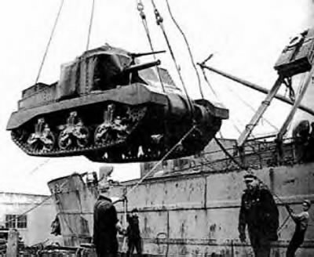
The U.S. Aids Its Allies (#1)
  Most Americans want to avoid war (isolationism)
  Roosevelt fears that if Allies fall, U.S. would have to fight
  He hopes to strengthen Allies so they can resist Germany
  Lend-Lease Act—
    passed in March 1941, it allowed the U.S. to loan weapons and other supplies to countries fighting Germany

Slide 4
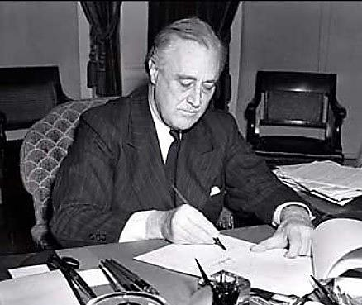
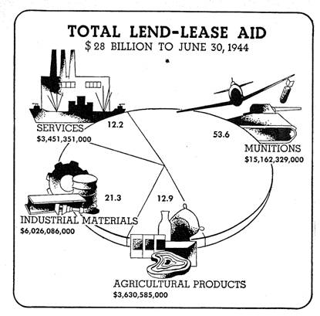
President Franklin D. Roosevelt signs the Lend-Lease bill to give aid to Britain and China (1941)

Slide 5
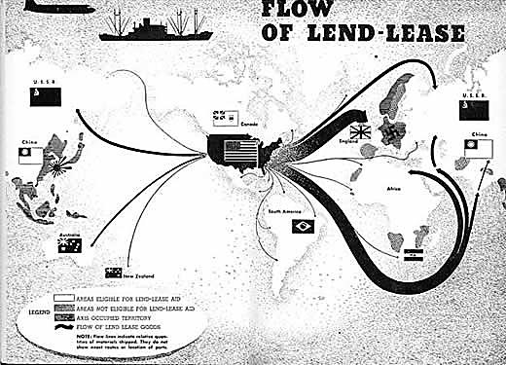

Slide 6
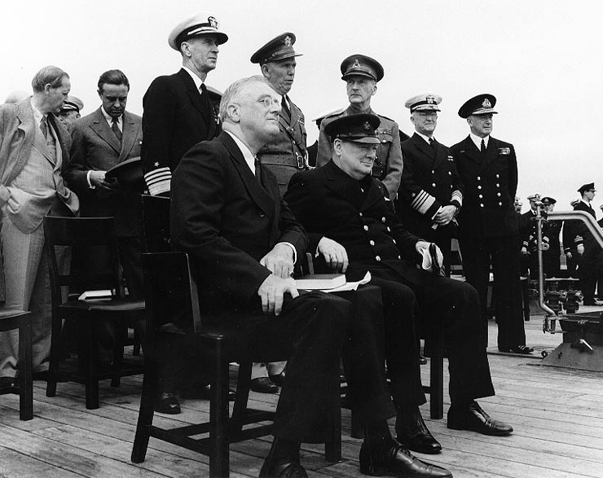
The U.S. Aids Its Allies (#1)
  Roosevelt and Churchill meet before U.S. enters the war, and issue a statement of principles
  Atlantic Charter—
    supports free trade, right to form own government, and serves as the Allies peace plan for after the war
  What does this sound similar to?

Slide 7
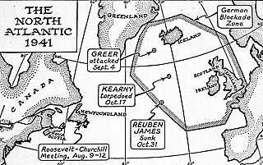
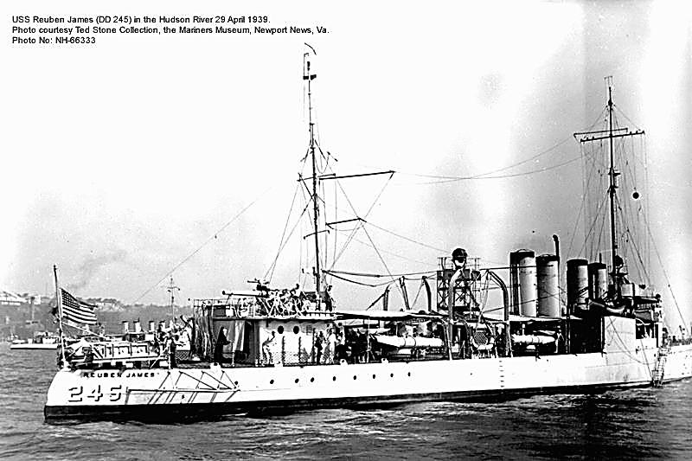
Undeclared Naval War with Germany
Hitler orders his U-boats to sink any U.S. ships supplying the Allies
An undeclared naval war goes on for months before the U.S. enters the war
USS Reuben James is the first U.S. naval vessel sunk in the war (in October 1941)

Slide 8
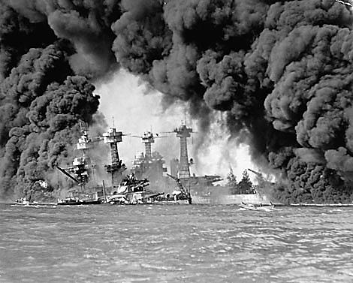
Ch. 16, Section 2 Introduction
Japan attacks Pearl Harbor in Hawaii and brings the United States into World War II

Slide 9
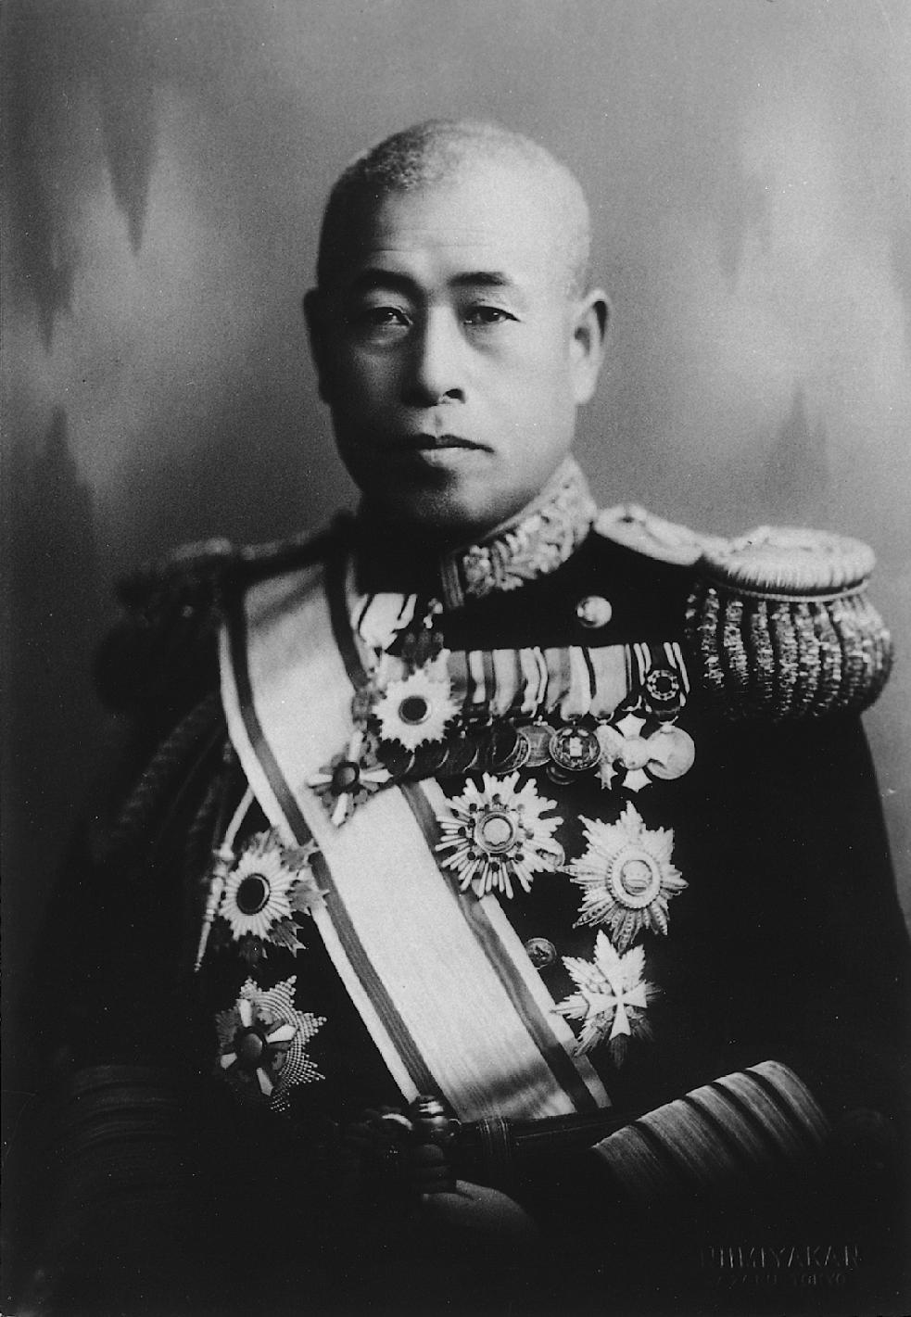
Japan and the U.S. (#2)
US was sending aid for the Chinese resistance against Japan
Japan develops a plan for attacks on European colonies in Southeast Asia (to gain resources)
US worried about the Philippines (which it controls)
In 1941 Pres. Roosevelt cut off oil shipments to Japan when it invaded French Indochina in July 1941
  Admiral Isoroku Yamamoto plans attack on U.S. fleet in Hawaii

Slide 10
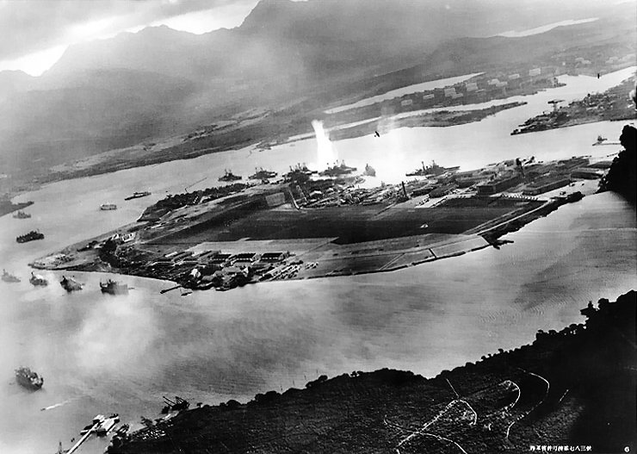
Surprise Attack on Pearl Harbor
Japan attacks Pearl Harbor—U.S. Naval base in Hawaii—on December 7, 1941
U.S. declares war on Japan December 8, 1941

Slide 11
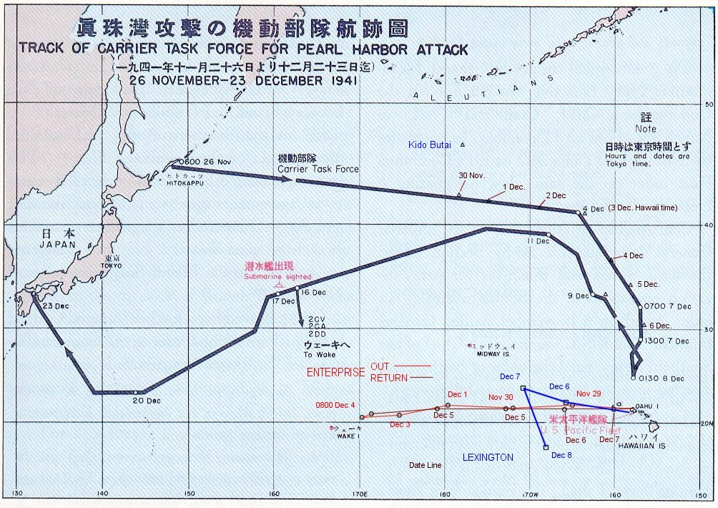
Route of Japanese Fleet Attacking Pearl Harbor

Slide 12
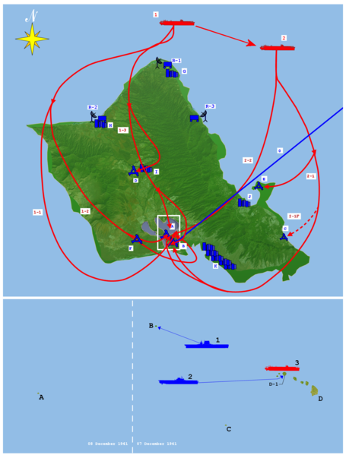
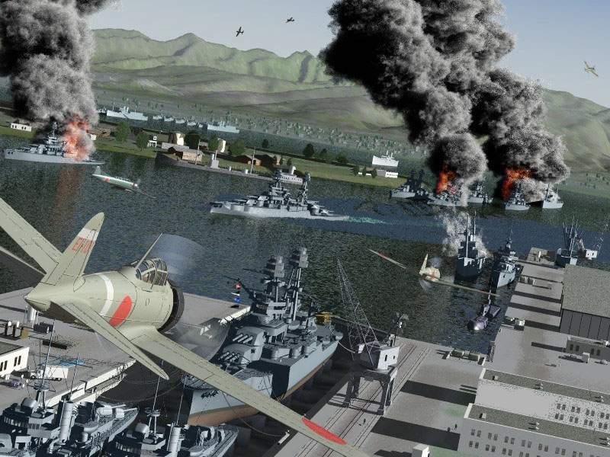
Waves of the Attack
First wave, 182 planes
Second wave, 171 planes

Slide 13
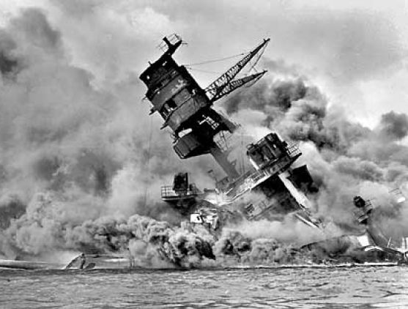
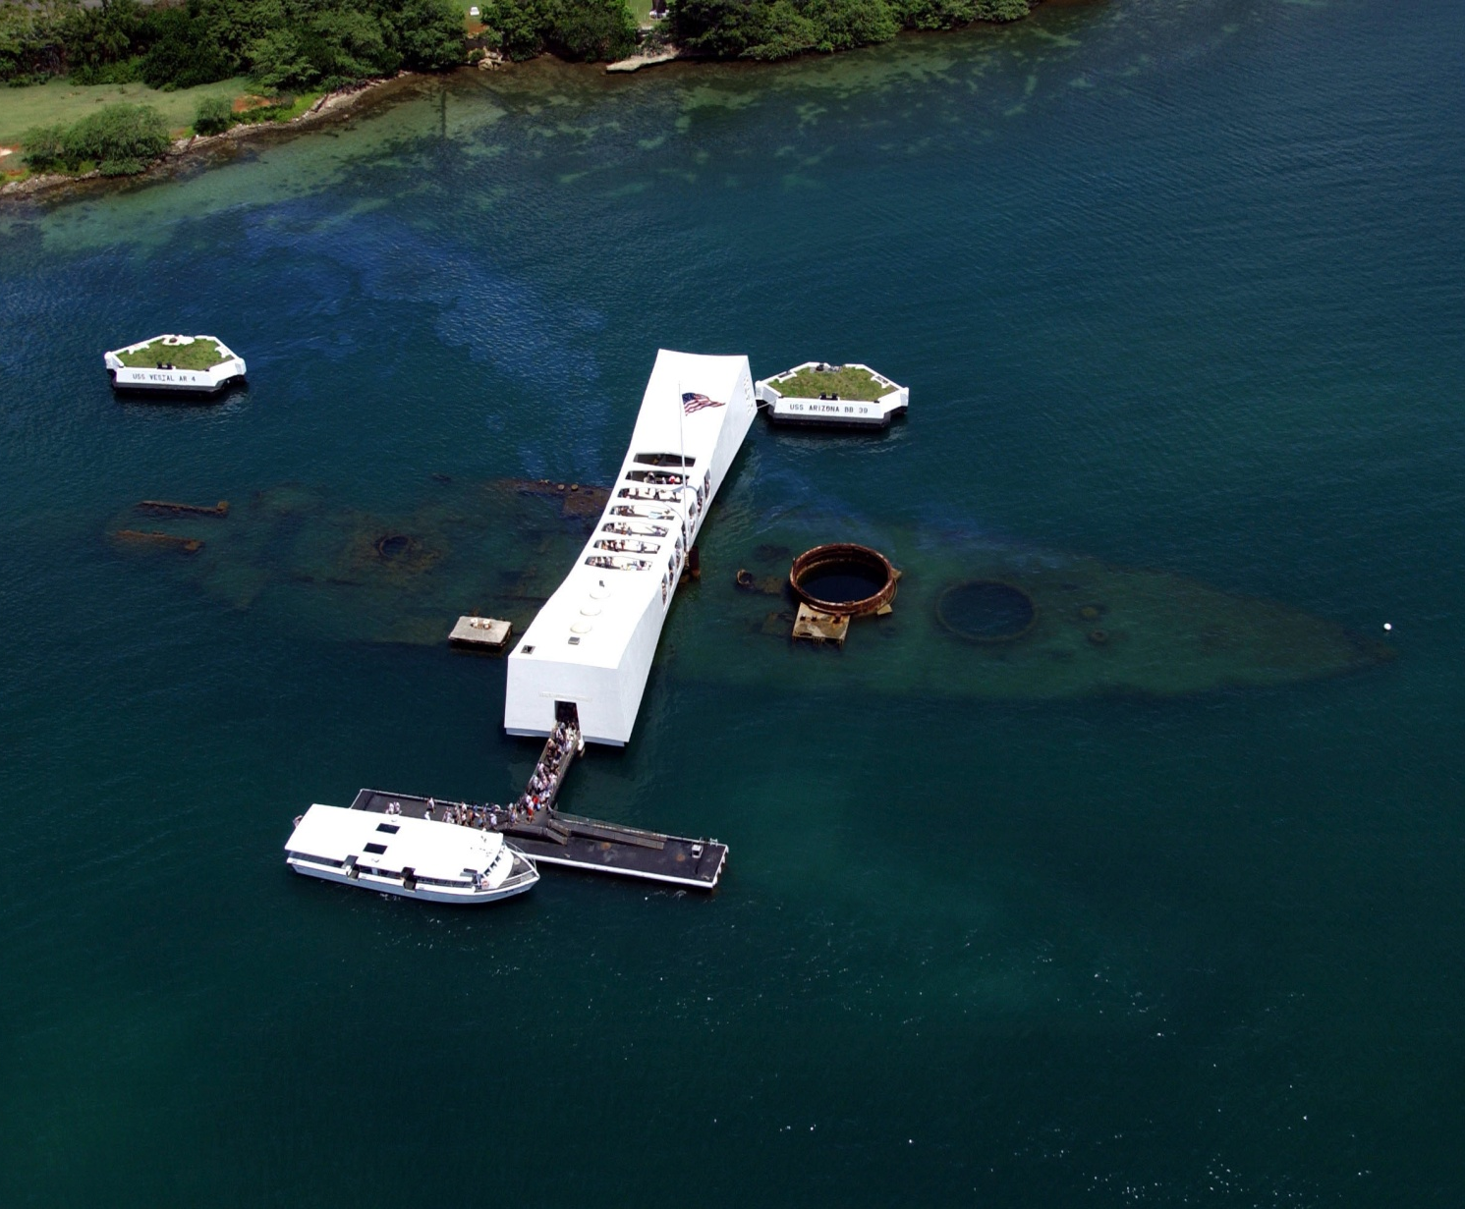
Battleship USS Arizona
U.S. Pacific fleet nearly destroyed
Japan now able to conquer more lands without fear of U.S. resistance

Slide 14
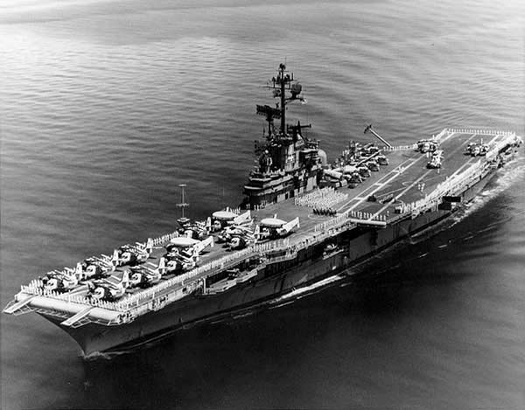
Silver Lining?
What kind of ship, which would prove to be the most important in the war, was not at Pearl Harbor?
Aircraft carriers

Slide 15
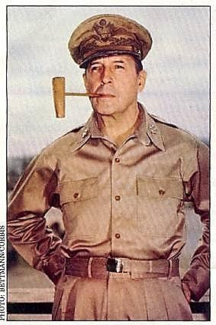
Japanese Victories (#3)
Japan also attacks Hong Kong, Thailand, and Guam and Wake Island (US-controlled islands) at same time as Pearl Harbor
The Philippines
  Japanese attack Philippine Islands defended by U.S., Filipino troops
  General Douglas MacArthur escapes via submarine to Australia and vows to return
  Philippines falls to Japan in 1942

Slide 16
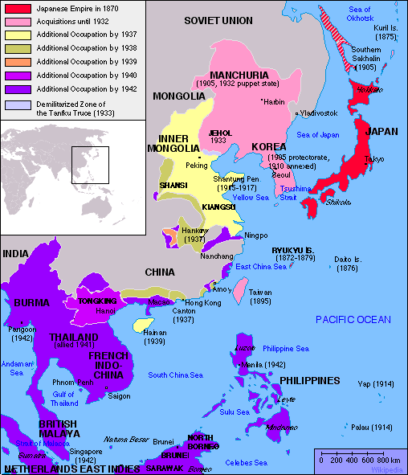
Gains in Many Places (#3)
Japan conquers British Singapore and the Dutch East Indies which are rich in minerals
Japan captures Burma, which threatens India, Britain’s main possession in Asia
Japanese forces treat conquered peoples and prisoners of war brutally

Slide 17
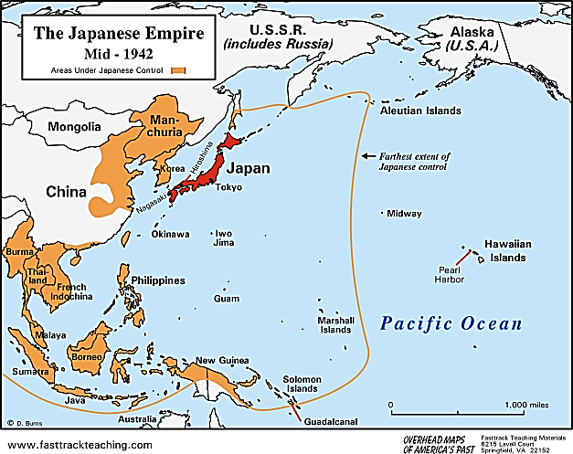

Slide 18
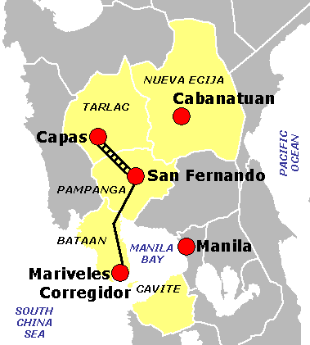
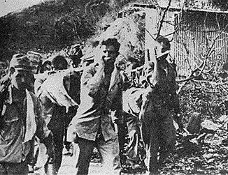
Bataan Death March
When Japan conquered the Philippines they marched 75,000 U.S. and Filipino captured soldiers miles to prisoner of war camps and thousands died along the way
Beheadings, cut throats, casual shootings, bayonet stabbings, numerous rifle butt beatings and a deliberate refusal to allow the prisoners food or water while keeping them continually marching for nearly a week in tropical heat

Slide 19
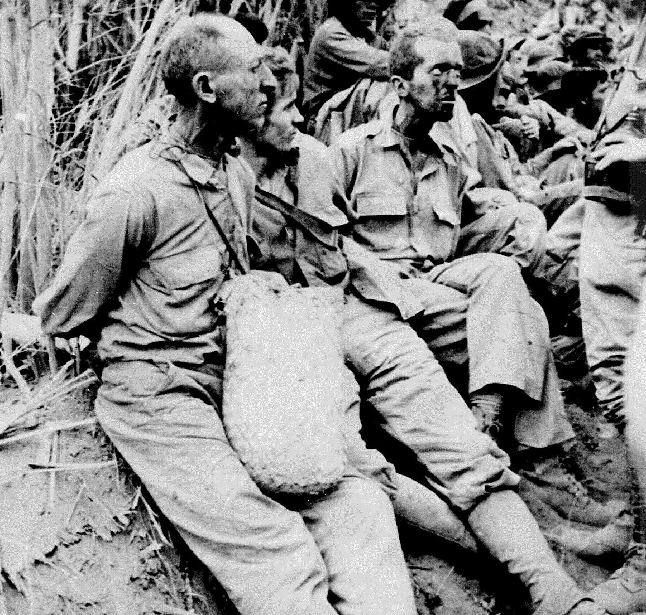
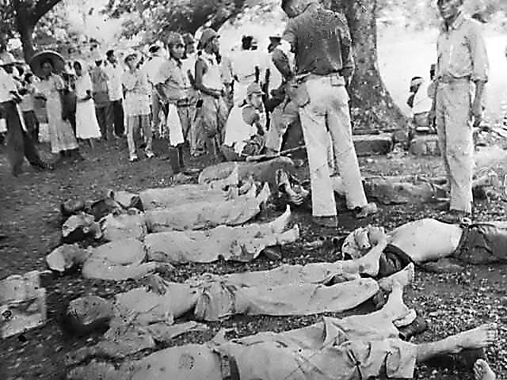
Pictures of the Bataan Death March

Slide 20
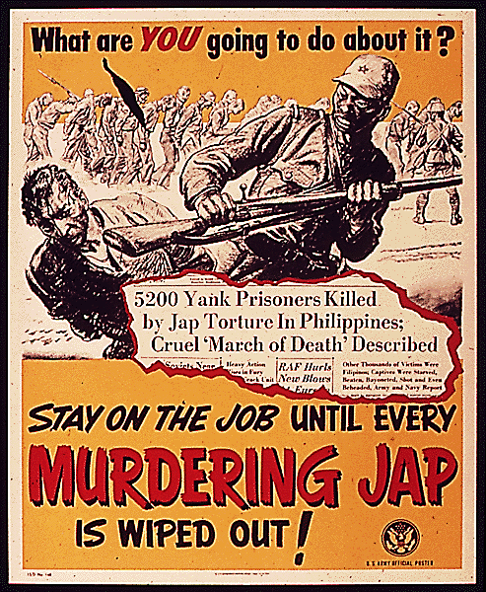
Propaganda Poster in the U.S. after the Bataan Death March

Slide 21
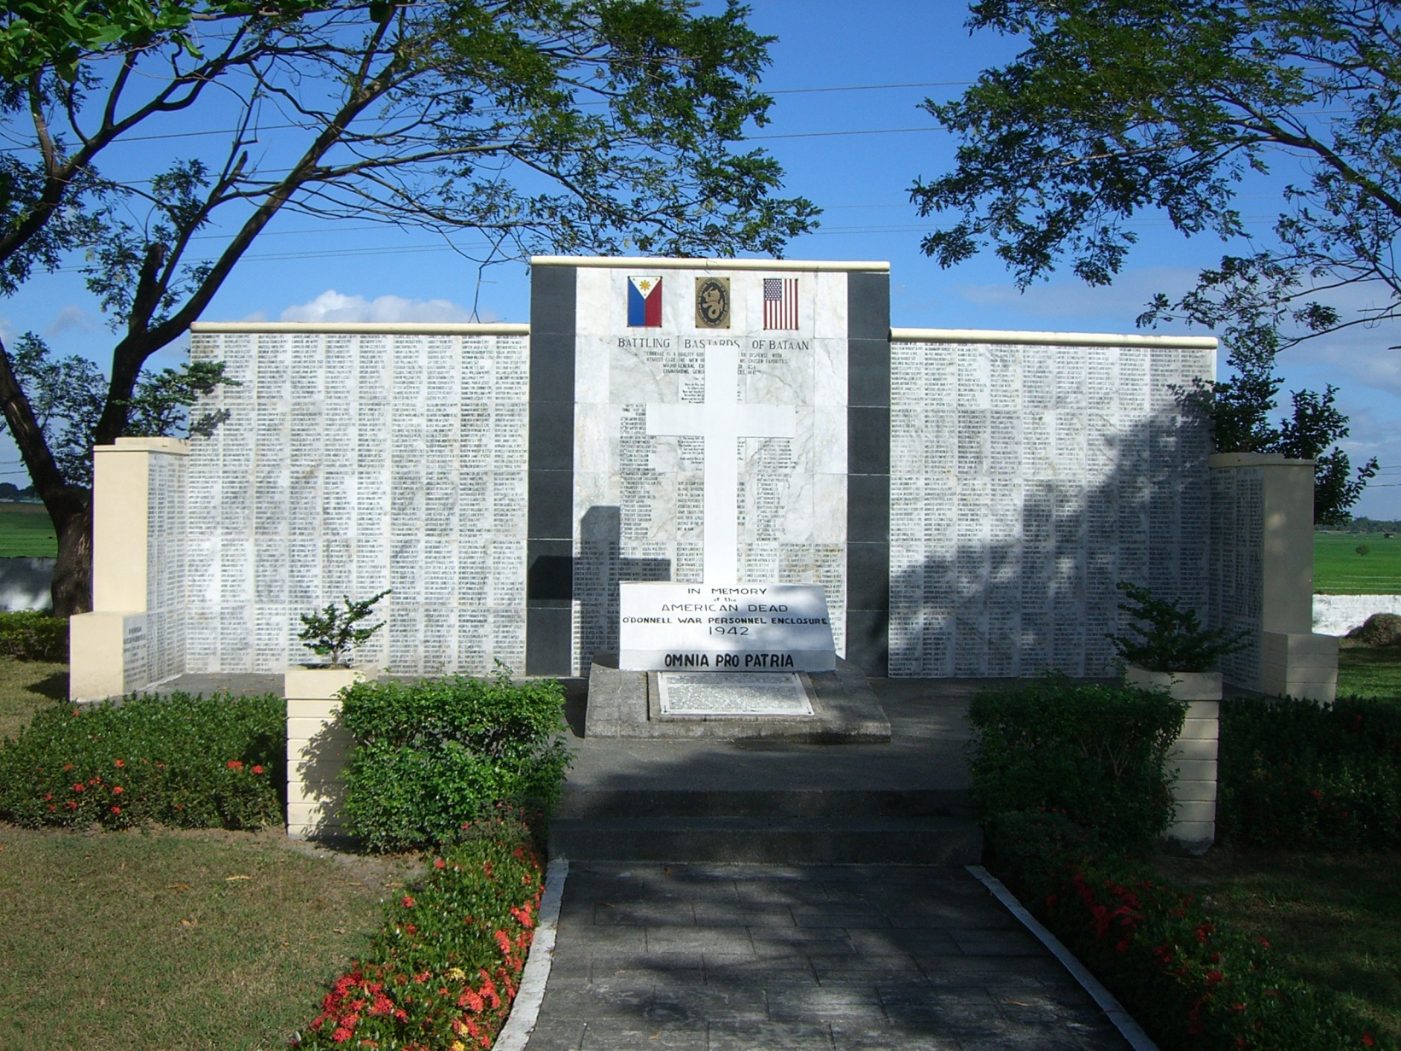
Bataan Death March Memorial
“The Battling Bastards of Bataan”

Slide 22
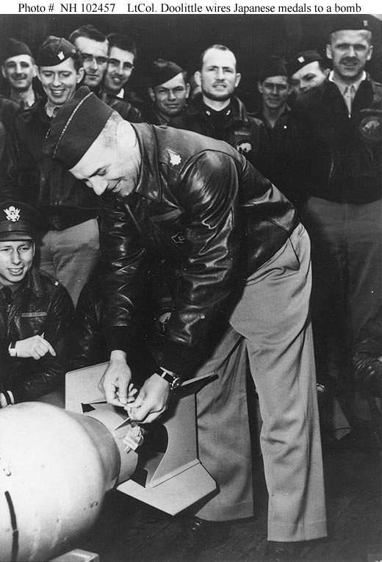
Doolittle Raid
U.S. bombers attack Tokyo and other Japanese cities in April 1942
  (Here Lt. Col. James H. Doolittle wires a Japanese medal to a bomb, for "return" to its originators in the first U.S. air raid on the Japanese home islands)
Raiders low on fuel had to ditch planes in China
Raid does little damage, but shows that Japan is vulnerable, and improves U.S. morale on the homefront

Slide 23
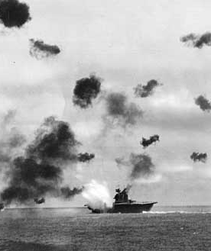
Battle of Coral Sea (#4)
Battle of the Coral Sea—
  U.S. stops Japanese advance, May 1942 (1st time Japanese were stopped in WWII)
  Prevented invasion of Australia
  1st naval battle where ships were not in sight of each other and all the fighting was done by planes from aircraft carriers

Slide 24
New Kind of Naval Warfare
Reconnaissance planes from aircraft carriers search for enemy task forces
When enemy found, bombers are sent to attack
Bombers do not engage each other, but pass each other on the way to the enemy aircraft carrier
Fighters and anti-aircraft guns defended the ships against bombers
Ships never close enough to see each other or shoot at each other

Slide 25
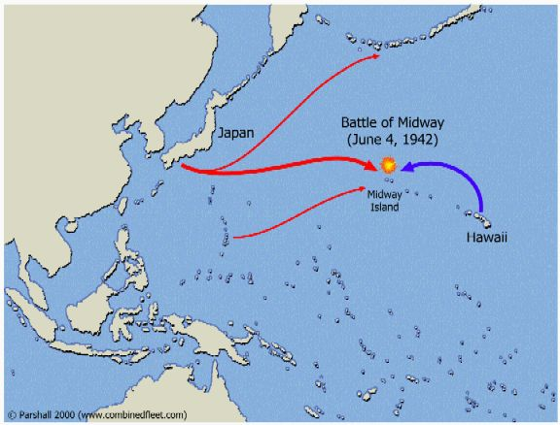
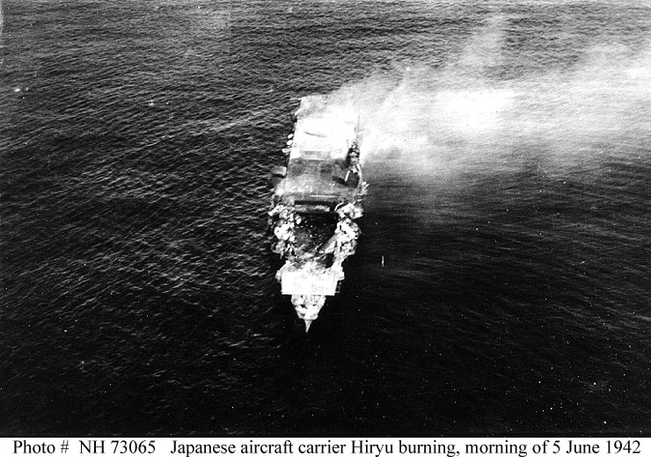
The Allies Strike Back (#5)
  Japan sends powerful fleet to capture Midway Island
  Battle of Midway—
    US destroyed all 4 of Japan’s aircraft carriers causing Japan to retreat
    This is the turning point in the war in the Pacific

Slide 26
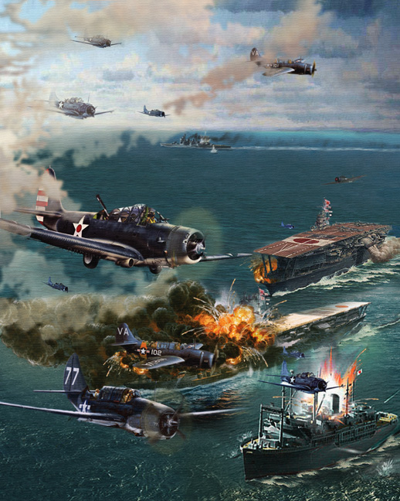
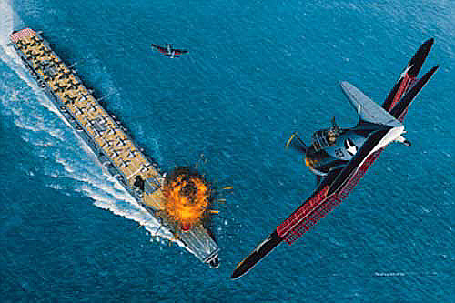
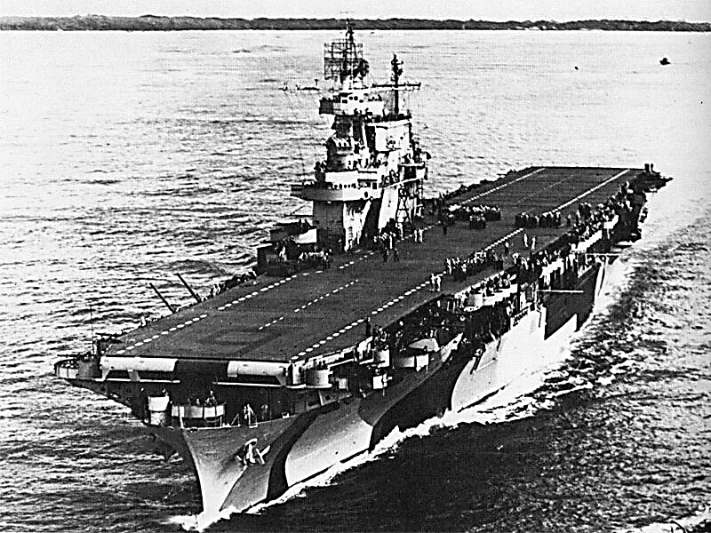
Battle of Midway

Slide 27
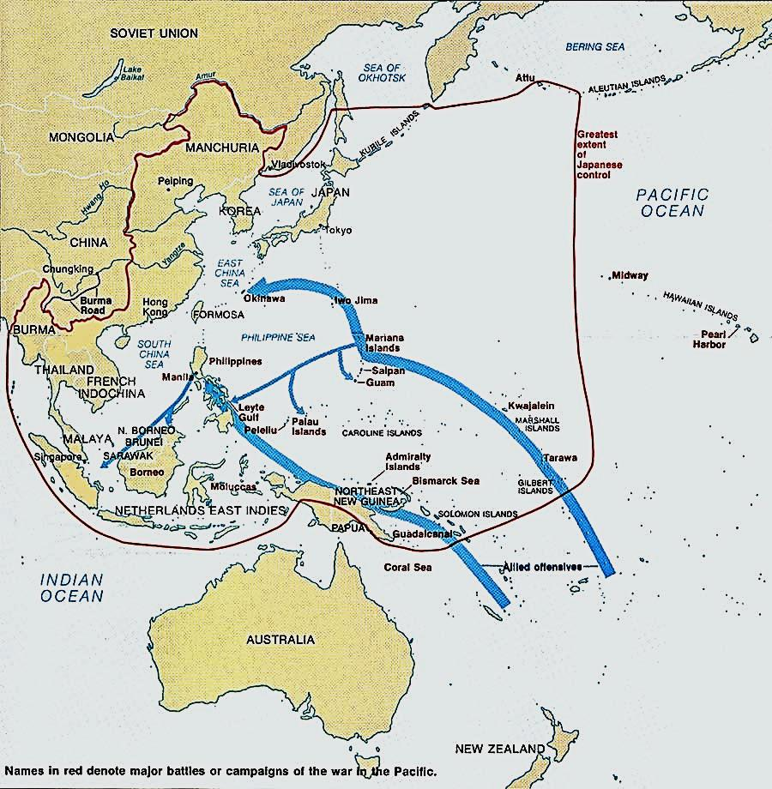
An Allied Offensive (#6)
MacArthur’s island-hopping plan
  Douglas MacArthur—American army commander in the Pacific
  “island-hopping” –
    move past Japanese strongholds in order to attack weaker bases, and get closer to Japan to eventually attack it

Slide 28
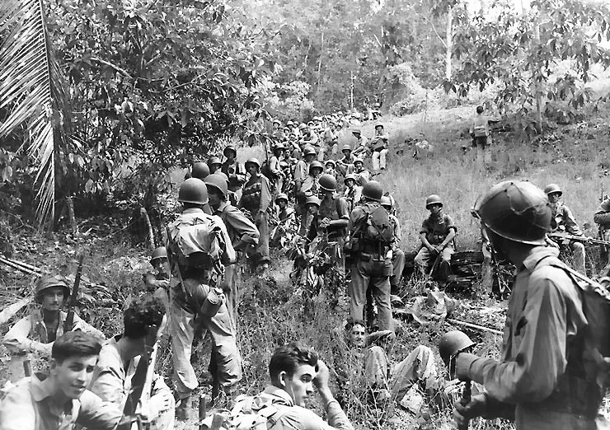
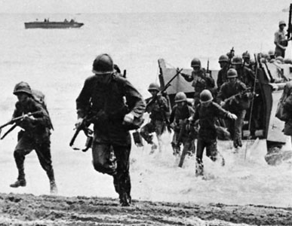
Battle of Guadalcanal (#7)
The Japanese were building an airbase on the island of Guadalcanal
In August 1942 thousands of marines stormed the island
In 6 months of fighting the Japanese lost 24,000 of the 36,000 soldiers defending the island
“The Island of Death”

