Slide 1
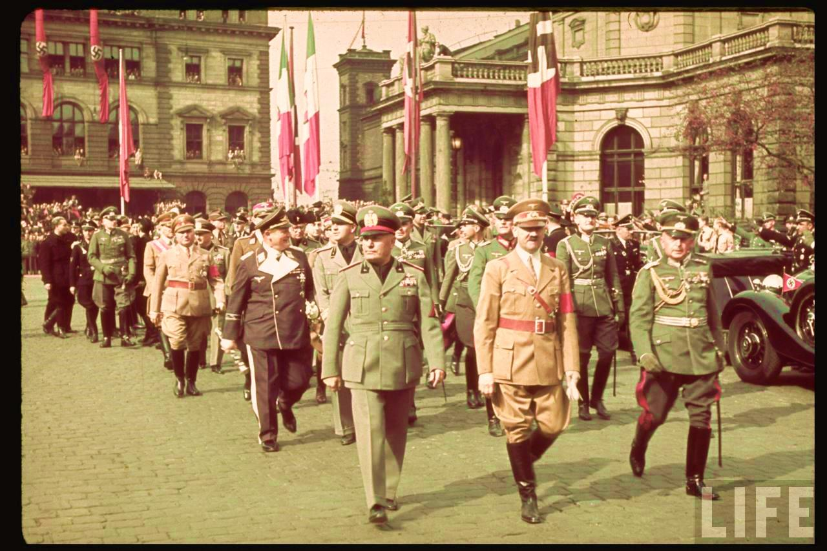
Modern World History Chapter 15, Section 3 Unit 2, Assign. #5 “Fascism Rises in Europe”

Slide 2
Fascism (#1)
Fascism – new militant political movement that emphasized loyalty to the state and leader
Fascism similar to communism in its totalitarian control of the people
Fascist supporters were aristocrats, industrialists, war veterans, and lower middle class
Unlike communism, fascism had no clearly defined program or theory and supports capitalism

Slide 3
Mussolini Rises to Power in Italy (#2)
Italians were bitterly disappointed by the lack of territorial gains in the Treaty of Versailles that ended World War I
Rising inflation and unemployment contributed to unrest
The democratic government of Italy seemed helpless to deal with the problems
People looked to a strong leader who would take action to address the problems
Pick me!

Slide 4
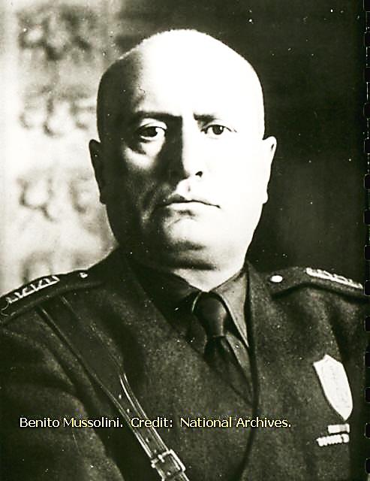
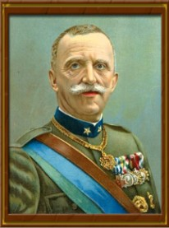
Mussolini Rises to Power in Italy (#2)
Benito Mussolini – a newspaperman and politician began the Fascist Party in 1919
His black shirt supporters fought with communists on the streets
He won the support of the middle class by playing upon their fears of a communist workers revolt
In 1922 30,000 Fascists marched on Rome and demanded that King Victor Emmanuel III put Mussolini in charge
Due to widespread violence and a threatened general uprising, the king puts Mussolini in charge of the government

Slide 5
Mussolini as Leader of Italy (#3)
Became known as “Il Duce” – the leader
Abolished democracy
Outlawed all political parties except the Fascists
Secret police
Censorship and propaganda
Outlawed strikes
Never had total control like Hitler or Stalin

Slide 6
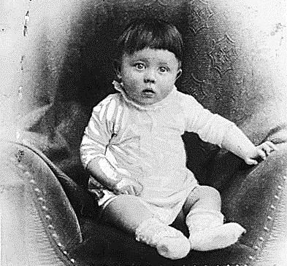
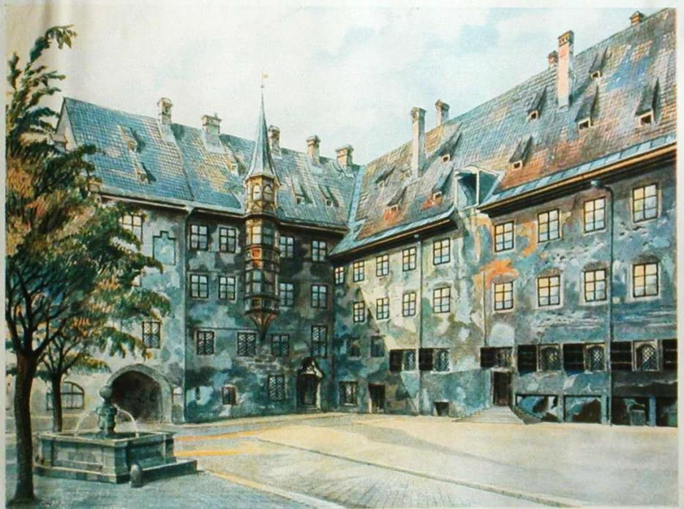
Hitler Before Nazi Party (#4)
Hitler was born in Austria in 1889, and moved to Germany when he was 3
His family moved a lot and he was greatly affected by the death of his younger brother
Hitler had a lot of conflict with his father (both were very strong-willed)
Hitler struggled in school (low effort) and wanted to become an artist while his father wanted him to become a clerk in an office
After his father died in 1903 he finished school and led the life of a painter, but was rejected by the Academy of Fine Arts in Vienna

Slide 7
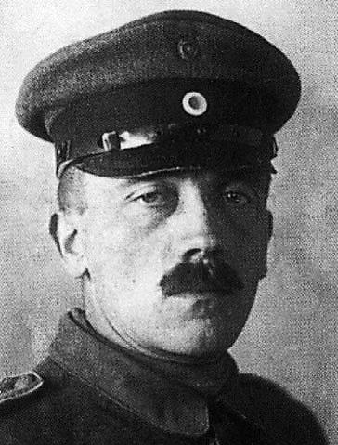
Hitler Before Nazi Party (#4)
His mother died in 1907 and Hitler was broke and homeless
He moved to Munich, Germany and volunteered to serve in the German Army during WWI
He earned the Iron Cross for bravery twice during the war
He believed the German army was not defeated on the battle field but had been stabbed in the back by politicians who signed the armistice and the Treaty of Versailles
He stayed in the army for awhile and got involved in minor political groups when he got out (and soon joined the Nazi Party)

Slide 8
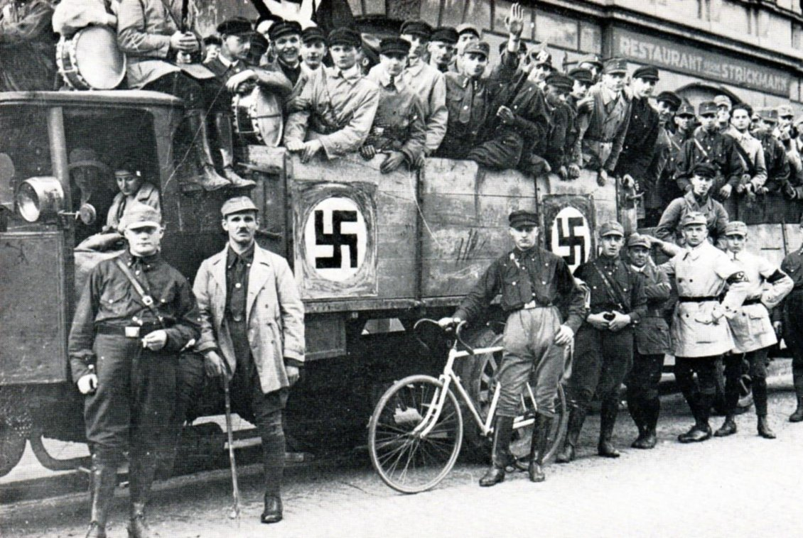
Nazi Party (#5)
The Nazis were a tiny right-wing political group centered in the city of Munich
They were named the National Socialist German Workers’ Party (Nazis for short)
Nazis believed Germany had to overturn the Treaty of Versailles and combat communism
They built up a private militia called the storm troopers or Brown Shirts
They created a German brand of fascism
Used the Swastika as their symbol
Adolf Hitler quickly became its leader (der Fuhrer) due to his skill as an organizer and speaker

Slide 9
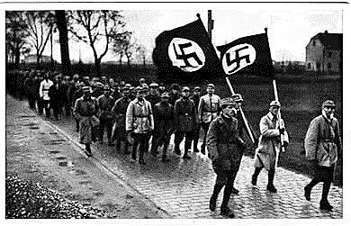
Nazi Attempt to Seize Power (#6)
The Nazis were inspired by the Fascists “March on Rome” in Italy
They plotted to seize power in the capital city of Munich
The attempt failed and Hitler was arrested
He was tried for treason and sentenced to 5 years in jail (though he served less than 9 months)

Slide 10
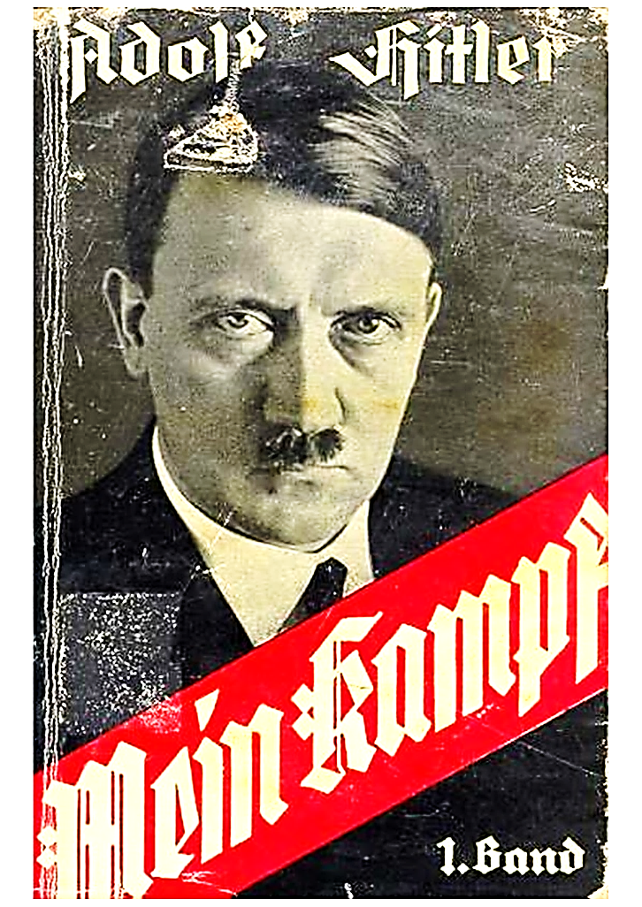
Mein Kampf (#7)
Mein Kampf was written by Hitler while he was in jail for the failed Munich Putsch
Outlined his basic beliefs and goals for Germany:
Germans (Aryans) were the master race
Other races (Jews, Slavs, etc.) were inferior
Called the Treaty of Versailles an outrage and vowed to regain lost territory
Declared Germany overcrowded and in need of lebensraum (living space) and promised to get it in Eastern Europe and Russia

Slide 11
Hitler Gains Power Legally (#8)
After Hitler left jail he revived the Nazi Party
The Nazis were mostly ignored during Germany’s postwar recovery
When the Great Depression hit the German economy collapsed and civil unrest broke out
Frightened and confused Germans looked for a strong leader to get them out of the bad economic times
The Nazis gradually grew in power at this time

Slide 12
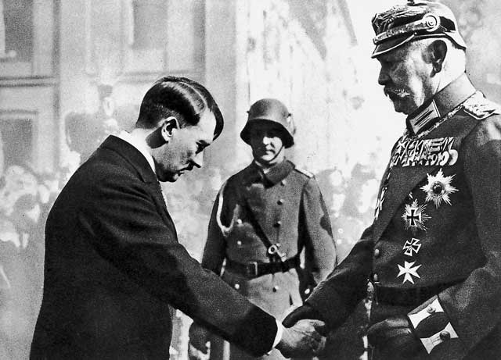
Hitler Gains Power Legally (#9)
Nazi Party
Nazis became the largest political party in Germany by 1932
Conservative leaders thought they could control Hitler and use him for their purposes
These leaders advised President Paul von Hindenburg to name Hitler as chancellor, which he did in early 1933

Slide 13
Hitler as Chancellor (#10)
Called for new elections hoping to win a majority in the parliament (Reichstag)
Reichstag fire – 6 days before the elections a fire destroyed the Reichstag building
Hitler blamed the communists
Fear of communism helped the Nazis gain a slim majority in the Reichstag in the elections

Slide 14
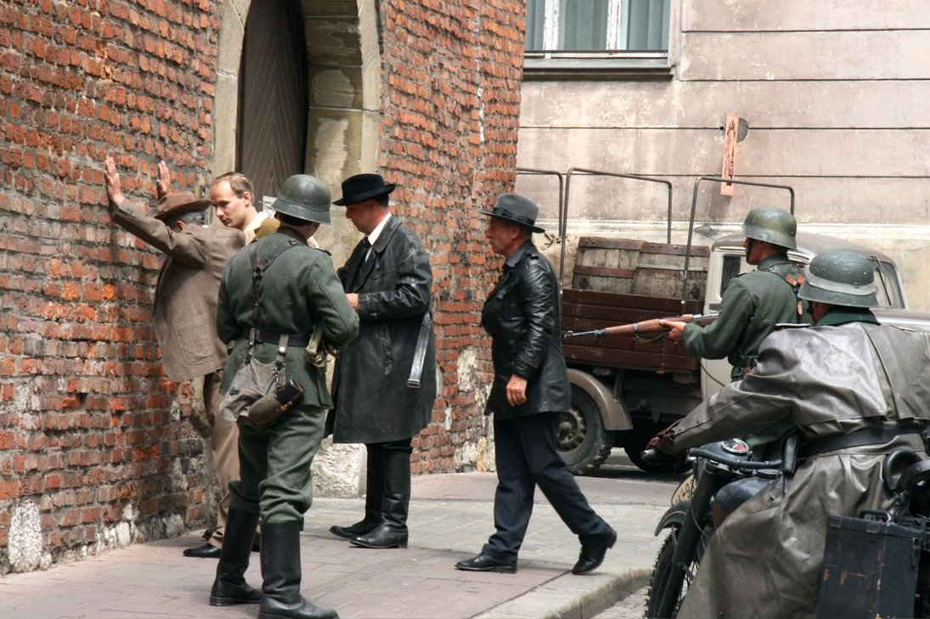
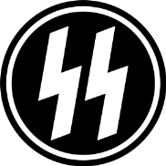
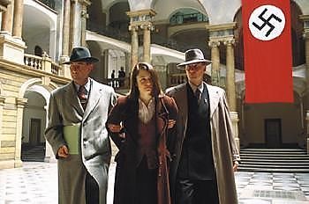
Hitler’s Totalitarian Control (#11)
Banned all other political parties
Had opponents arrested and thousands murdered
SS – secret police loyal directly to Hitler (eventually carried out most of the war crimes associated with the Holocaust)
Gestapo – secret police for the Nazi Party

Slide 15
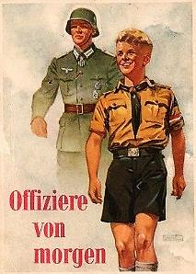
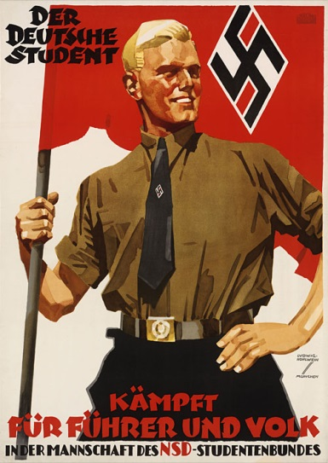
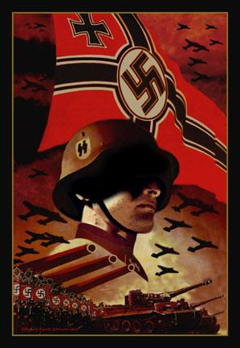
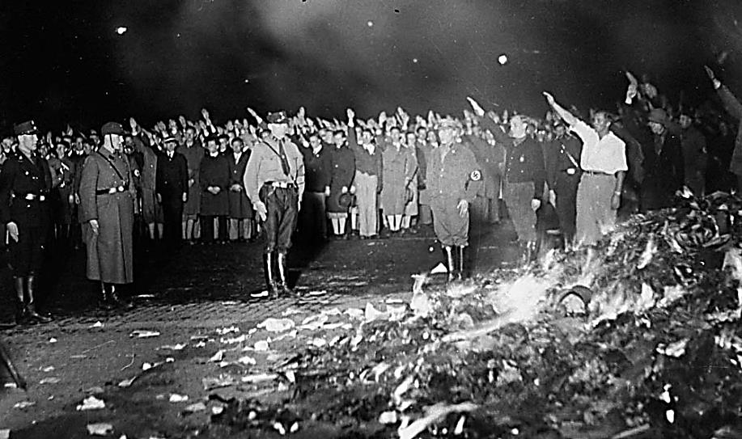
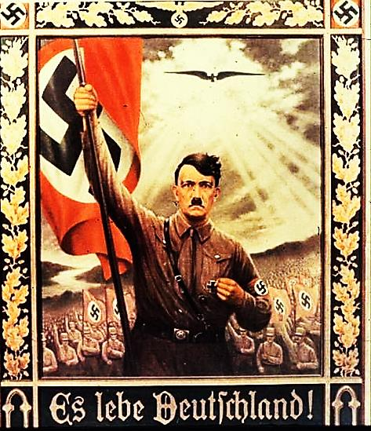
Hitler’s Totalitarian Control (#11)
To shape public opinion he turned the press, radio, literature, and film into propaganda tools
Censorship led to book burnings
Churches were forbidden to criticize the government
Schoolchildren had to join the Hitler Youth or the League of German Girls
Twisted the philosophy of Friedrich Nietzsche to support his brute force

Slide 16
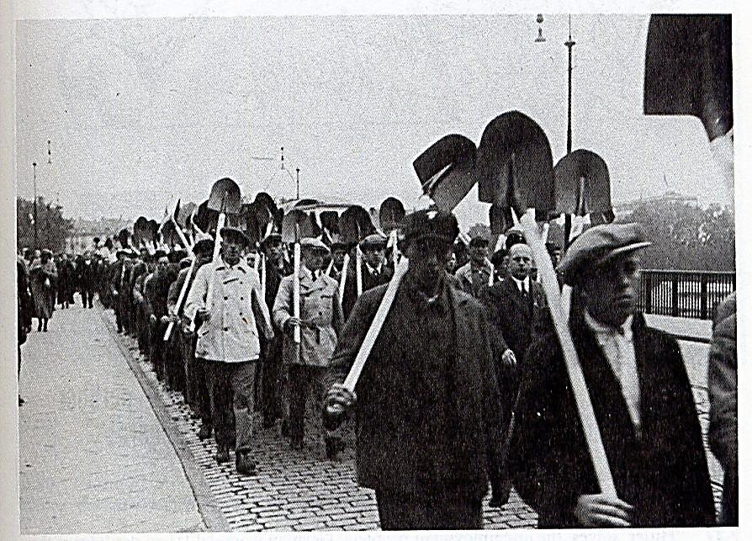
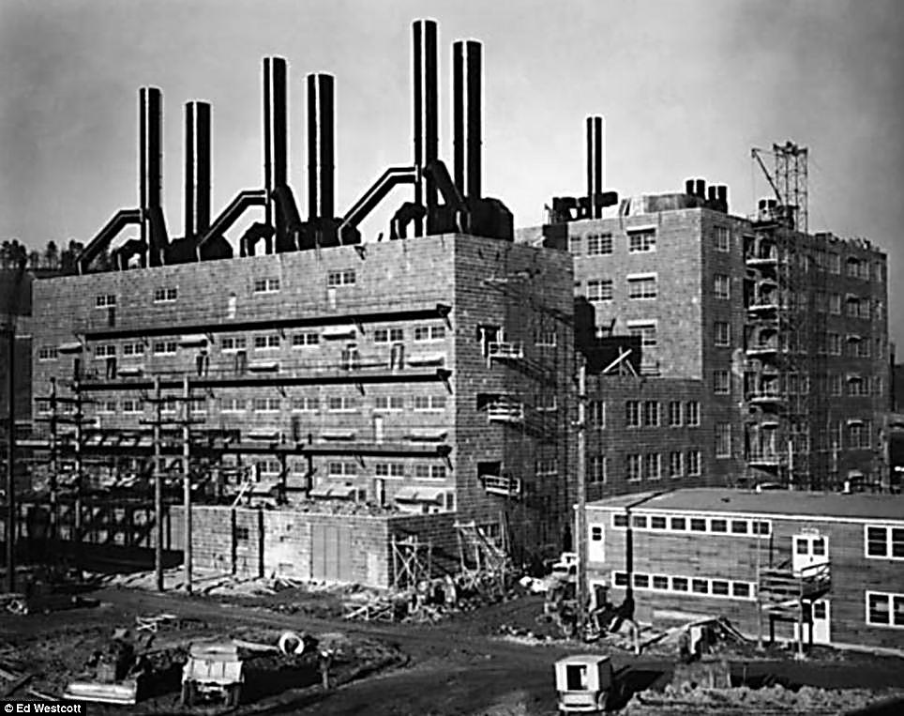
Nazis Take Command of the Economy (#12)
Banned strikes and unions
Government closely regulated workers and businesses
Gov’t constructed factories and highways
Number of unemployed dropped from 6 million to 1.5 million by 1936

Slide 17
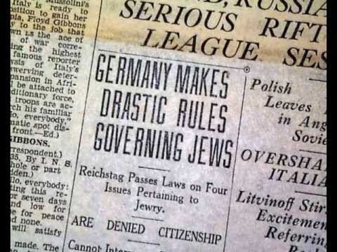
Nazi Hatred of Jews (#13)
Jews were less than 1% of the population
Nazis used them as scapegoats for all of Germany’s problems since WWI
Led to a wave of anti-Semitism across Germany
Nuremberg Laws – deprived Jews of their rights as citizens
Violence against Jews mounted

Slide 18
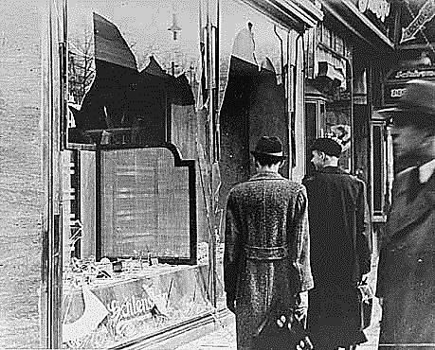
Nazi Hatred of Jews (#14)
Kristallnacht – night of November 9, 1938 known as “The Night of the Broken Glass,” Nazi mobs attacked Jews in their homes and on the streets and destroyed thousands of Jewish-owned buildings (homes, businesses and synagogues)

Slide 19
Dictators Across Europe (#15)
Democracies:
Britain, France, Scandinavian nations
Dictatorships:
Germany
Italy
USSR
Hungary
Poland
Yugoslavia
Albania
Bulgaria
Romania

