Slide 1
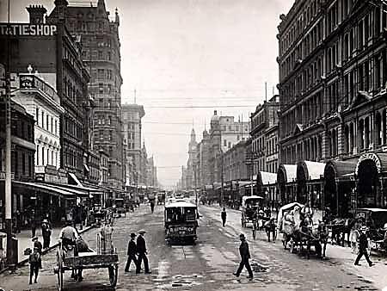
Ch. 20, Section 3 Life in Cities

Slide 2
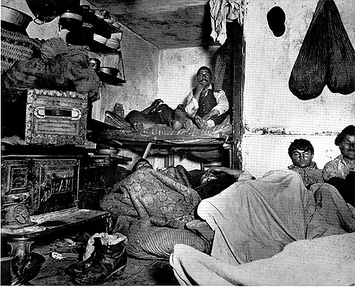
Urban Problems
Jacob Riis – he was a journalist and photographer best known for his book “How the Other Half Lives” published in 1890 which exposed the horrible conditions in New York City tenement houses
“Story of Us” clip 28:15-39:00

Slide 3
Urban Problems (continued)
Overcrowding led to sanitation problems as cities couldn’t keep up with garbage collection (#2)
Tenements were unsafe and most cities in 1900 did not have laws requiring landlords to fix up the tenements or maintain safety standards (#3)
Tenements had other problems like few windows, so they lacked fresh air and sunlight, not enough running water or indoor plumbing, and unclean drinking water (#4)
Bacteria in these dirty conditions grew and diseases spread quickly in these crowded neighborhoods and affected children the most (#5)

Slide 4
Urban Problems (continued)
Oil refineries, steel mills, and other factories polluted the air so badly in cities that it affected people’s health (#6)
Pittsburgh was so polluted it had to turn on its street lights during the day
By the late 1800s cities were beginning new sewage and water purification systems and hiring full-time firefighters and police officers (#7)

Slide 5
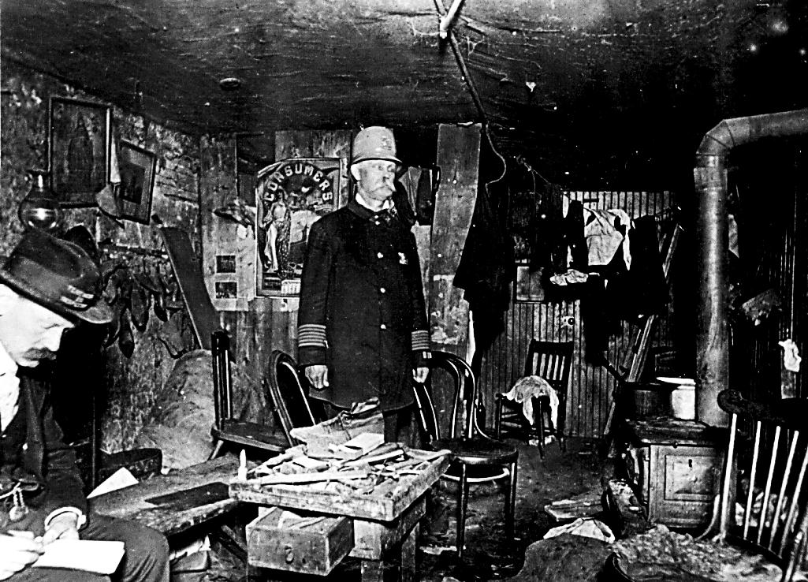
Improving City Life
Jacob Riis
Jacob Riis’ book “How the Other Half Lives” shocked Americans and influenced them to begin efforts to improve conditions in tenements (#1)
The Charity Organization Society worked to help those living in tenements and helped get the 1901 New York State Tenement House Act passed, which required new buildings to have better ventilation and running water (#2)
New York City Tenement Inspector

Slide 6
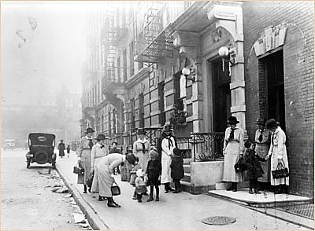
Improving City Life (Continued)
settlement houses – neighborhood centers in poor slum areas of cities that began in the late 1800s that offered people education, recreation, and social activities
These houses were staffed mostly be educated women from wealth families, and many of them lived at the settlement house

Slide 7
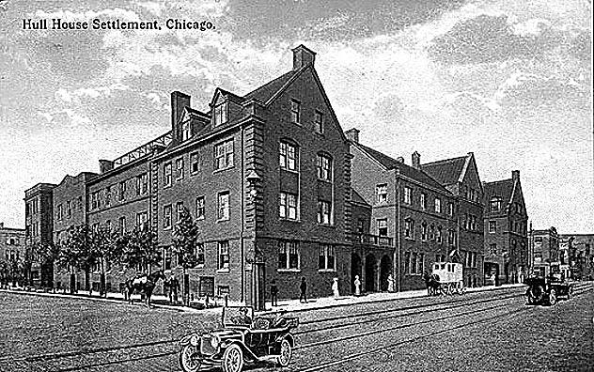
Improving City Life (Continued)
Jane Addams – she along with Ellen Gates Starr founded the most famous settlement house, Hull House, in 1889 in Chicago
Hull House served over 2,000 people a week, mostly immigrants
Hull House provided services such as English classes, day care, cooking and sewing classes, and social activities for children and adults (#5)

Slide 8
Improving City Life (Continued)
Florence Kelley – a reformer at Hull House who studied the problems facing immigrants and poor city dwellers
She helped convince Illinois to pass a law in 1893 limiting working hours for women and prevented child labor
She late became the state’s chief factory inspector to enforce these new labor laws
The settlement movement spread to other cities after the success of Hull House, and continued to provide programs and services for city dwellers through the early 1900s

