Slide 1
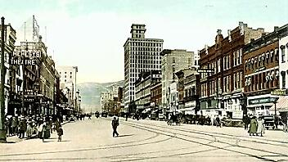
Ch. 20, Section 2 The Growth of Cities

Slide 2
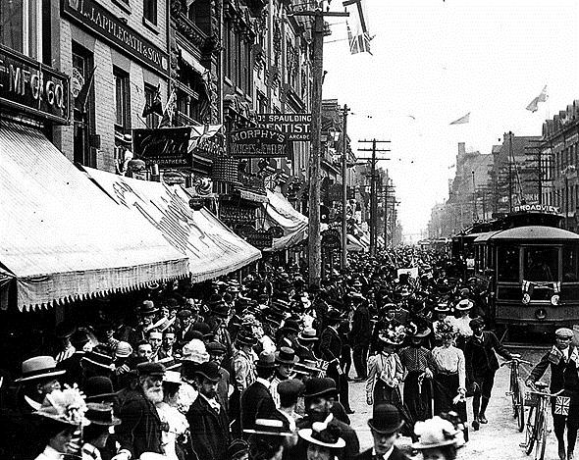
The Growth of Urban Cities
In 1850 only New York City had a population over 500,000
By 1900 six cities had a population that big and 35 cities had populations over 100,000
40% of all Americans lived in urban areas
Along with immigrants, workers from rural areas went to the cities as farm equipment replaced them
African Americans also left the South in large numbers and moved to northern cities to escape discrimination and to find educational and economic opportunities

Slide 3
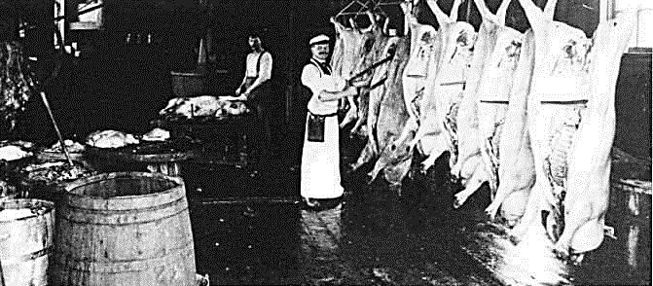
The Growth of Urban Cities (continued)
Chicago was the best example of the rise of cities as large numbers of African Americans and immigrants from southern and eastern Europe made it grow (#3)
(3/4 of Chicago’s population in 1900 was made up of immigrants and their children)
Because Chicago is the center of our railroad line systems it controlled the nation’s trade and industries like meat-packing plants grew there (#4)

Slide 4
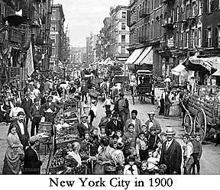
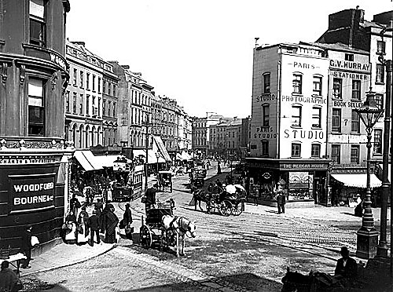
Changing Cities
US cities like Chicago were not prepared to provide housing, transportation and other services for their growing populations (Changing Cities #1)
As cities grew in population, they ran out of building space in downtown areas, and buildings could only be built 5 stories tall in order to support the weight of the building materials (Building Skyscrapers #1)

Slide 5
Building Skyscrapers
In the late 1800s architects began building taller building called skyscrapers using steel beams to make sturdy frames that could support the weight of these buildings (#2)
The safety elevator, patented by Elisha Otis in the 1850s, made it more practical to live in and work in these tall new buildings (#3)
“Story of Us: Cities” – 17:00 to 23:00

Slide 6
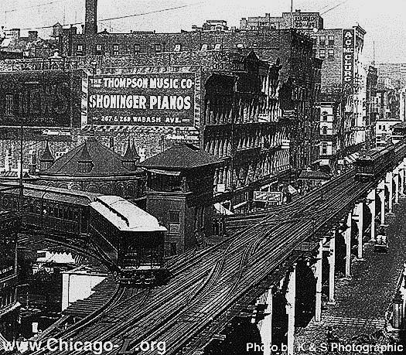
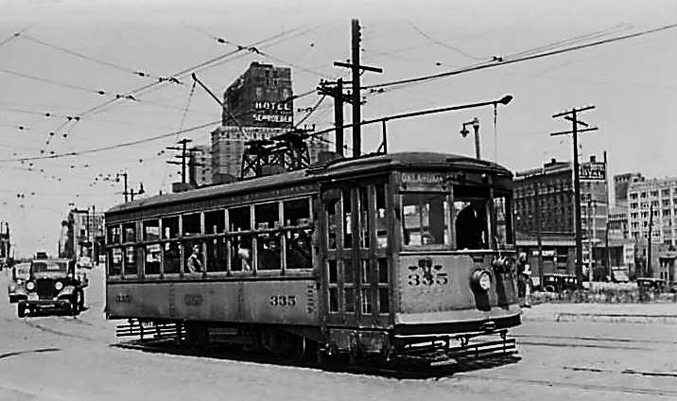
Getting Around
mass transit – public transportation designed to move many people, which developed in US cities as their populations grew in the late 1800s
public transportation was developed differently in different cities (#2)
New York and Chicago had elevated trains
Boston (and then later New York) had underground subway trains)
San Francisco had cable cars
Milwaukee had electric trolleys
suburbs – residential neighborhoods outside of downtown areas that began to spring up around the Civil War but grew in the late 1800s as more people could afford to move to them

Slide 7
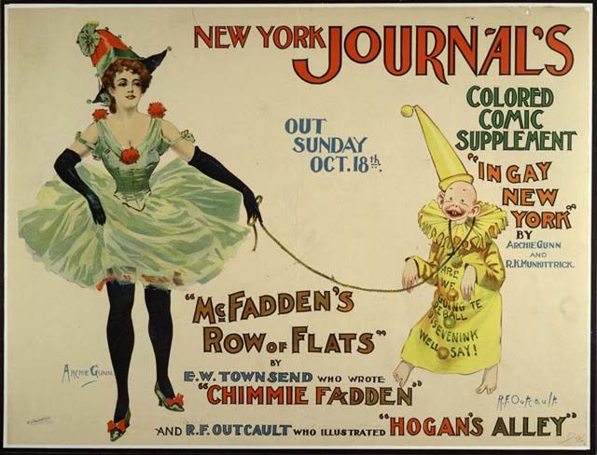
New Ideas
mass culture – leisure or cultural activities shared by many people which began to develop in the U.S. in the late 1800s and unified the nation
Invention of the typesetting machine greatly reduced the time and cost of printing
Joseph Pulitzer, editor of the New York World, and William Randolph Hearst, editor of the New York Journal, both introduced new features like comic strips, sports sections, and sensationalist stories to sell more newspapers (#2)

Slide 8
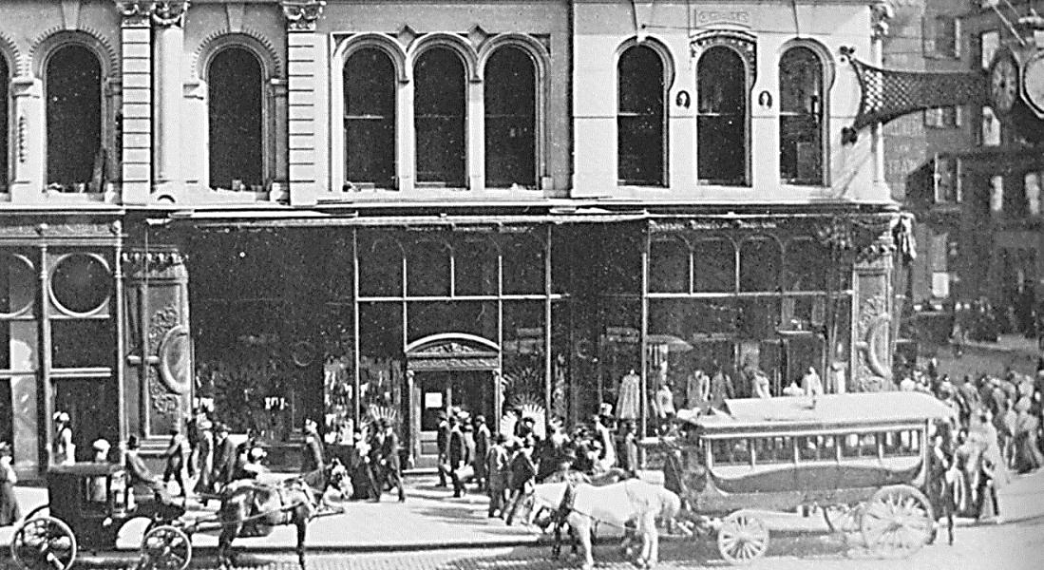
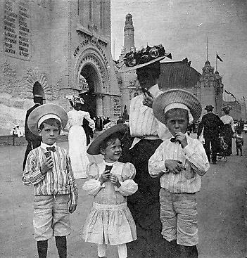
New Ideas (continued)
department stores – giant retail shops that appeared in some cities in the late 1800s that had different departments that sold different varieties of goods (like Marshall Field’s in Chicago) at low costs and with good quality
World fairs like the one held in St. Louis in 1904 were another example of mass culture as new ideas and products (like the ice cream cone) from around the world were introduced at them (#4)
Marshall Field’s – Chicago 1900
St. Louis World’s Fair – 1904

Slide 9
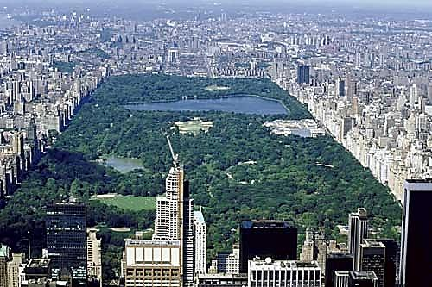
New Ideas (continued)
Amusement parks were built in the late 1800s to meet the public demand for entertainment like New York’s Coney Island with rides, games, and food (#5)
Frederick Law Olmsted – landscape architect who became famous for designing New York City’s Central Park and the U.S. Capitol grounds

