Slide 1
Chapter 27 Section 2
The Red Scare

Slide 2
The Red Scare
The Red Scare: A fear of Communist infiltration in America
U.S. officials feared communist elements were everywhere in America
HUAC: House Un-American Activities Committee. Launched hearings to expose Communist influence in Hollywood, especially the movie industry
Contributing factors: Chinese Communist Revolution, 1949; Soviets getting atomic weaponry, 1949.

Slide 3
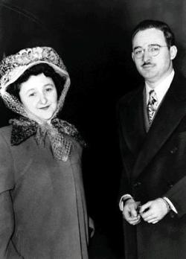
Julius and Ethel Rosenberg
Accused of passing atomic secrets to the Russians in 1951
Members of American Communist Party
Executed in 1953 for Espionage (spying)

Slide 4
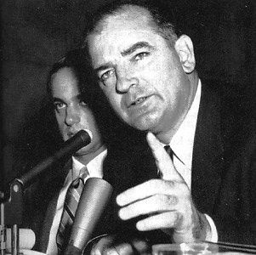
Joseph McCarthy
Republican senator from Wisconsin
Accused hundreds of people as being Communists (especially in U.S. State Department)

Slide 5
Joseph McCarthy
"I have here in my hand a list of 205 names that were known to the Secretary of State as being members of the Communist Party and who, nevertheless, are still working and shaping policy in the State Department."

Slide 6
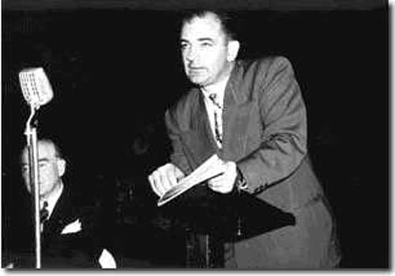
McCarthyism
Reckless charges against innocent citizens
Never backed up his claims – just accused
Nationally televised Army-McCarthy hearings (Attacks U.S. Army of “coddling Commies”
McCarthy forced to ‘name-names’ on live TV
Unable to do so

Slide 7
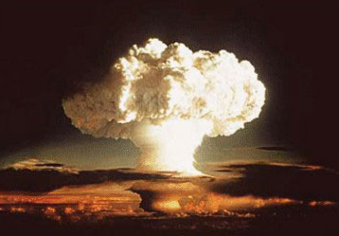
The Arms Race
The competition between the US and Soviet Union over the build-up of nuclear weapons
Included testing of the Hydrogen Bomb
American reaction:
Students conduct “Duck and Cover” drills
Home built with bomb shelters

Slide 8
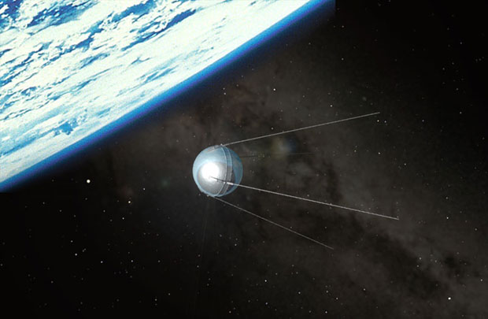
The Space Race
Begun in 1957 when Soviets launched first artificial satellite – Sputnik
If Soviets could launch a satellite, they could launch missiles to reach the US

Slide 9
Brinksmanship
Pres. Eisenhower’s modification of Truman’s containment policy
Idea to go to the “brink” of war to oppose communism

